Slide 1


Karkomi Holocaust Exhibition
Virtual Field Trip
Part 2

Slide 2
What surprised you?
What caught your attention?
What questions do you still have?
How do you think the people in these stories may have felt?

Slide 3
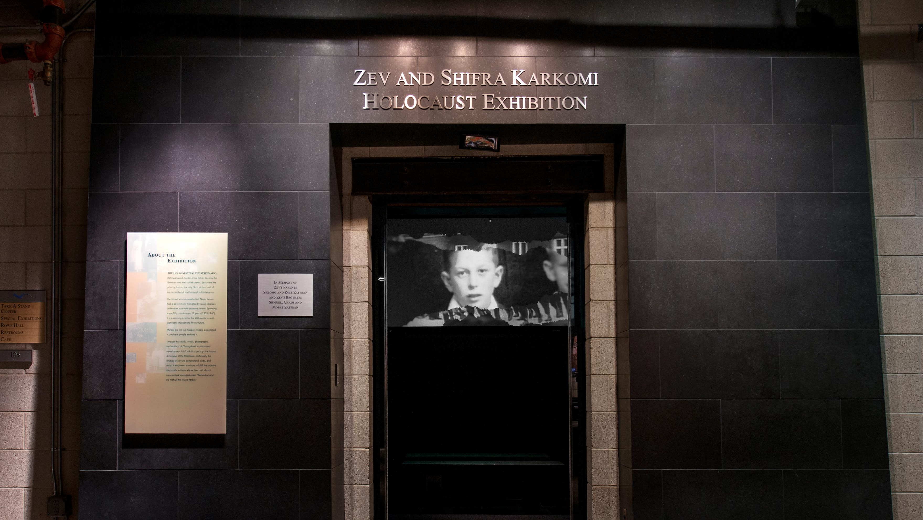

Slide 4
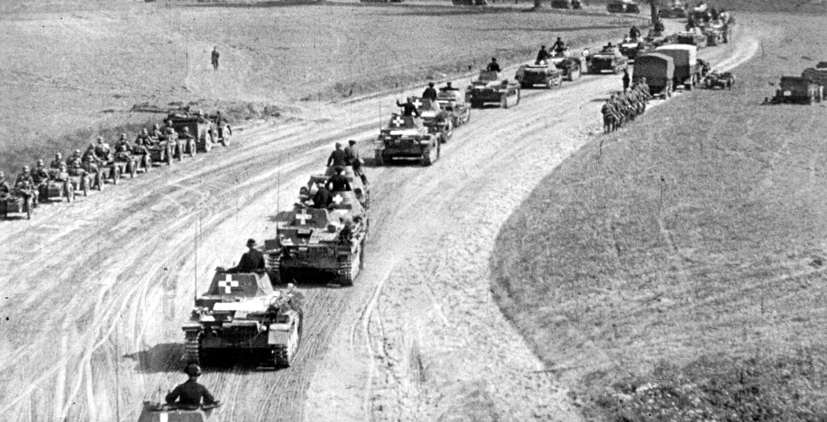
Invasion of Poland

Slide 5
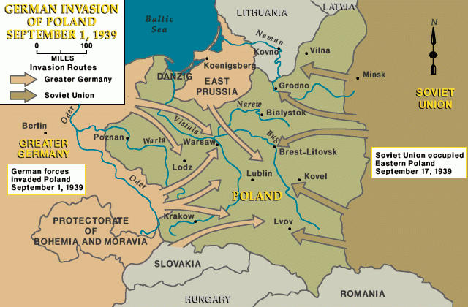

Slide 6
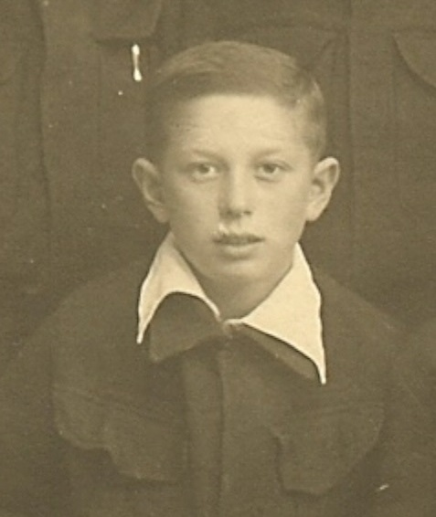
“We sat at a table eating, and I heard noises outside. We ran outside, and there I saw airplanes flying around, chasing each other. The Nazis were shooting down Polish planes….
I was four years old.”
- Sam Harris

Slide 7
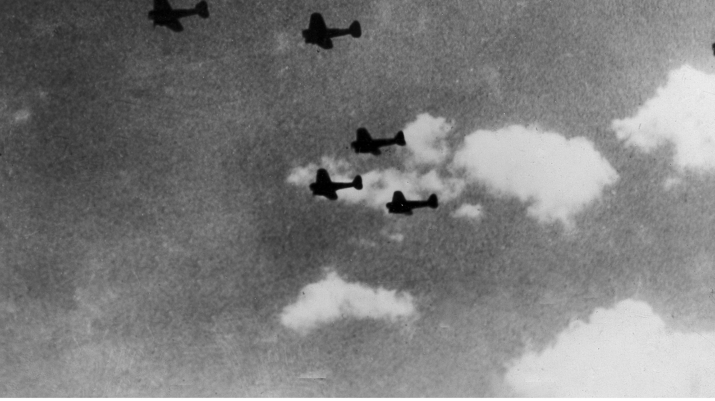
German Heinkel He 111 bombers on their way to England during the Battle of Britain.

Slide 8
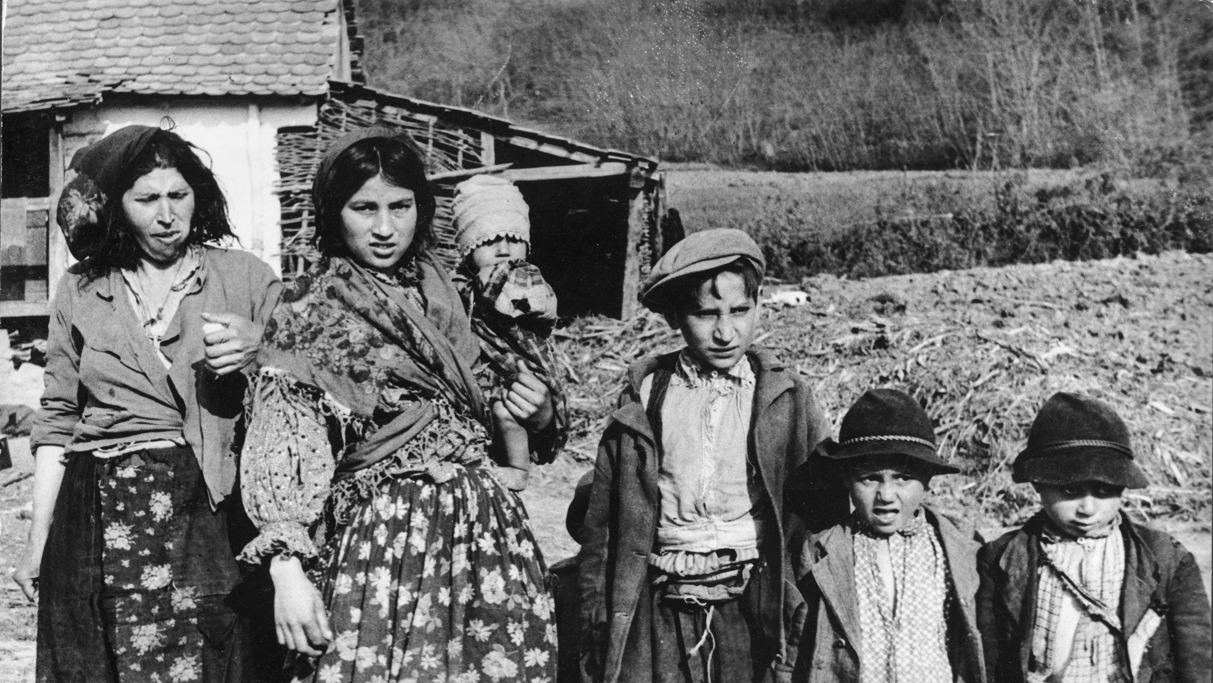
Roma Family

Slide 9
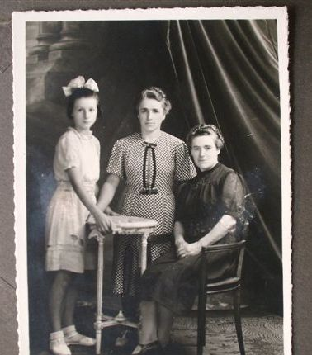
Simone Arnold (left) with her aunt and mother, shortly before she was ordered to report to a re-education home for being a Jehovah’s Witness.

Slide 10
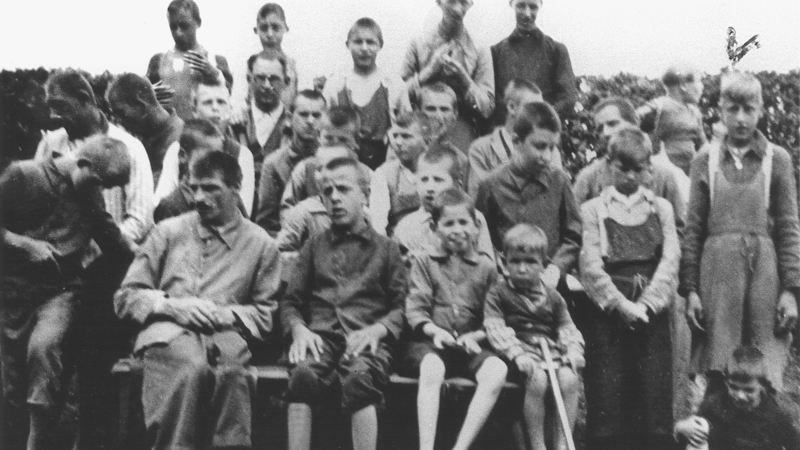
Children at a Catholic institution for the disabled in Ecksberg, Germany.

Slide 11
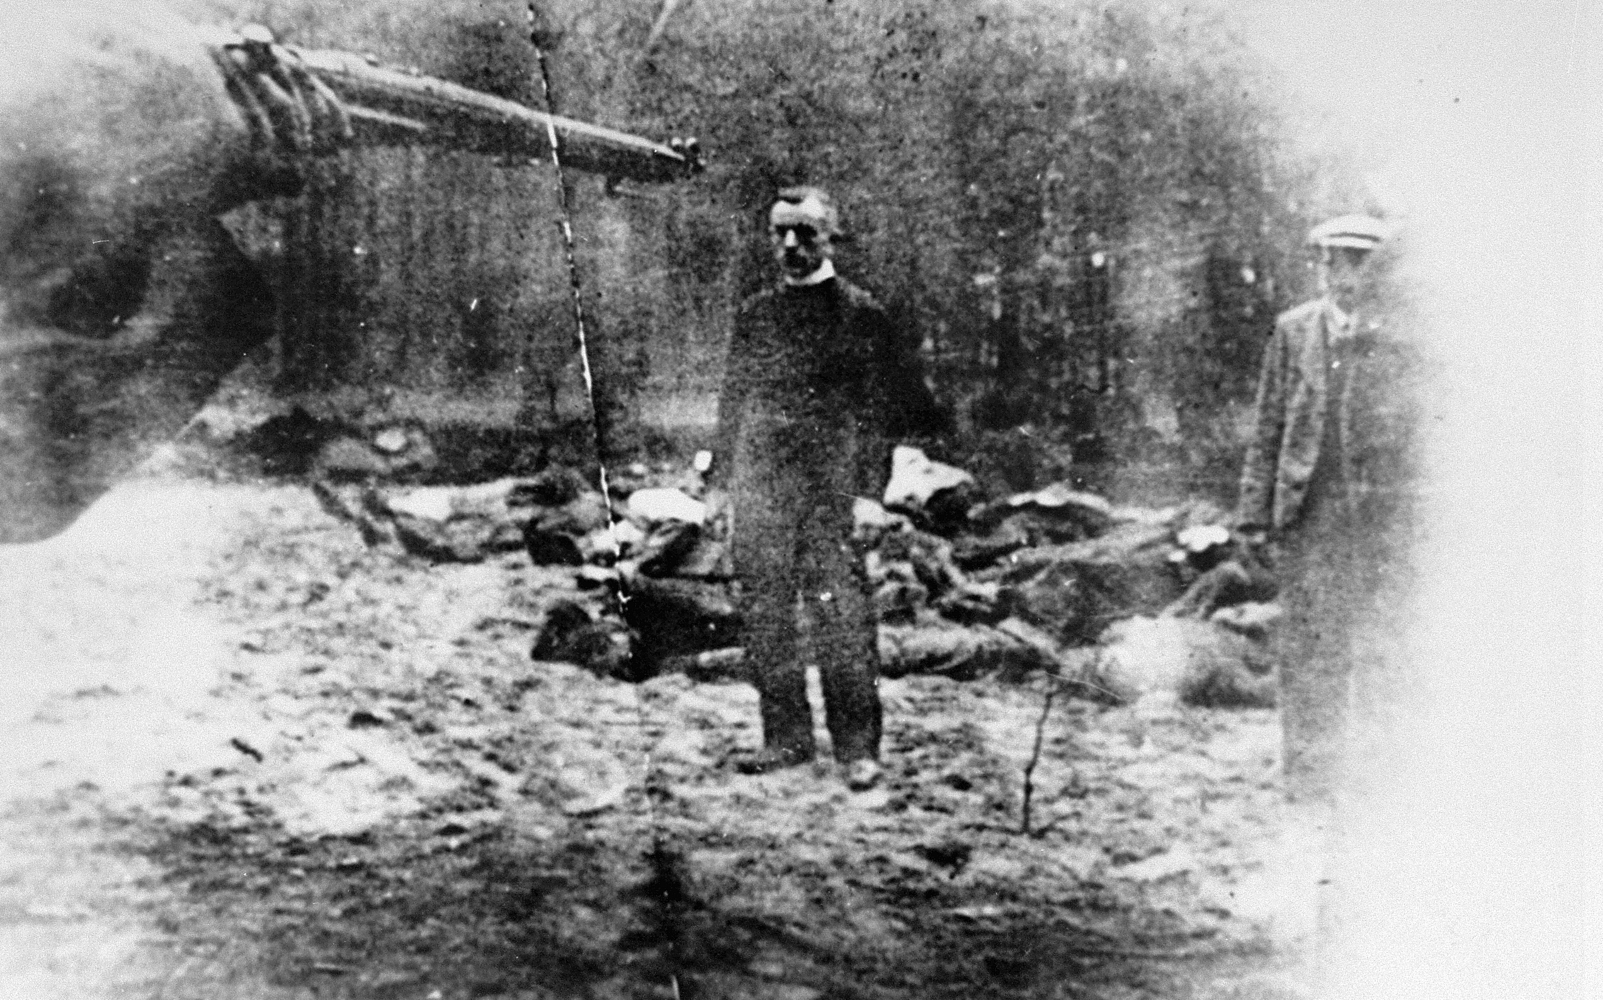
Execution of Piotr Sosnowski, a Polish deacon in Tuchola Forest, Poland.

Slide 12
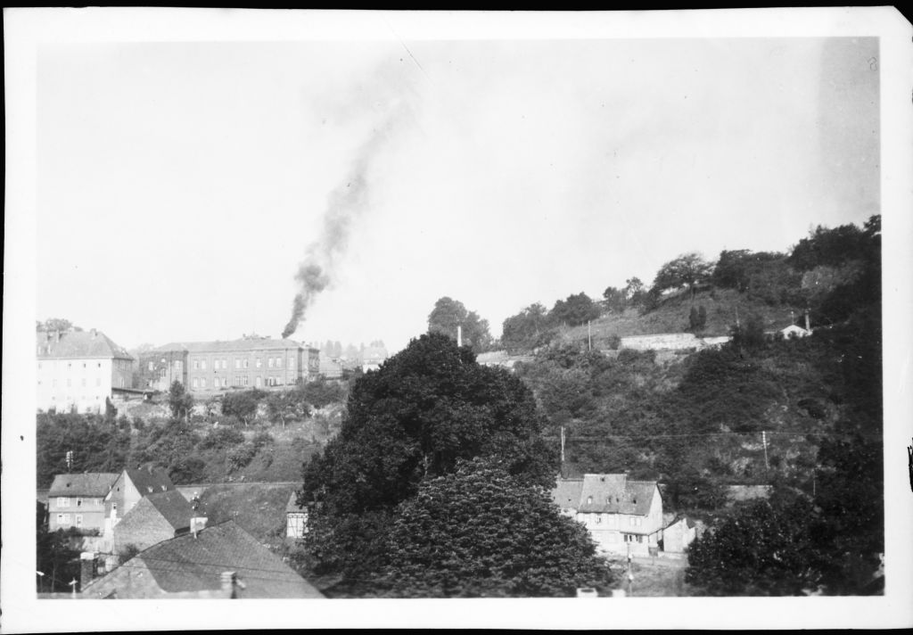
Hadamar euthanasia center

Slide 13
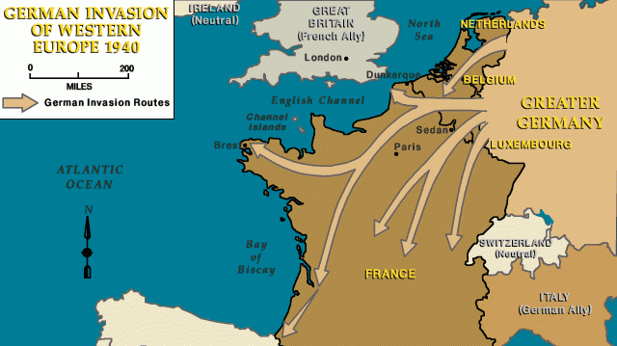

Slide 14
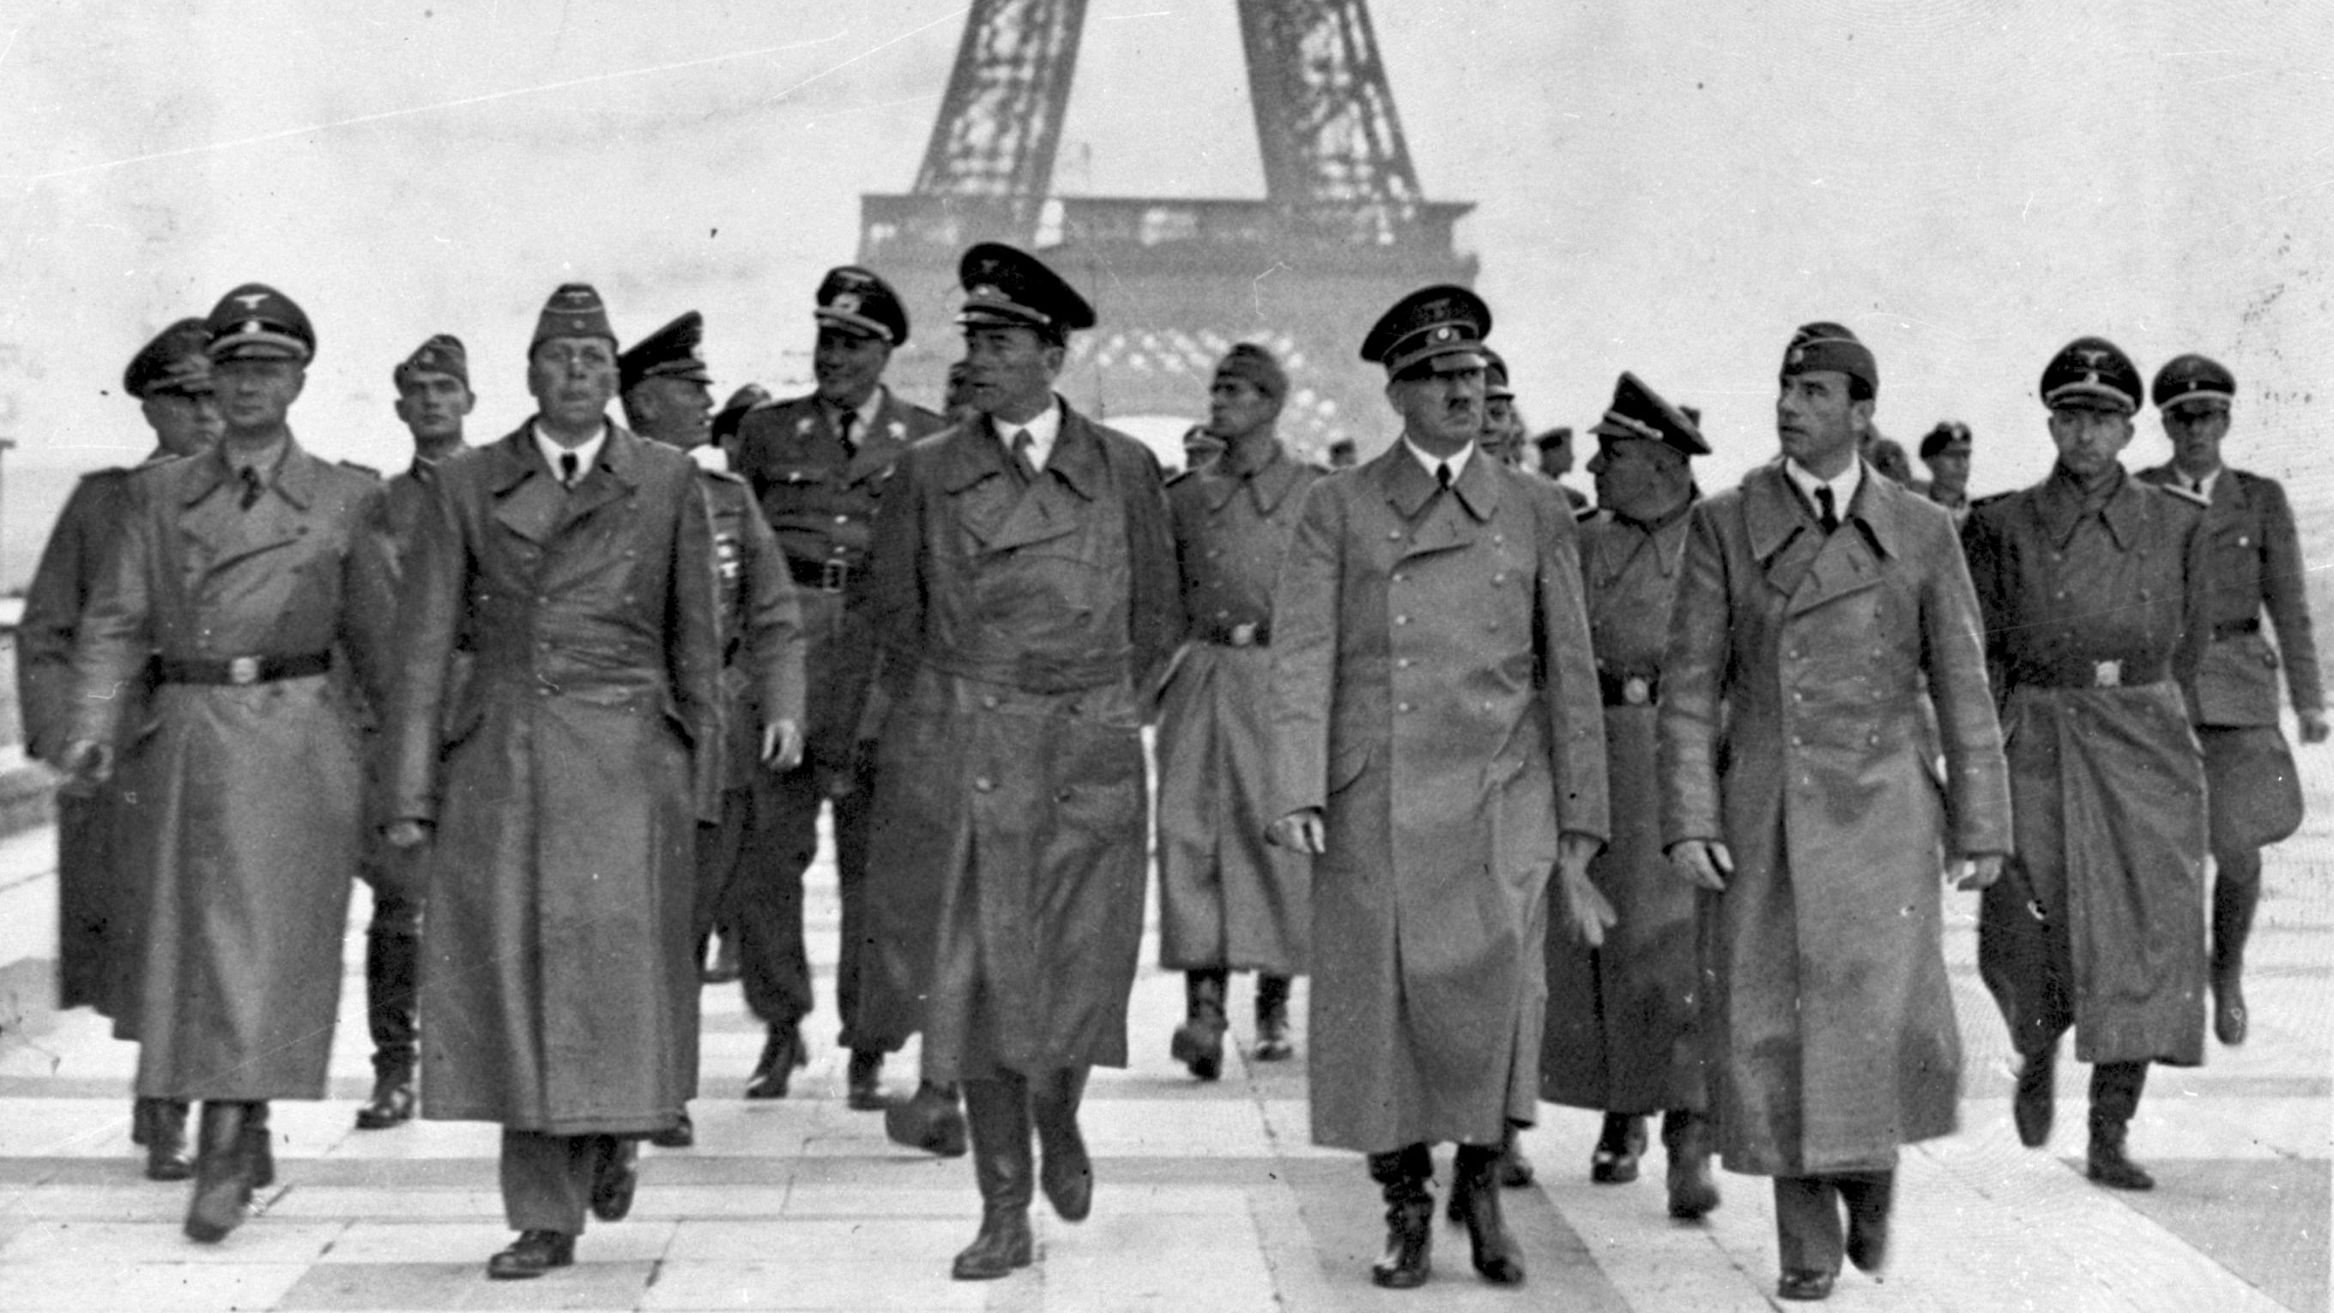

Slide 15

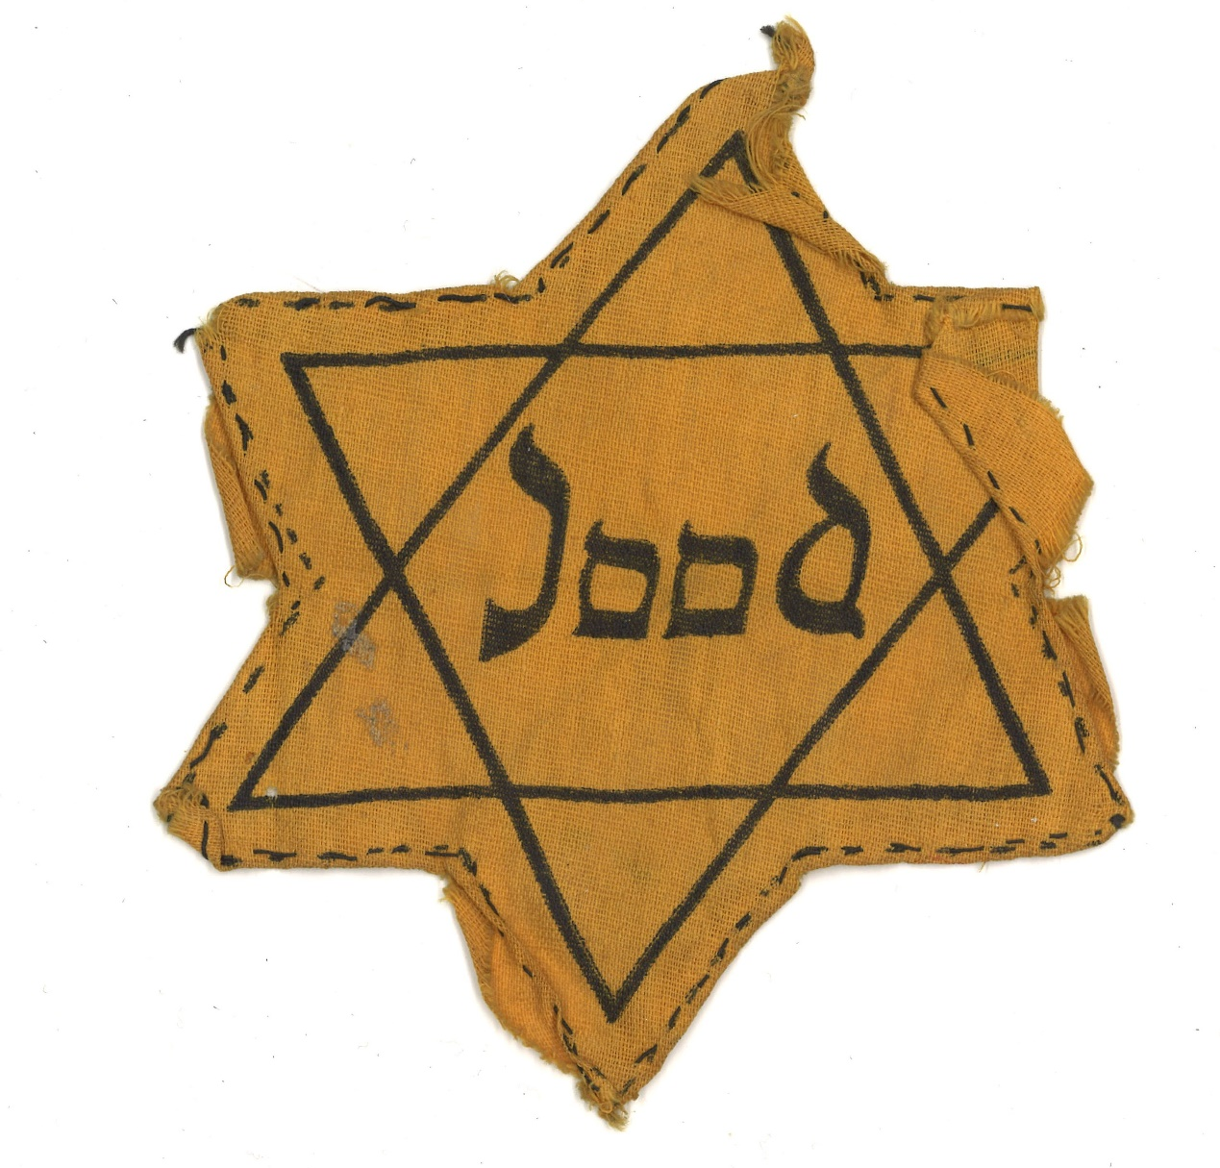
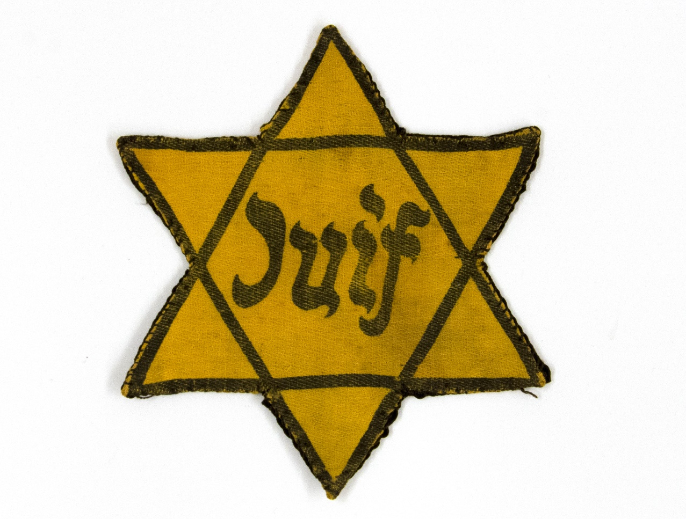
French Jewish Star
German Jewish Star
Dutch Jewish Star

Slide 16
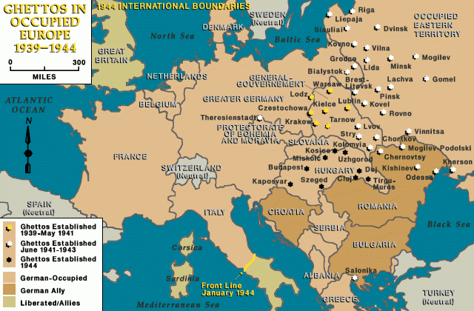

Slide 17
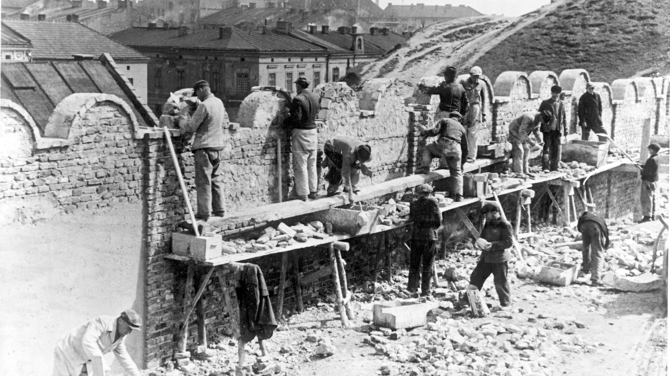
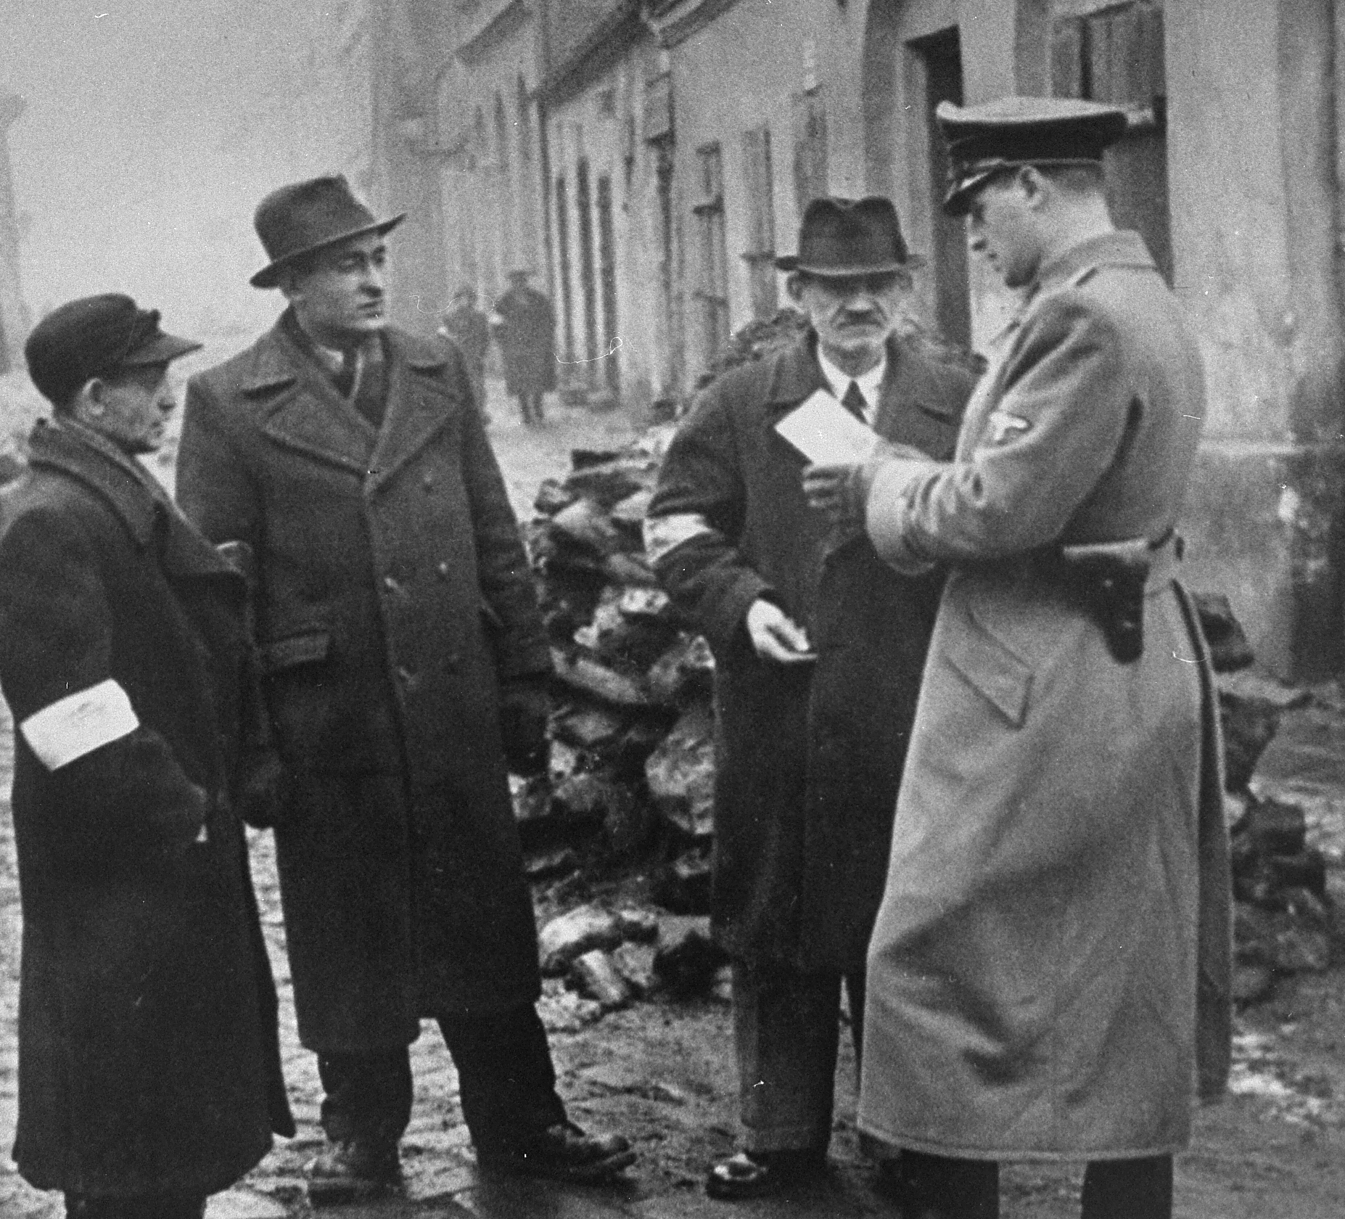
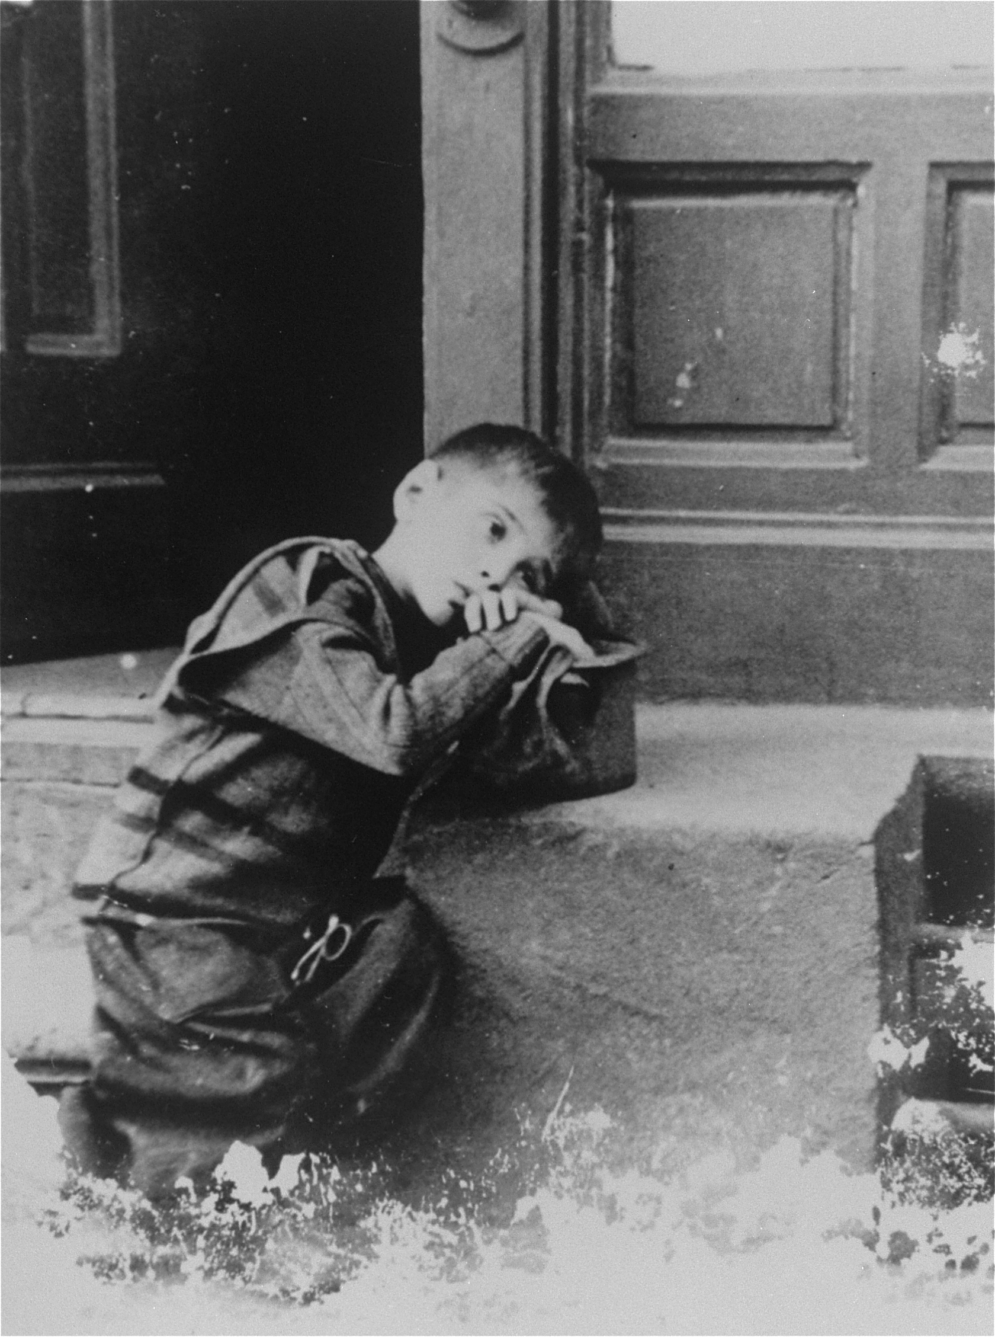
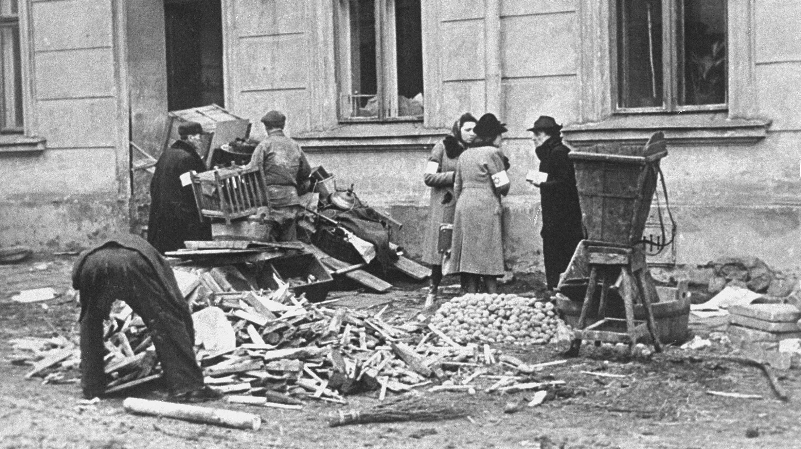
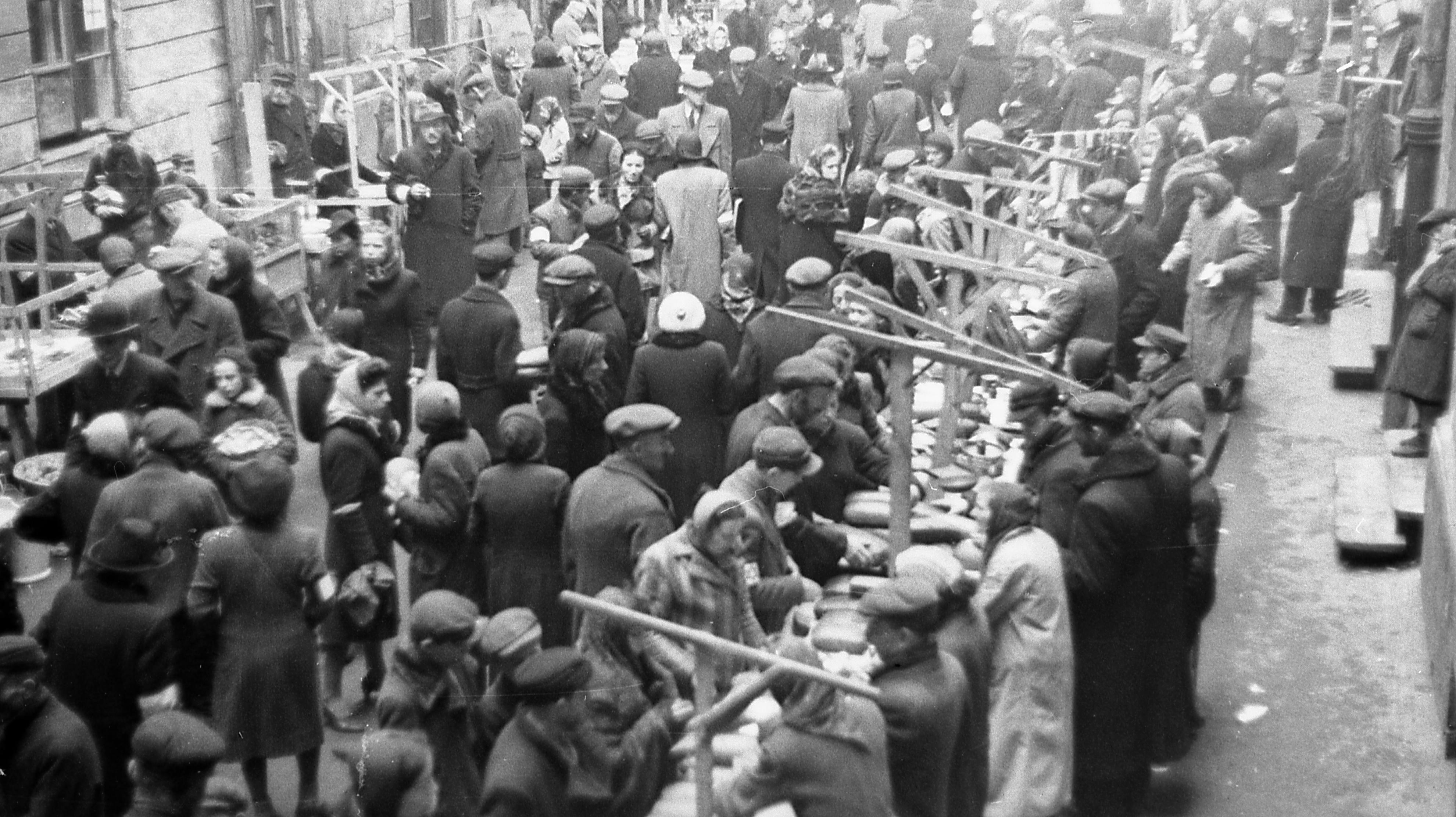
Jews at forced labor, constructing wall around Krakow ghetto.
German policeman checking identification papers of Jews in Krakow ghetto.

Slide 18
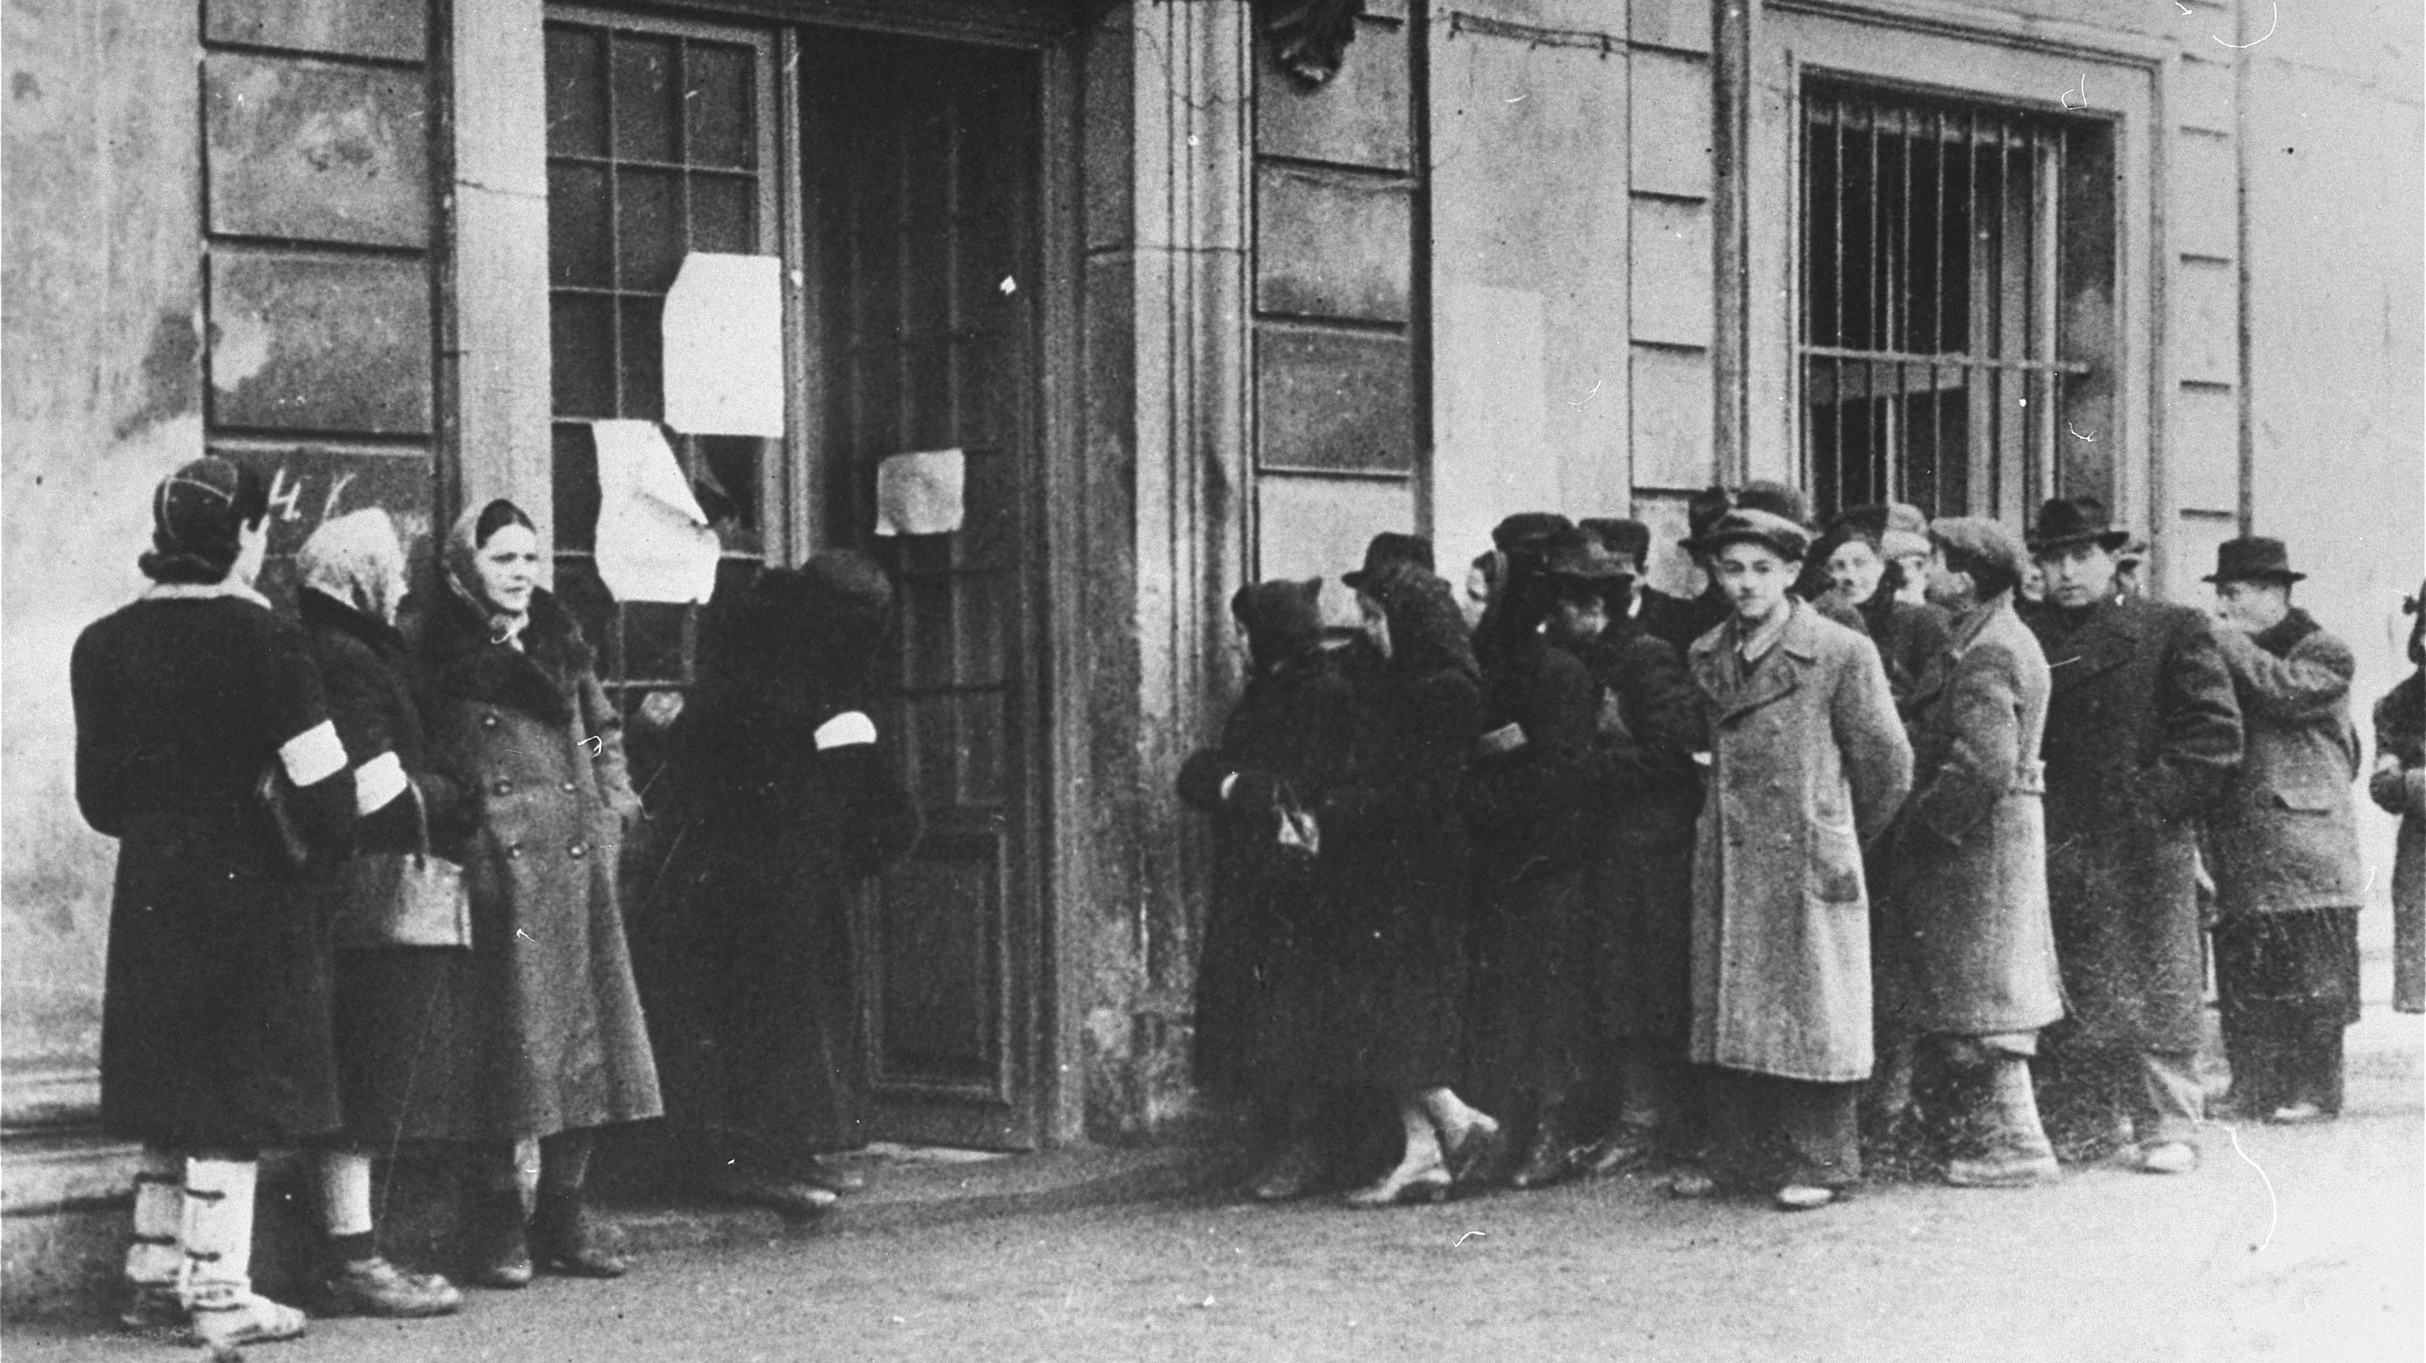
Jews waiting in line outside the Judenrat to register for apartments in the ghetto.

Slide 19
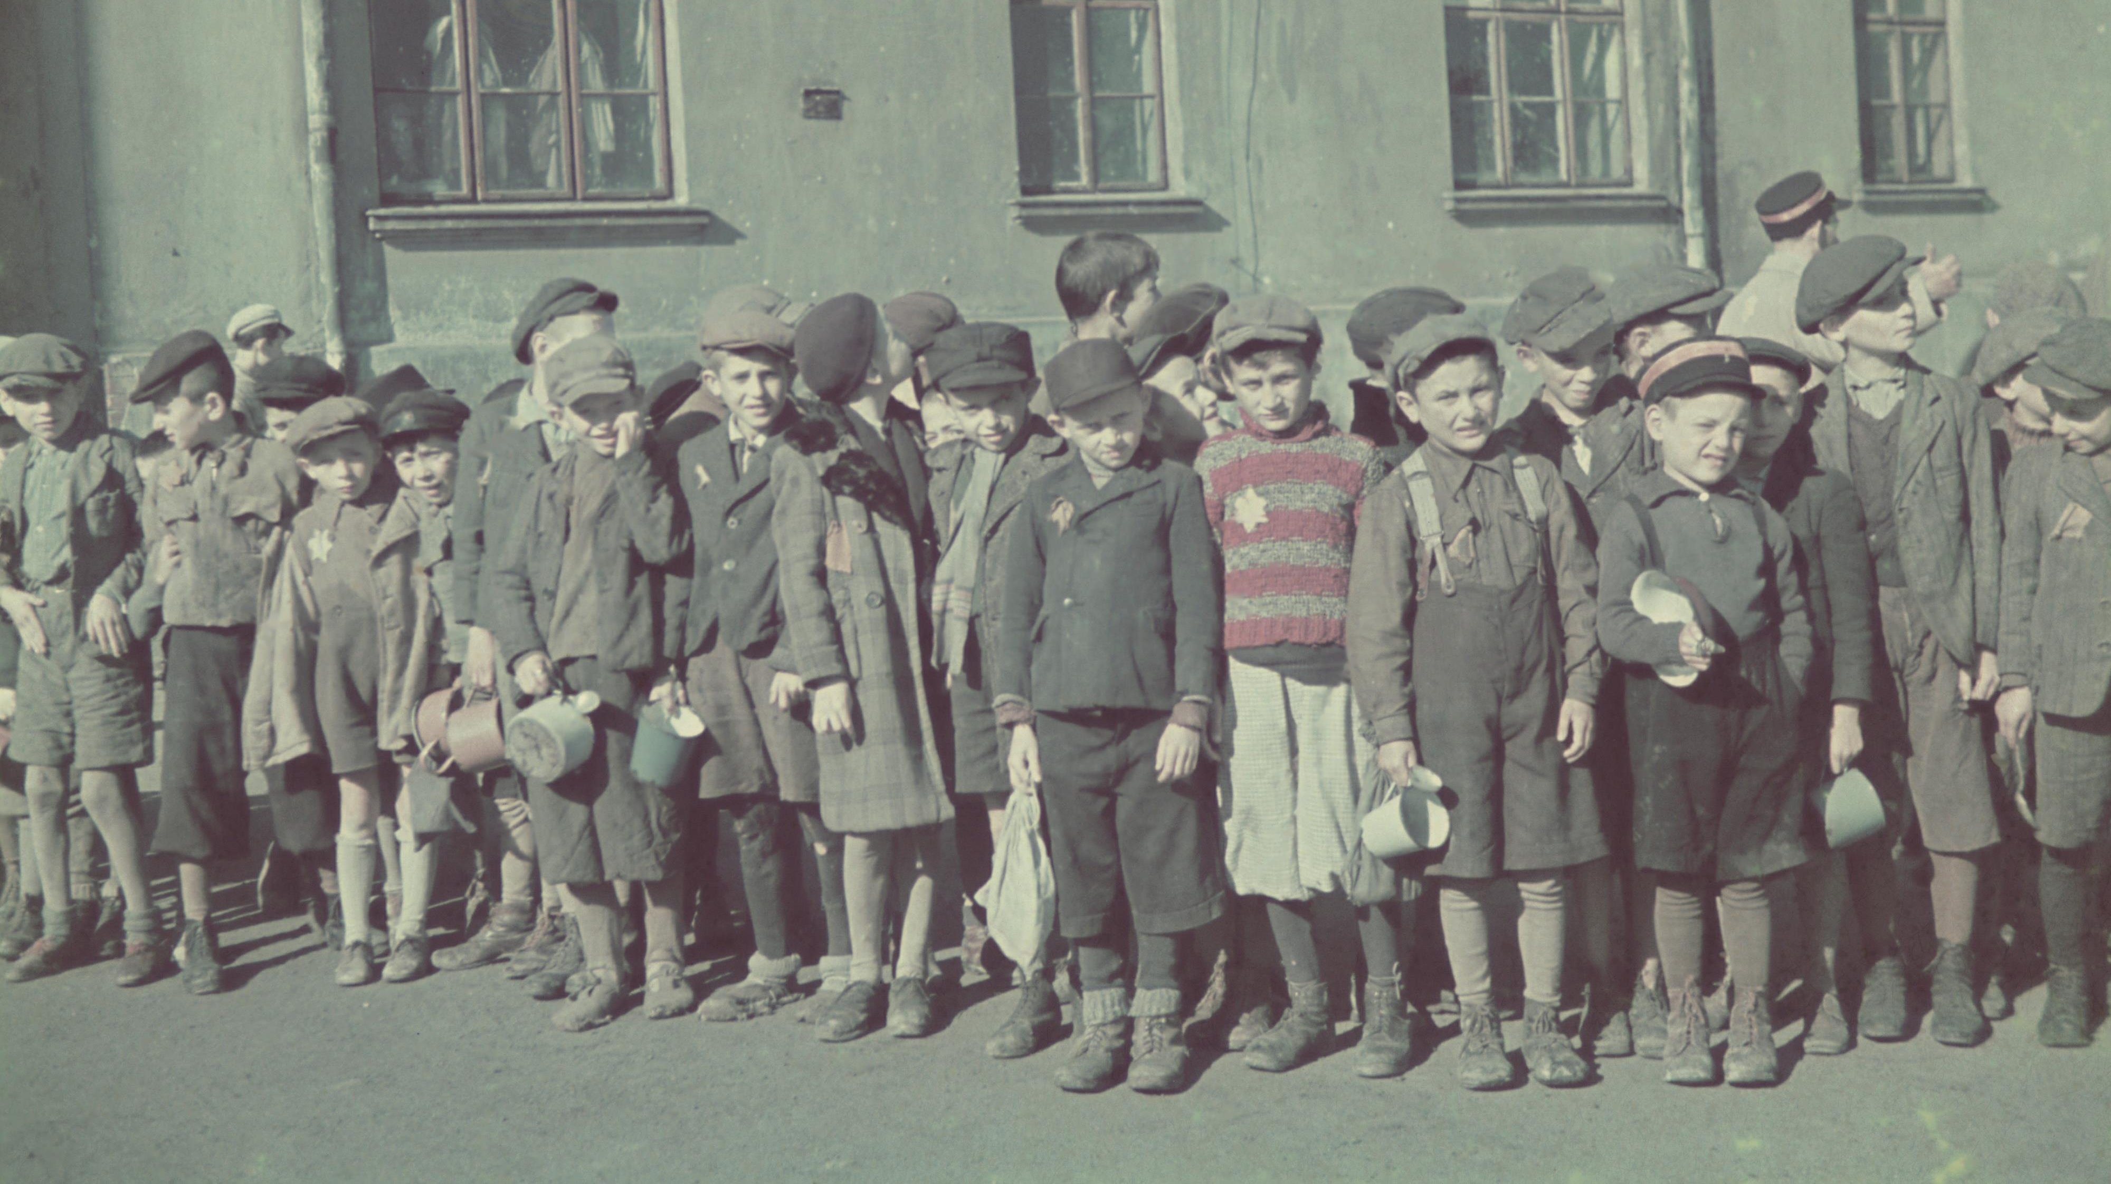
School children waiting in line outside Lodz ghetto soup kitchen.

Slide 20
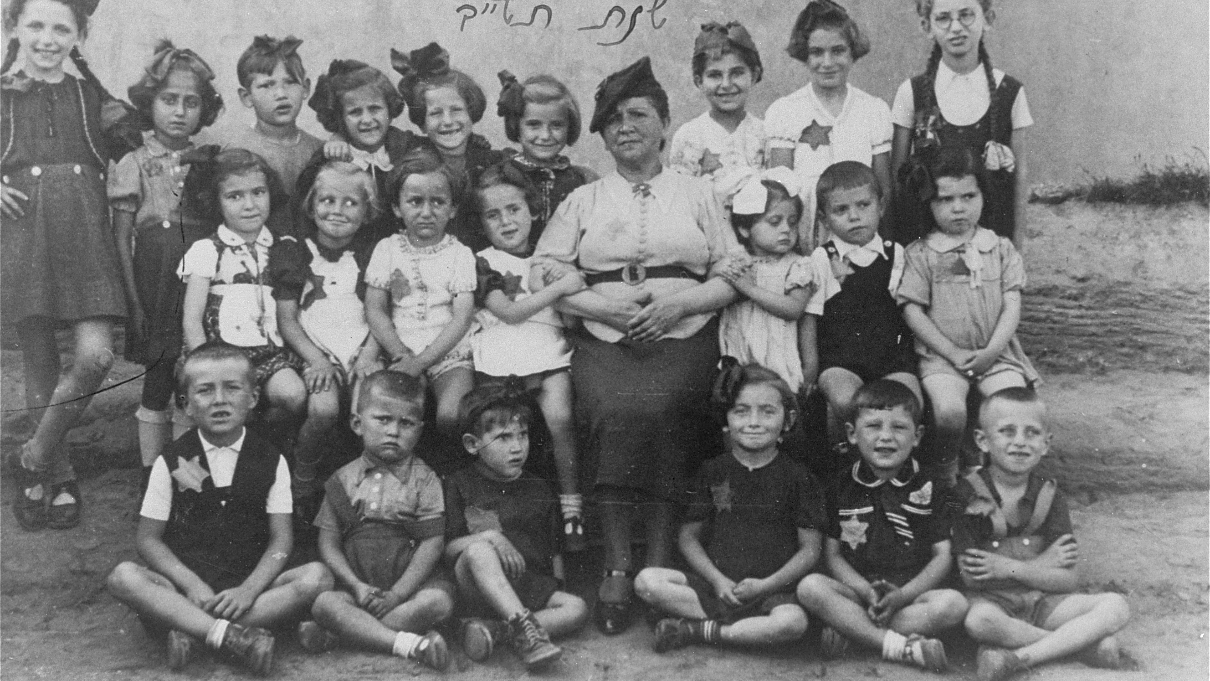
Class photograph from Lodz ghetto.

Slide 21
Public prayer on Yom Kippur in Lodz ghetto.

Slide 22
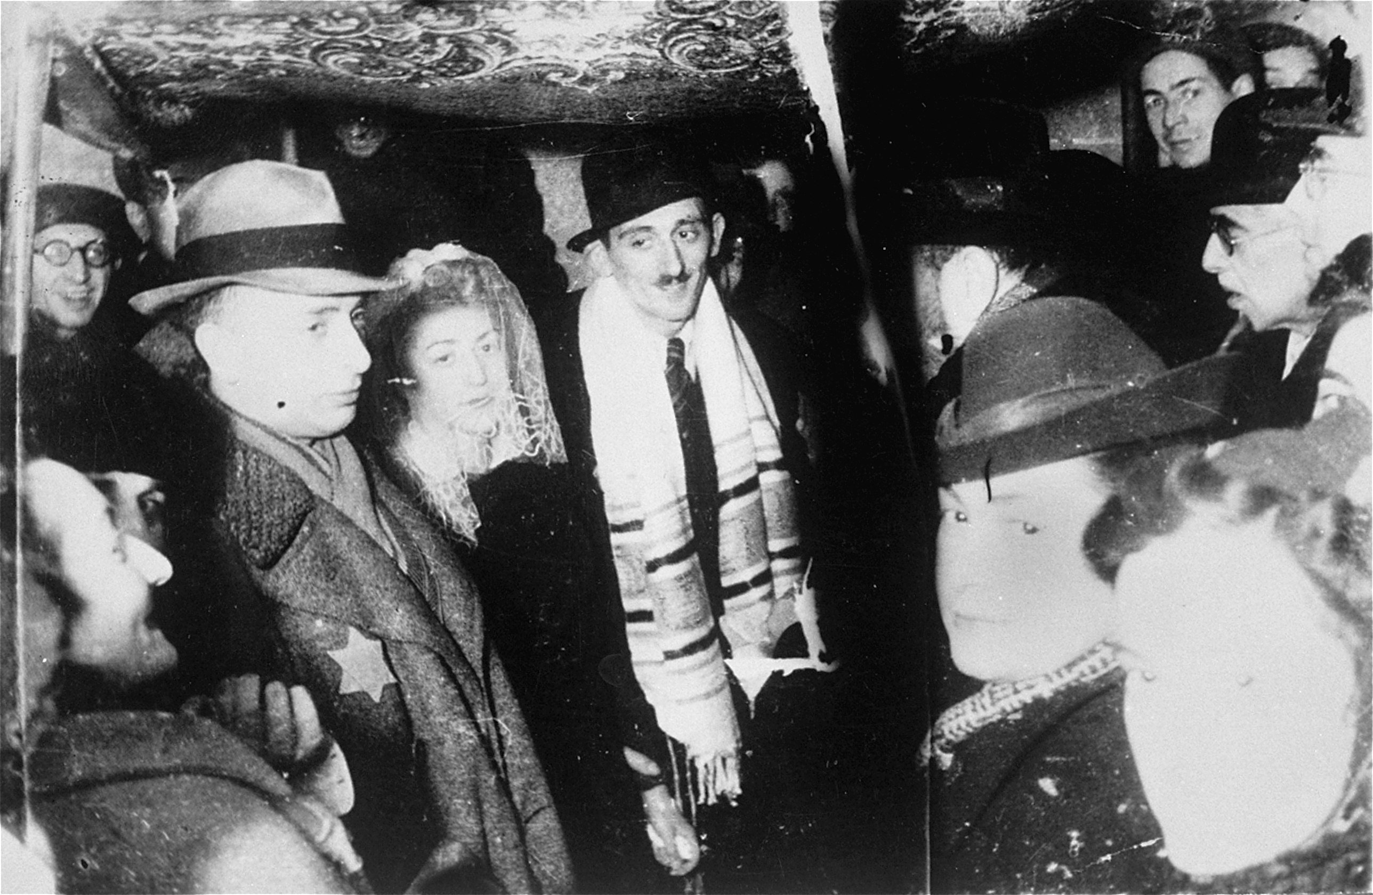
Henryk Ross and Stefania Schoenberg standing beneath a chuppah during their wedding in the Lodz Ghetto.

Slide 23
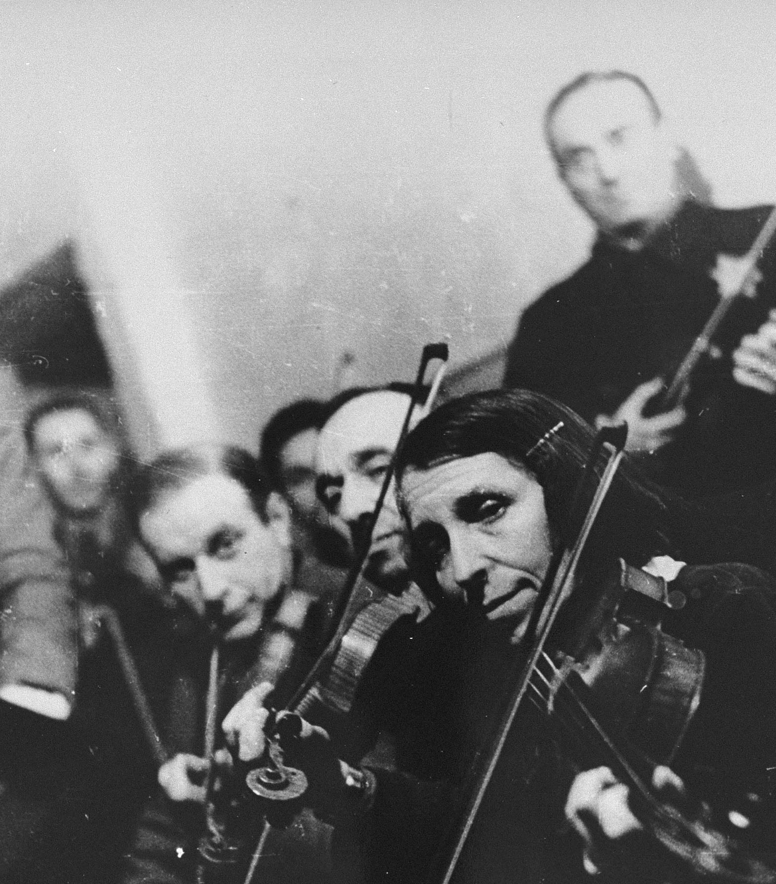
Violinists in Kovno ghetto orchestra.

Slide 24
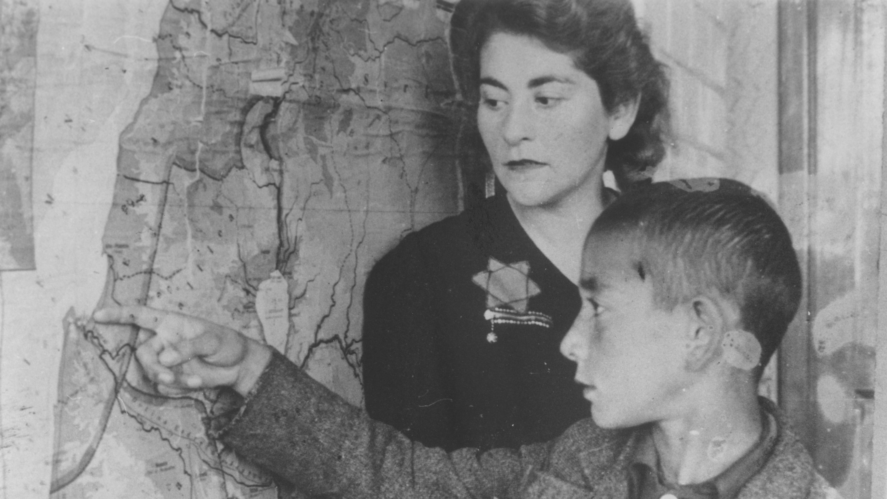
Student in the Lodz ghetto showing his teacher the location of Haifa, Palestine.

Slide 25
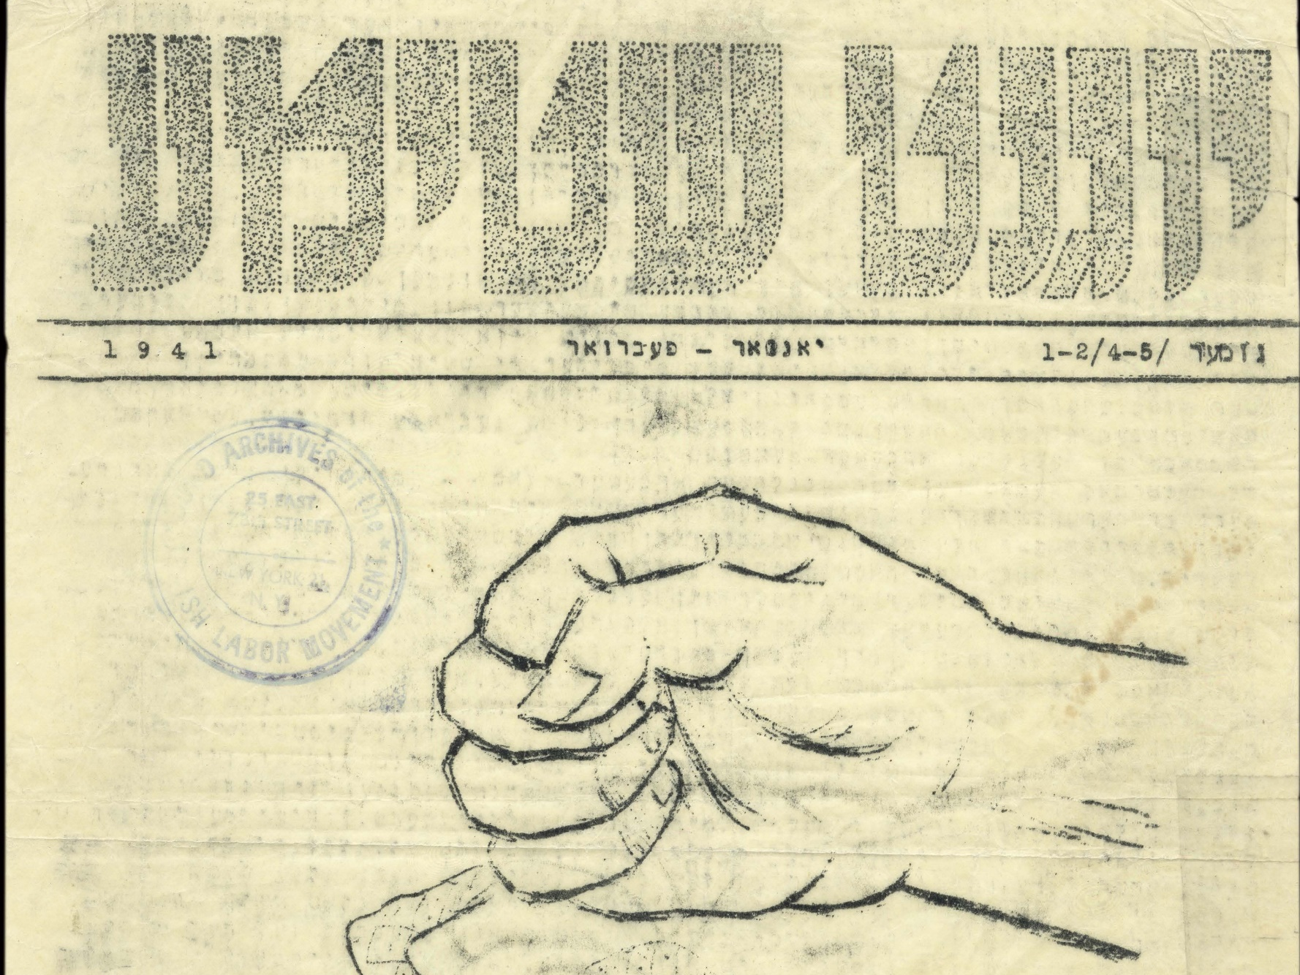
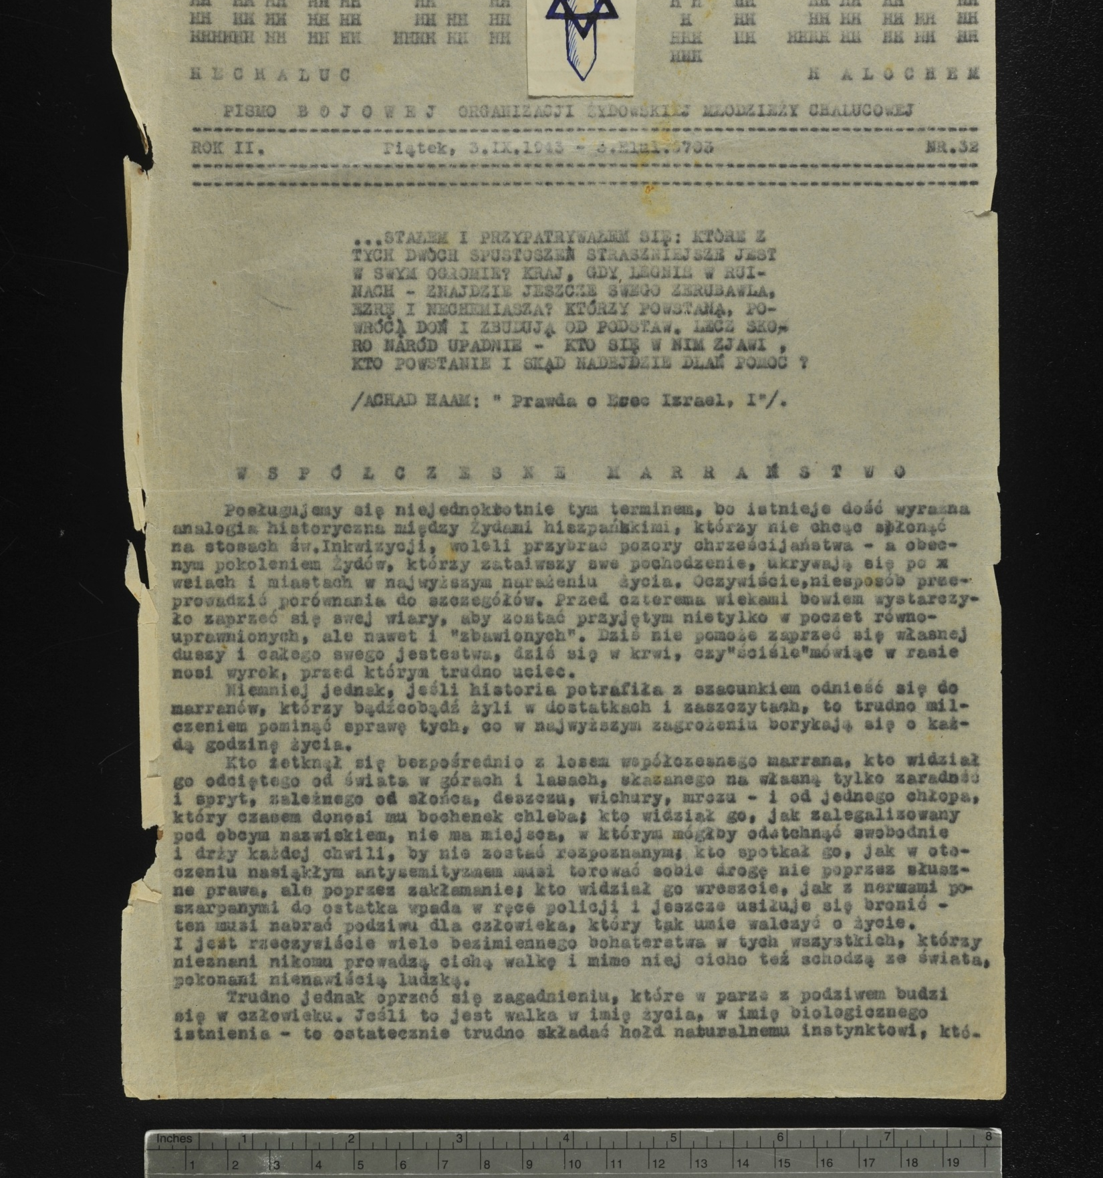

Slide 26
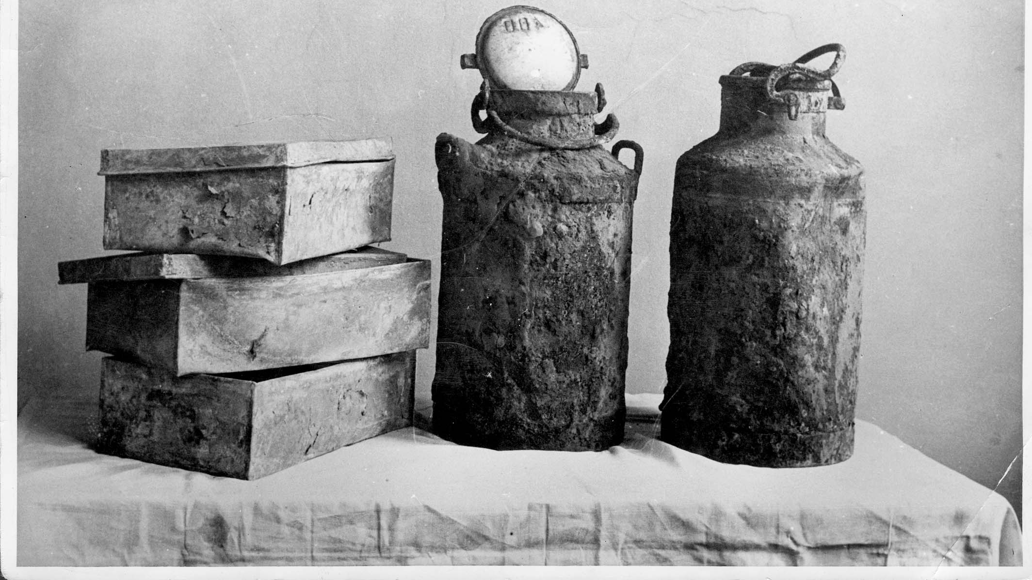
Oneg Shabbat archive

Slide 27
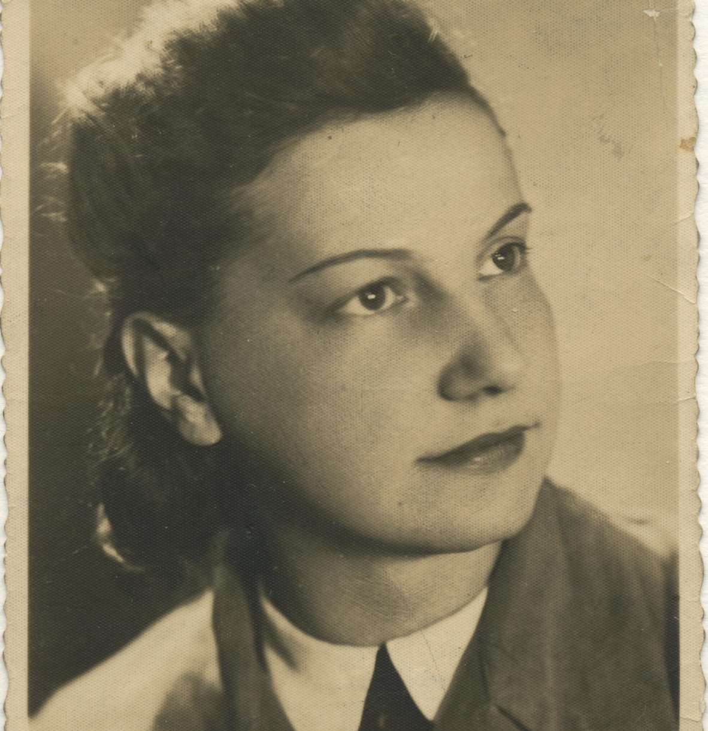
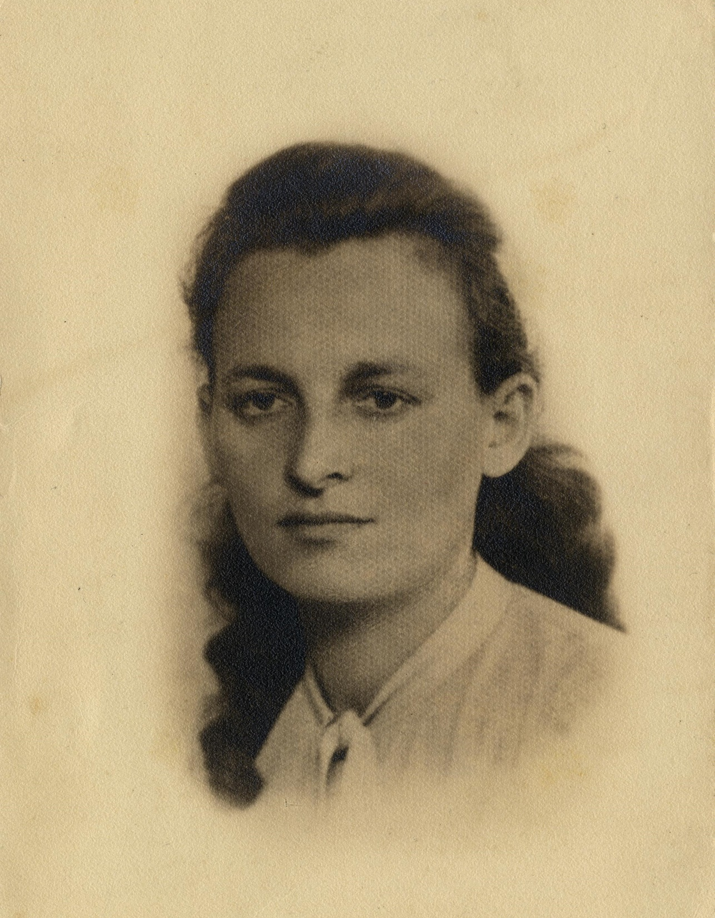
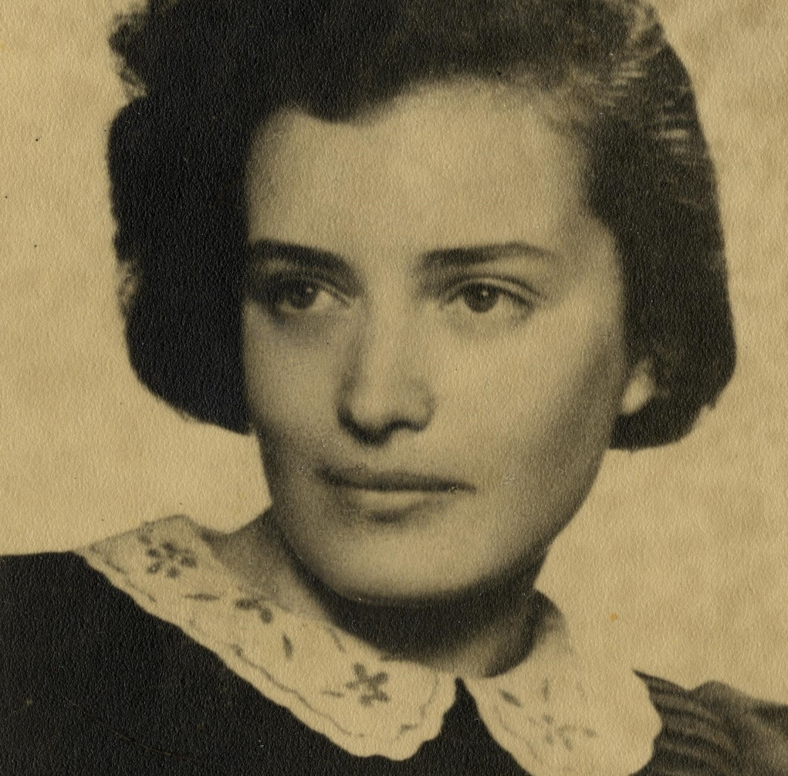
Women couriers

Slide 28
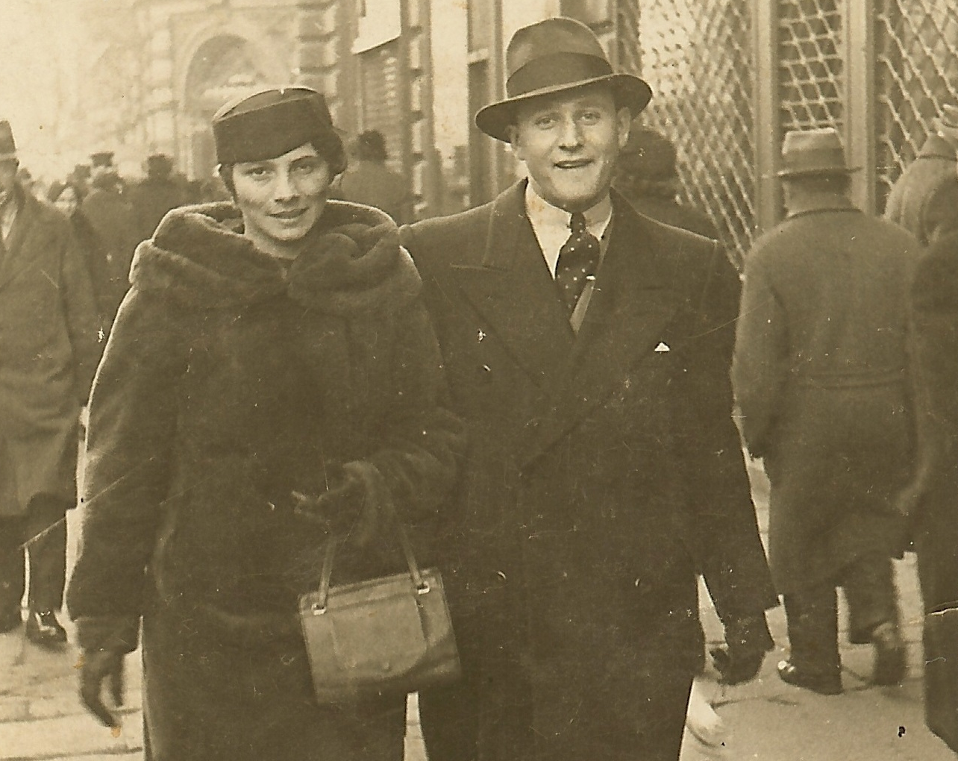

Slide 29
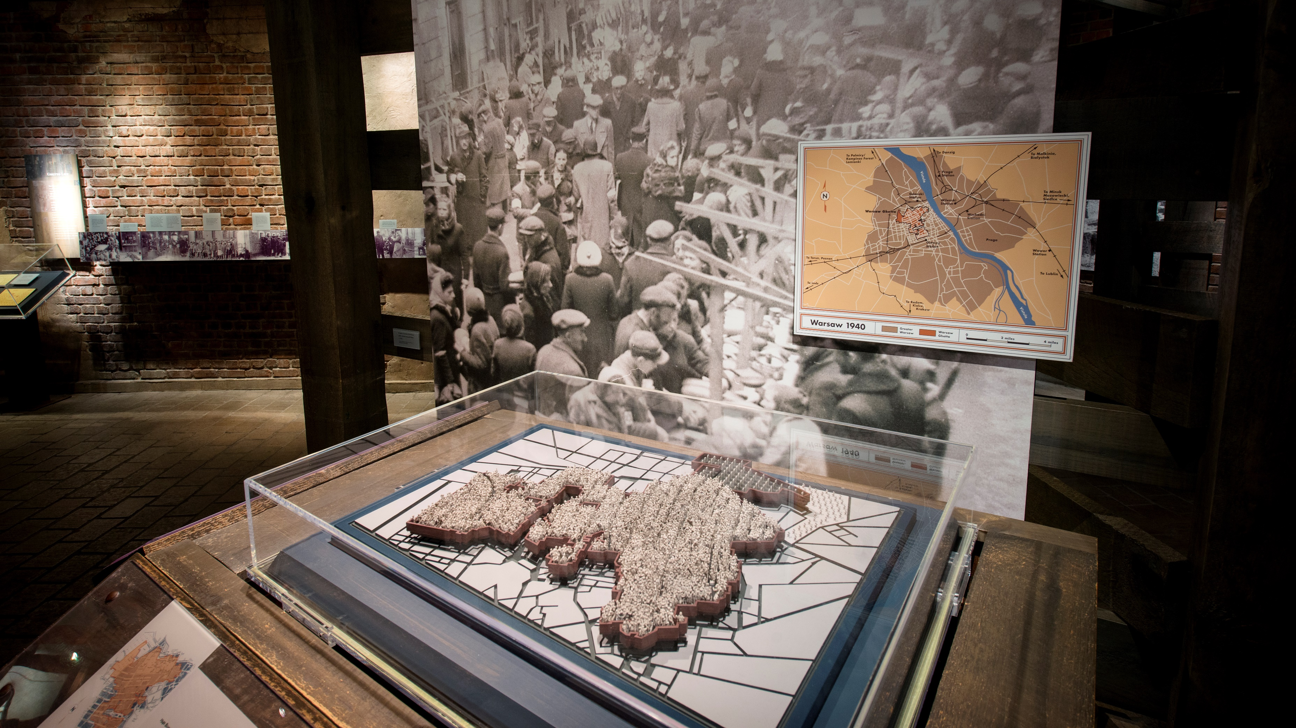
Model of Warsaw ghetto

Slide 30
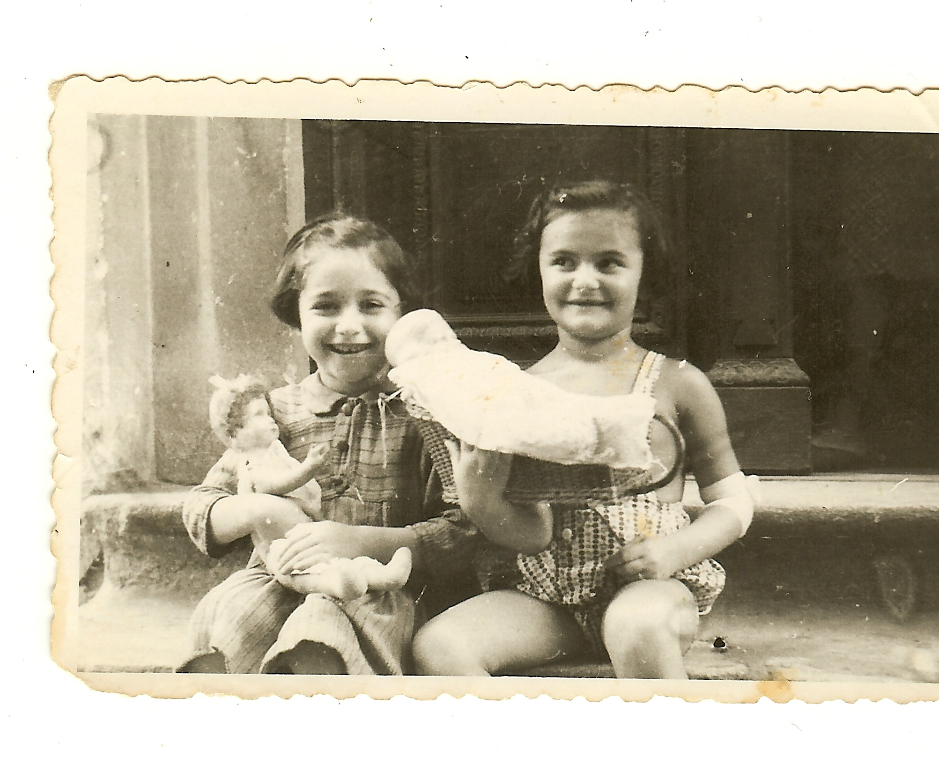
Cipora Katz
(right)

Slide 31
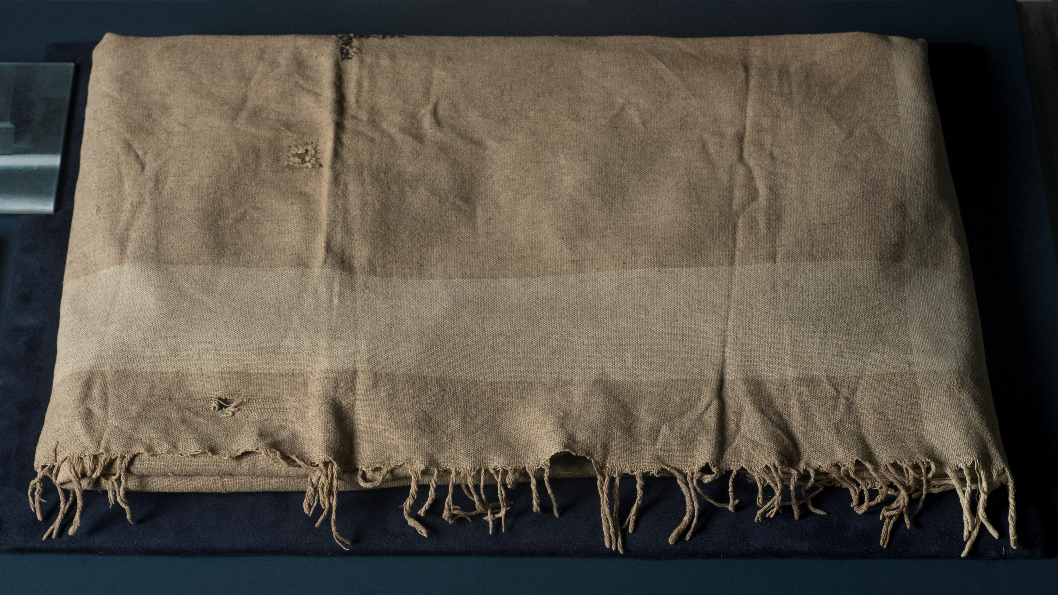

Slide 32
Questions for Discussion:

Slide 33
Photo Credits:

