Slide 1


Karkomi Holocaust Exhibition
Virtual Field Trip
Part 1

Slide 2
What surprised you?
What caught your attention?
What questions do you still have?
How do you think the people in these stories may have felt?

Slide 3
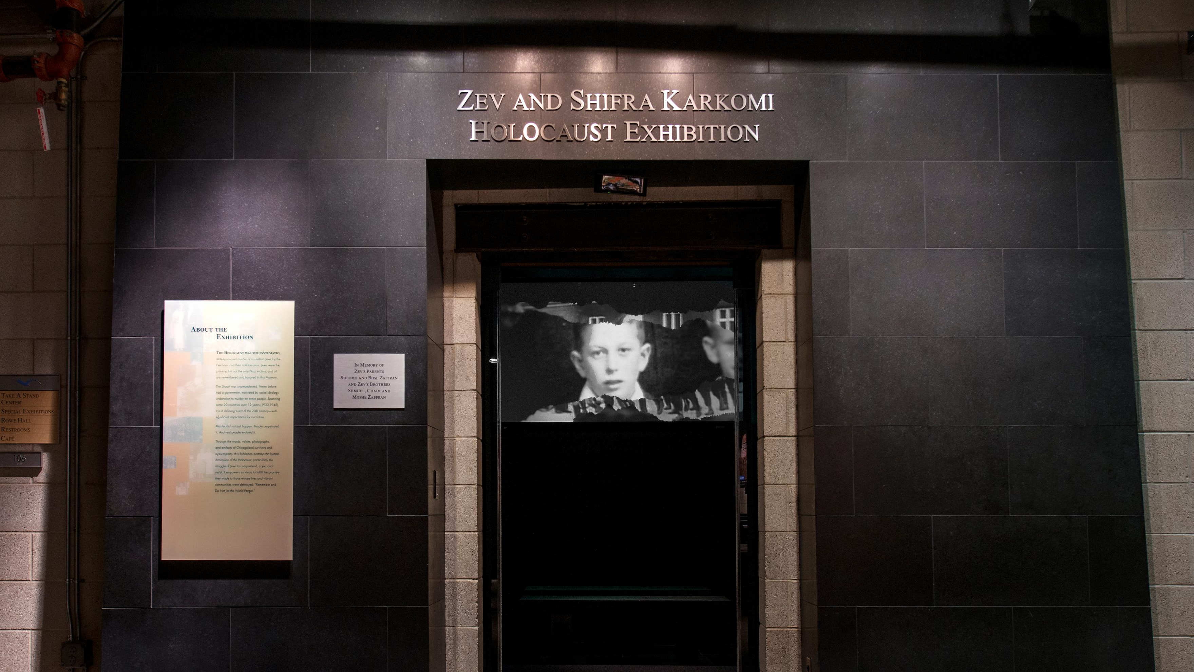

Slide 4
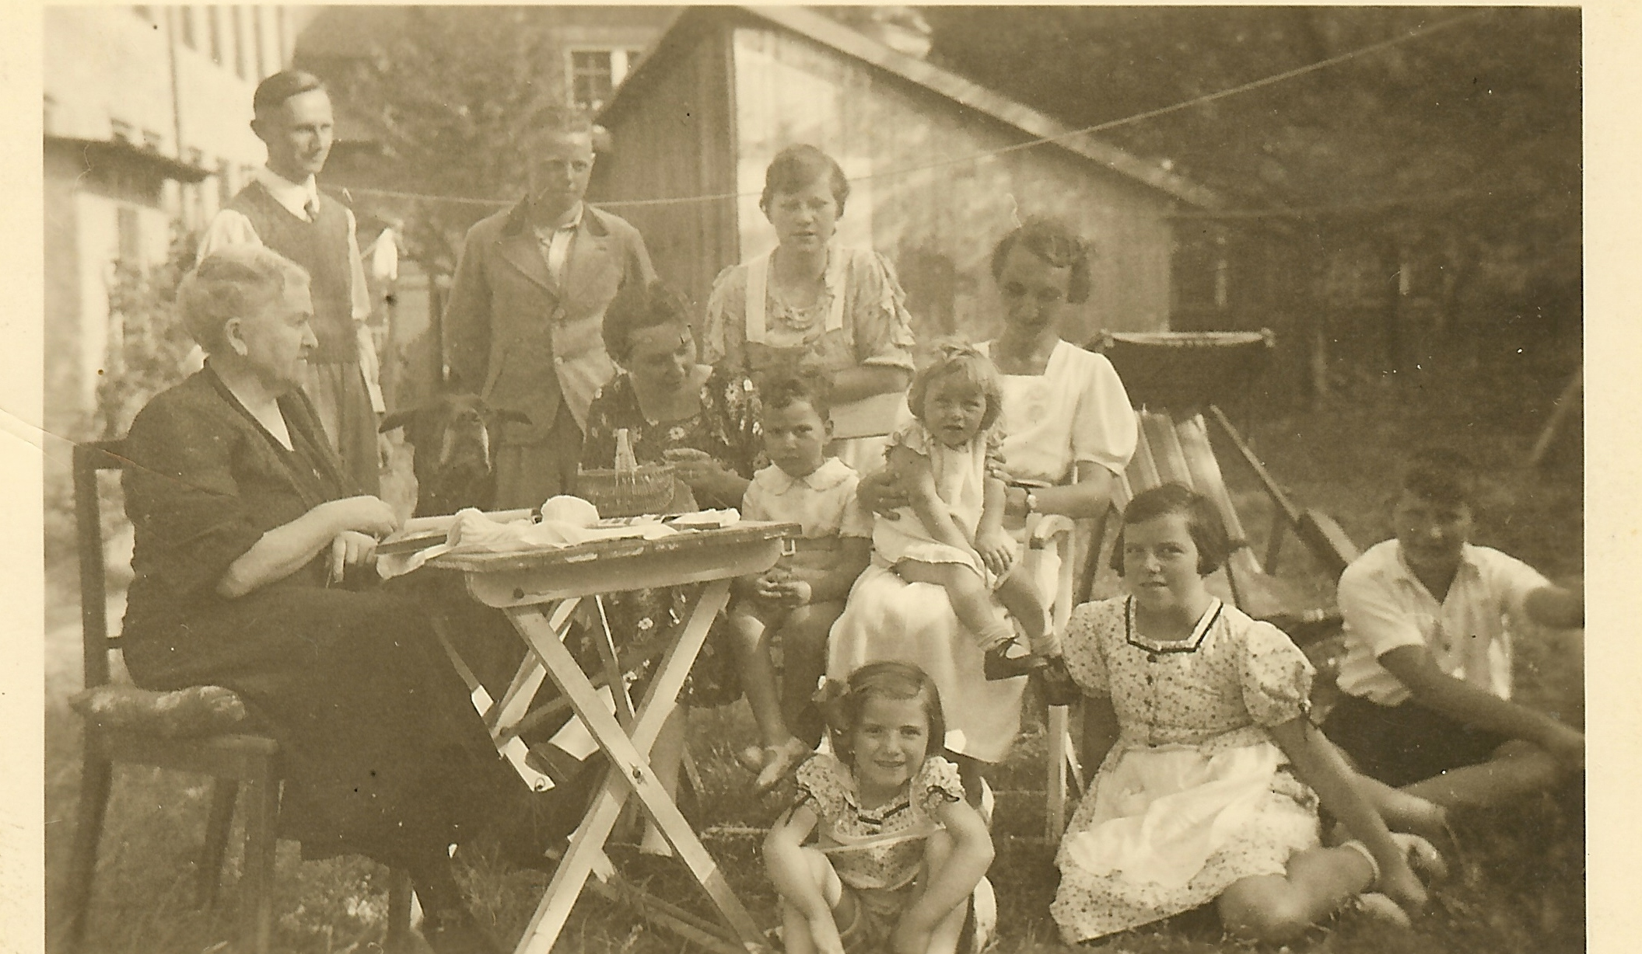
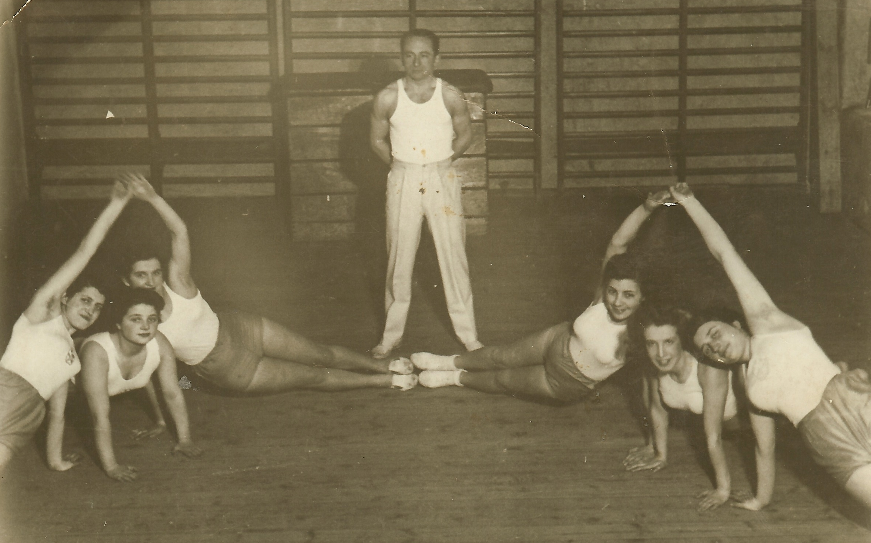
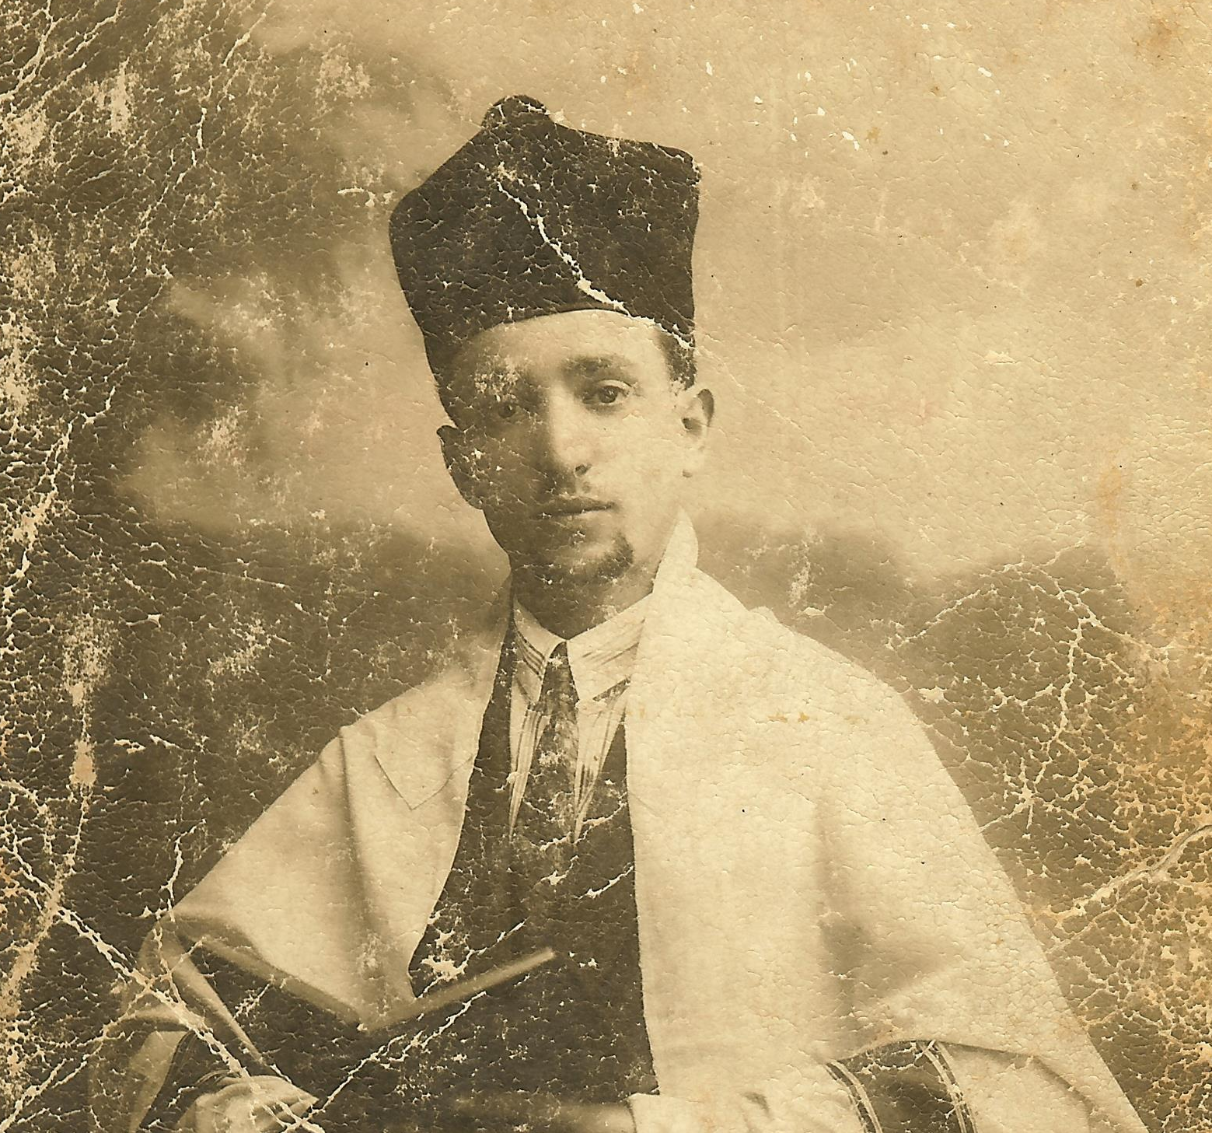
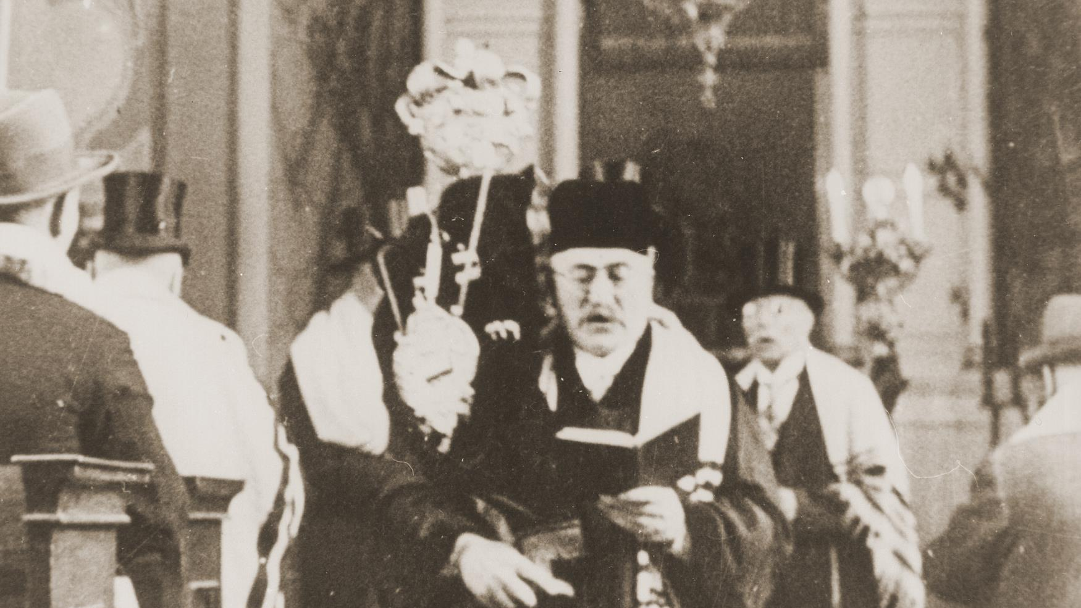
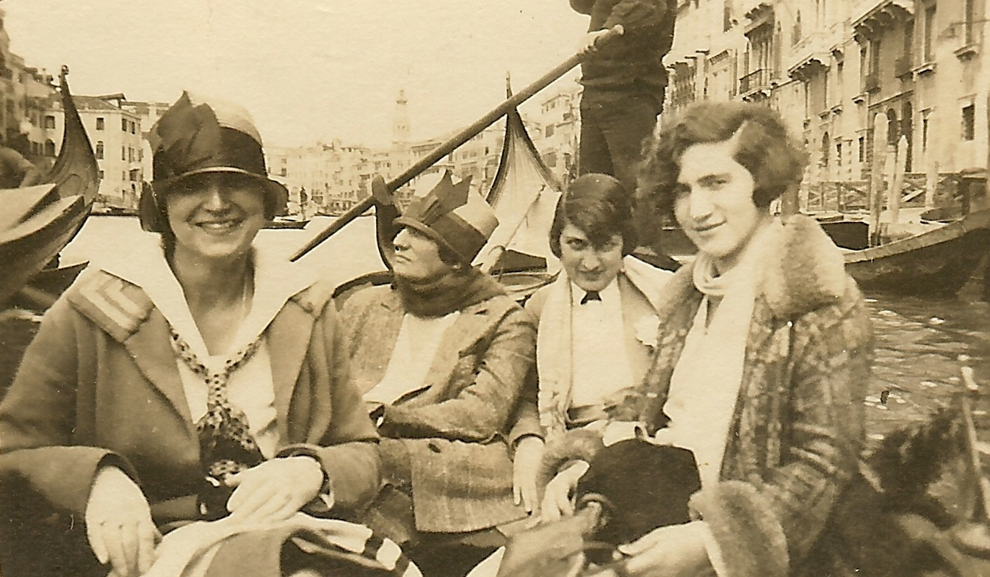
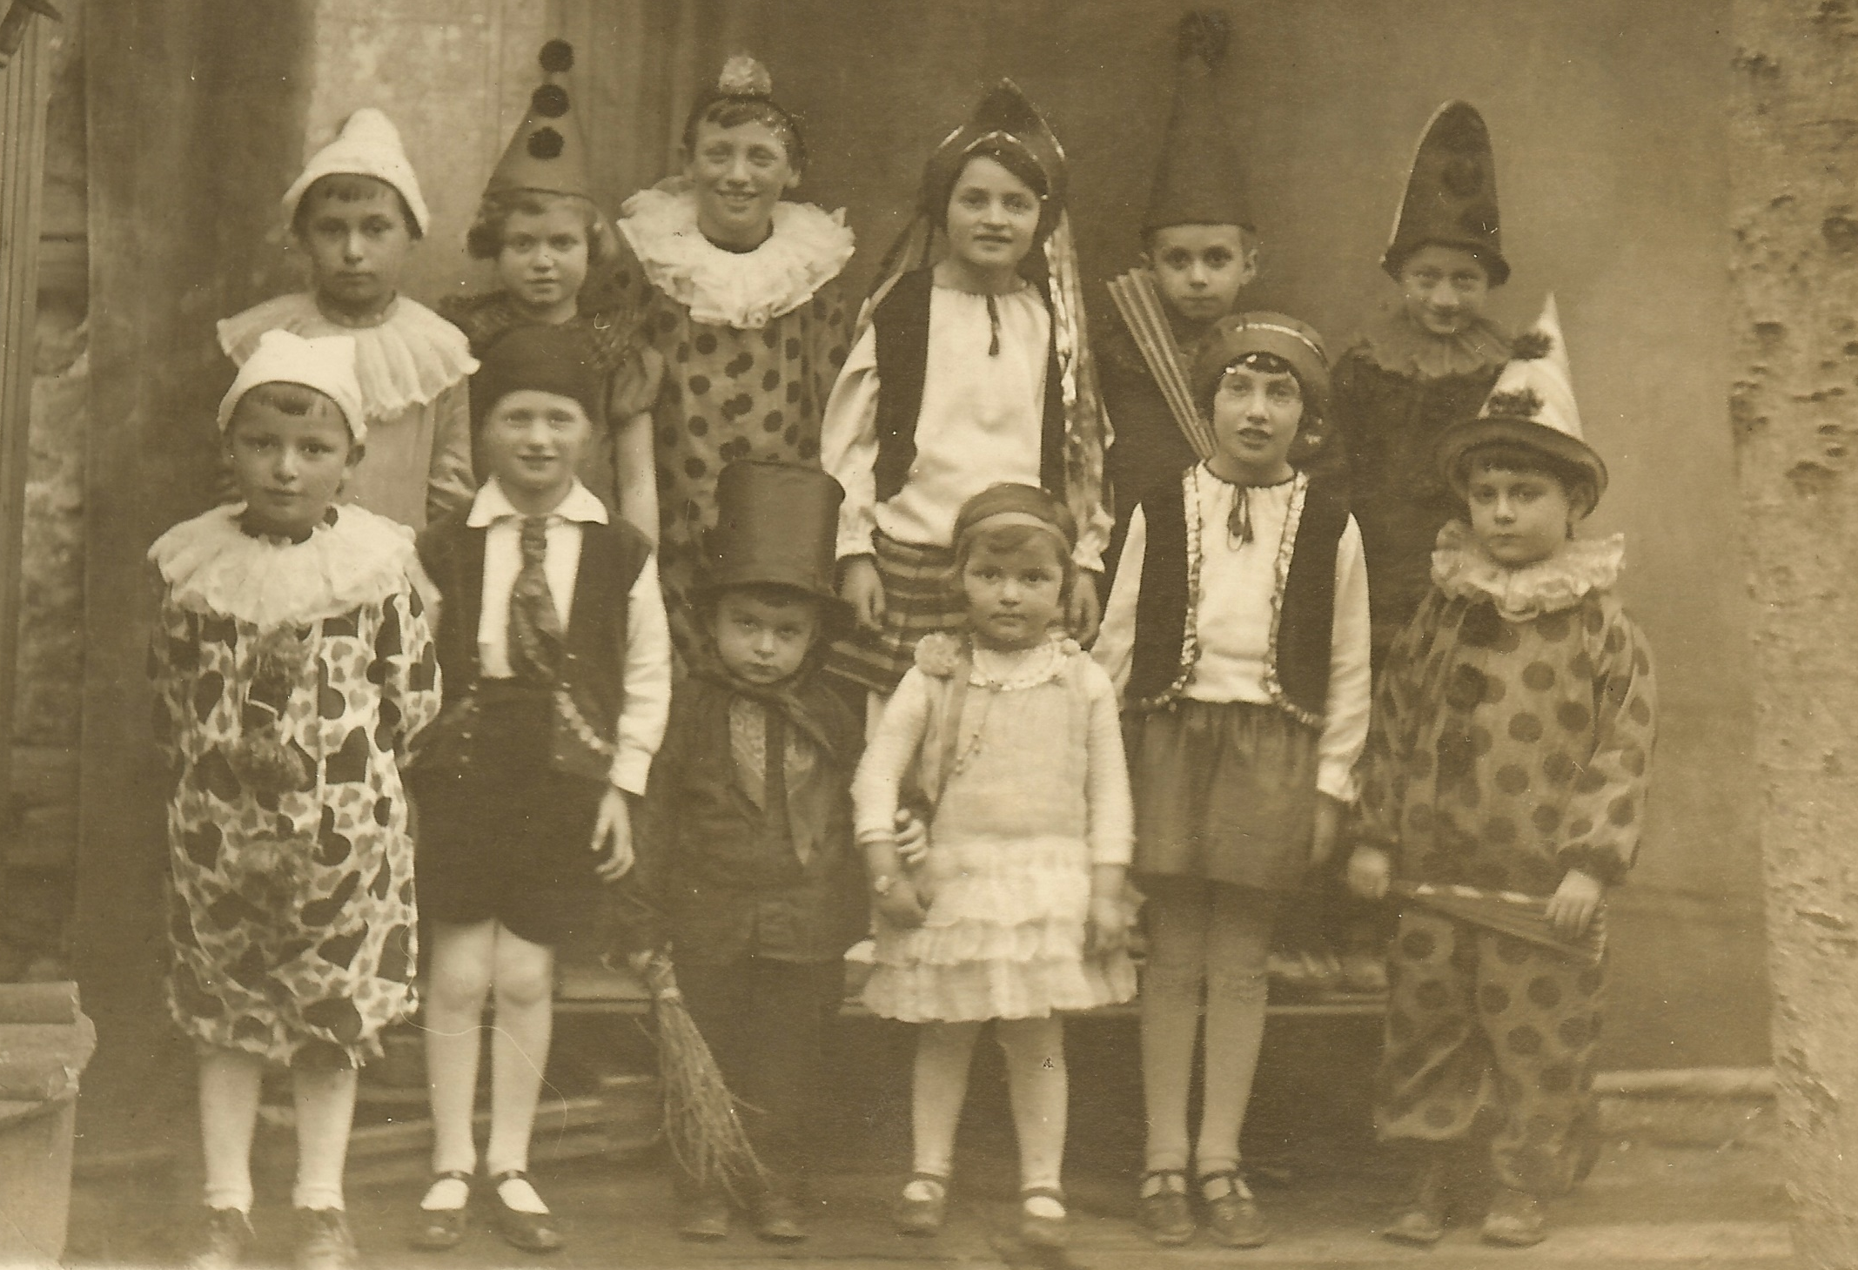
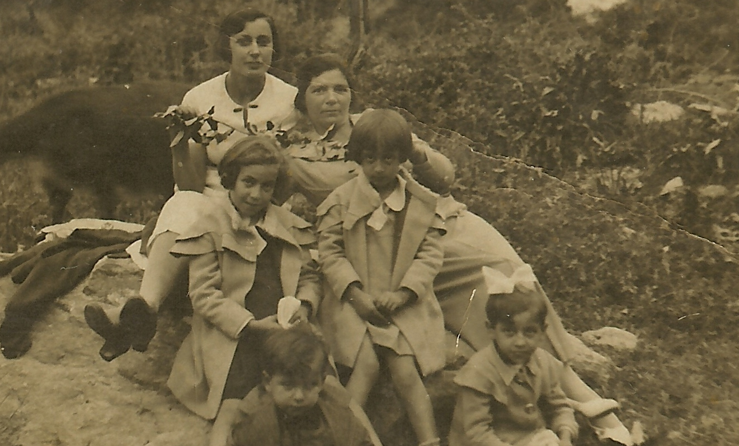

Slide 5
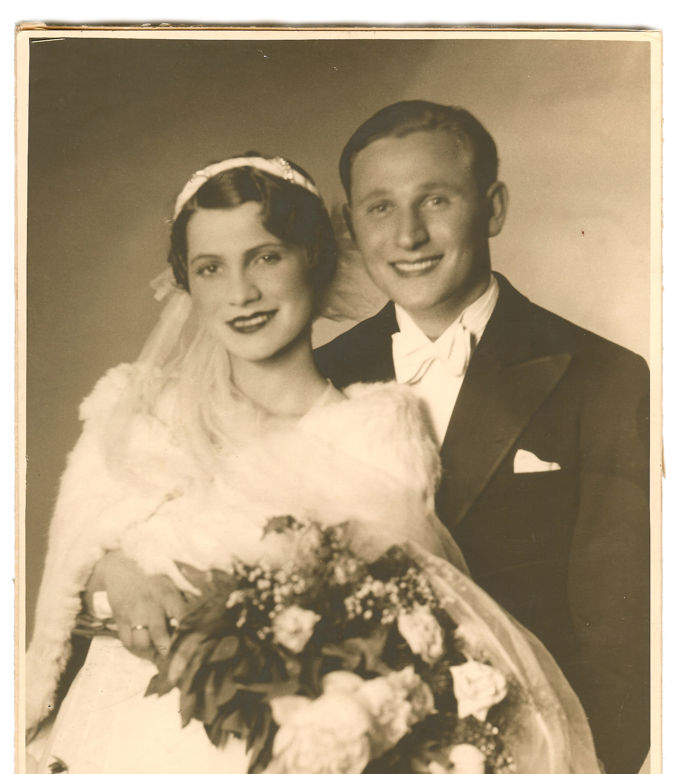
Adam and Pela Starkopf

Slide 6
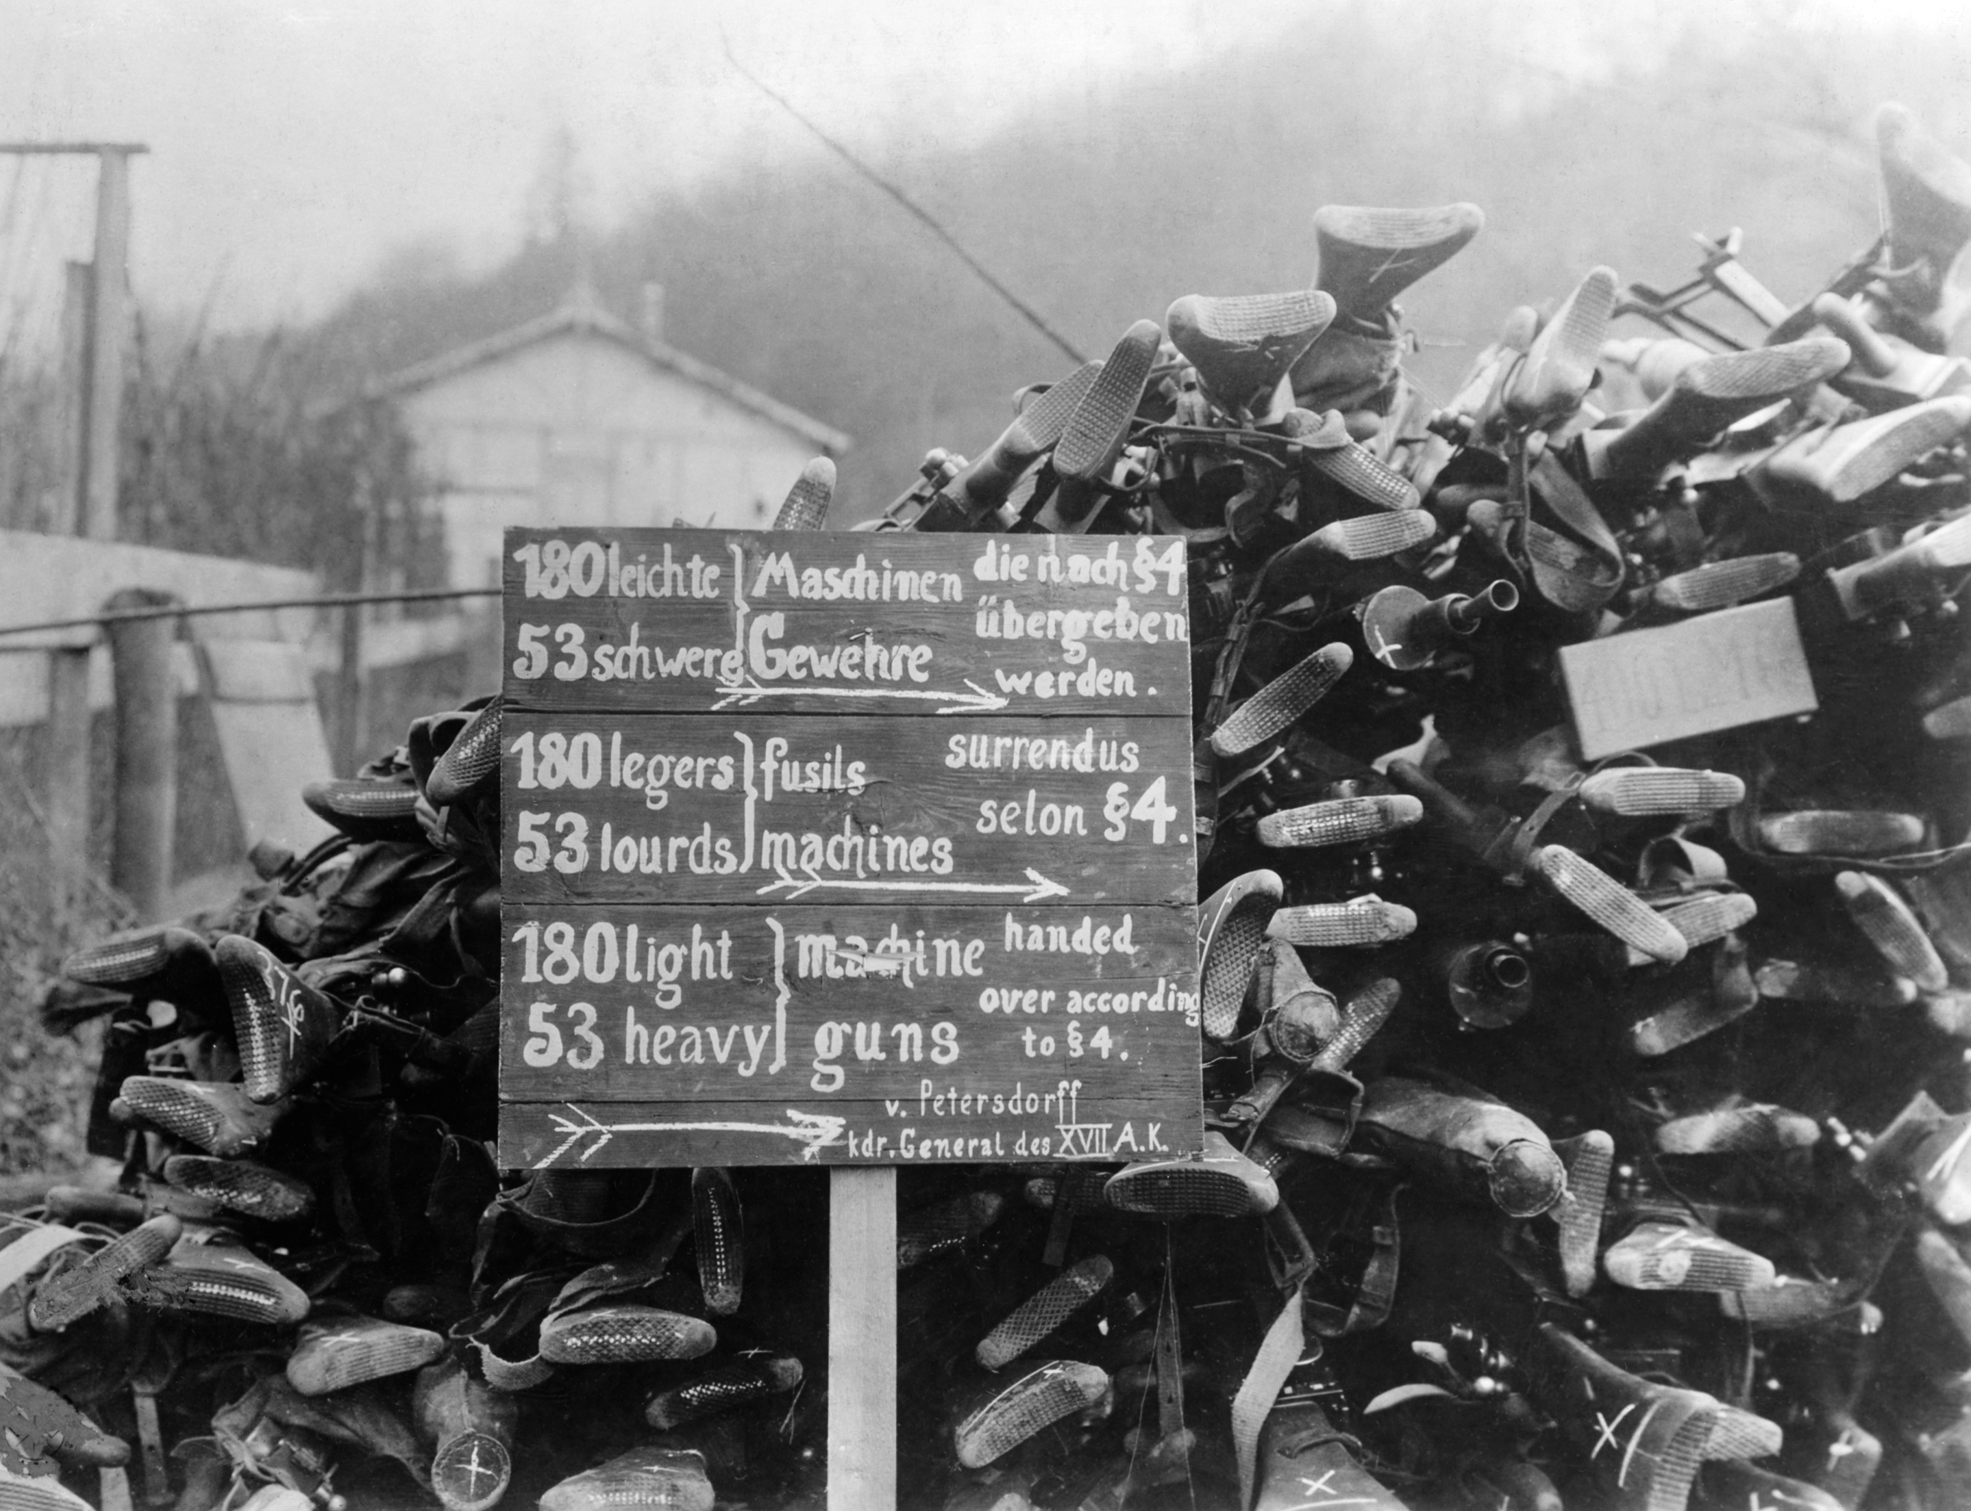
Weapons surrendered per the Treaty of Versailles

Slide 7
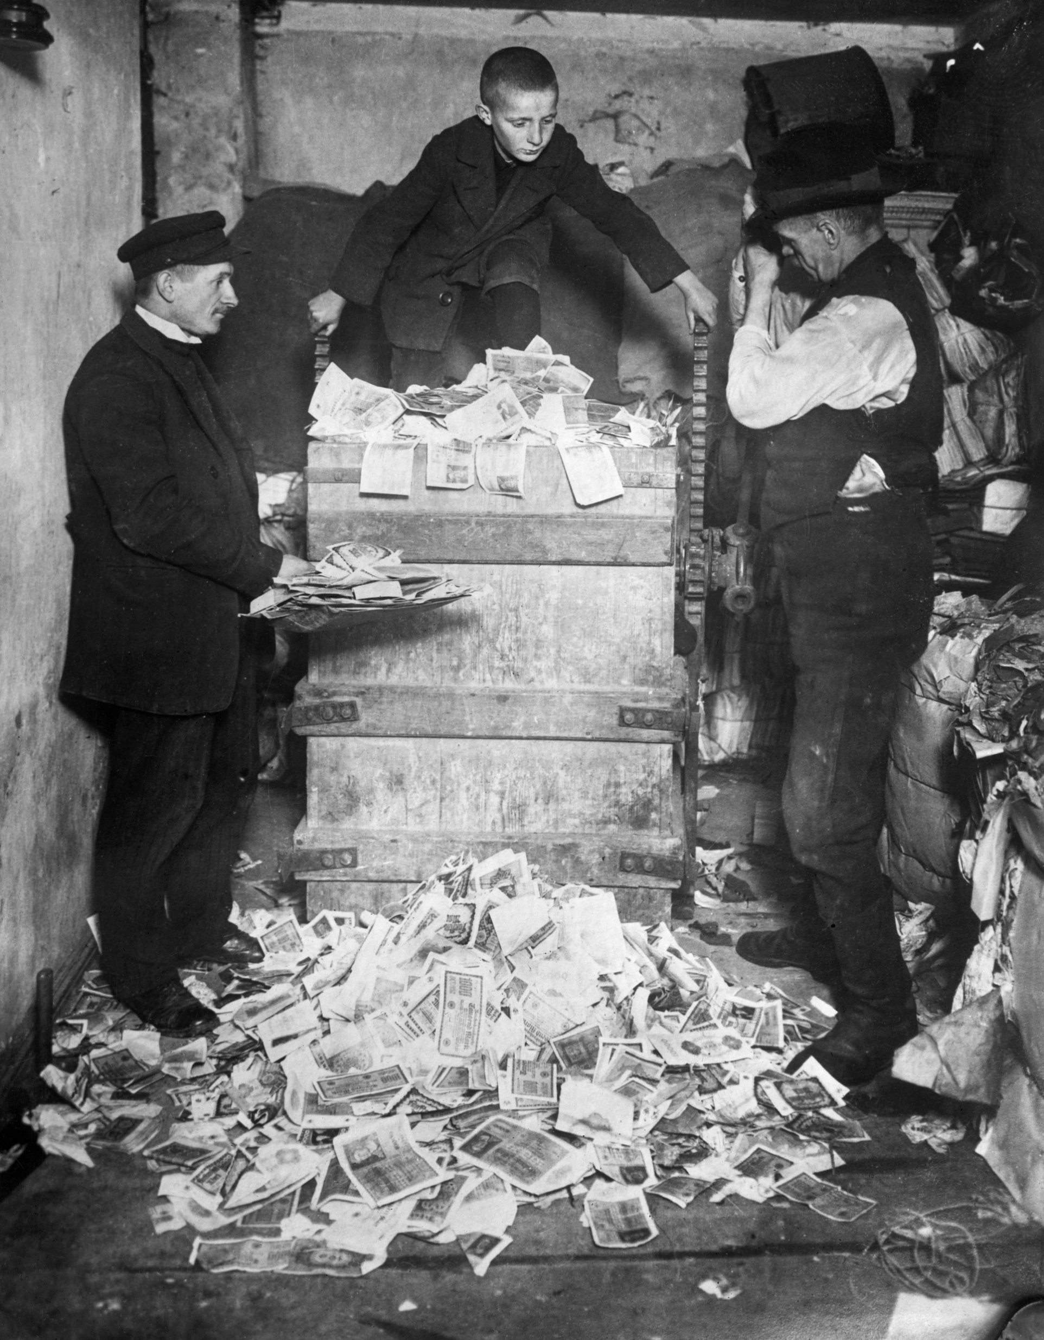

Slide 8
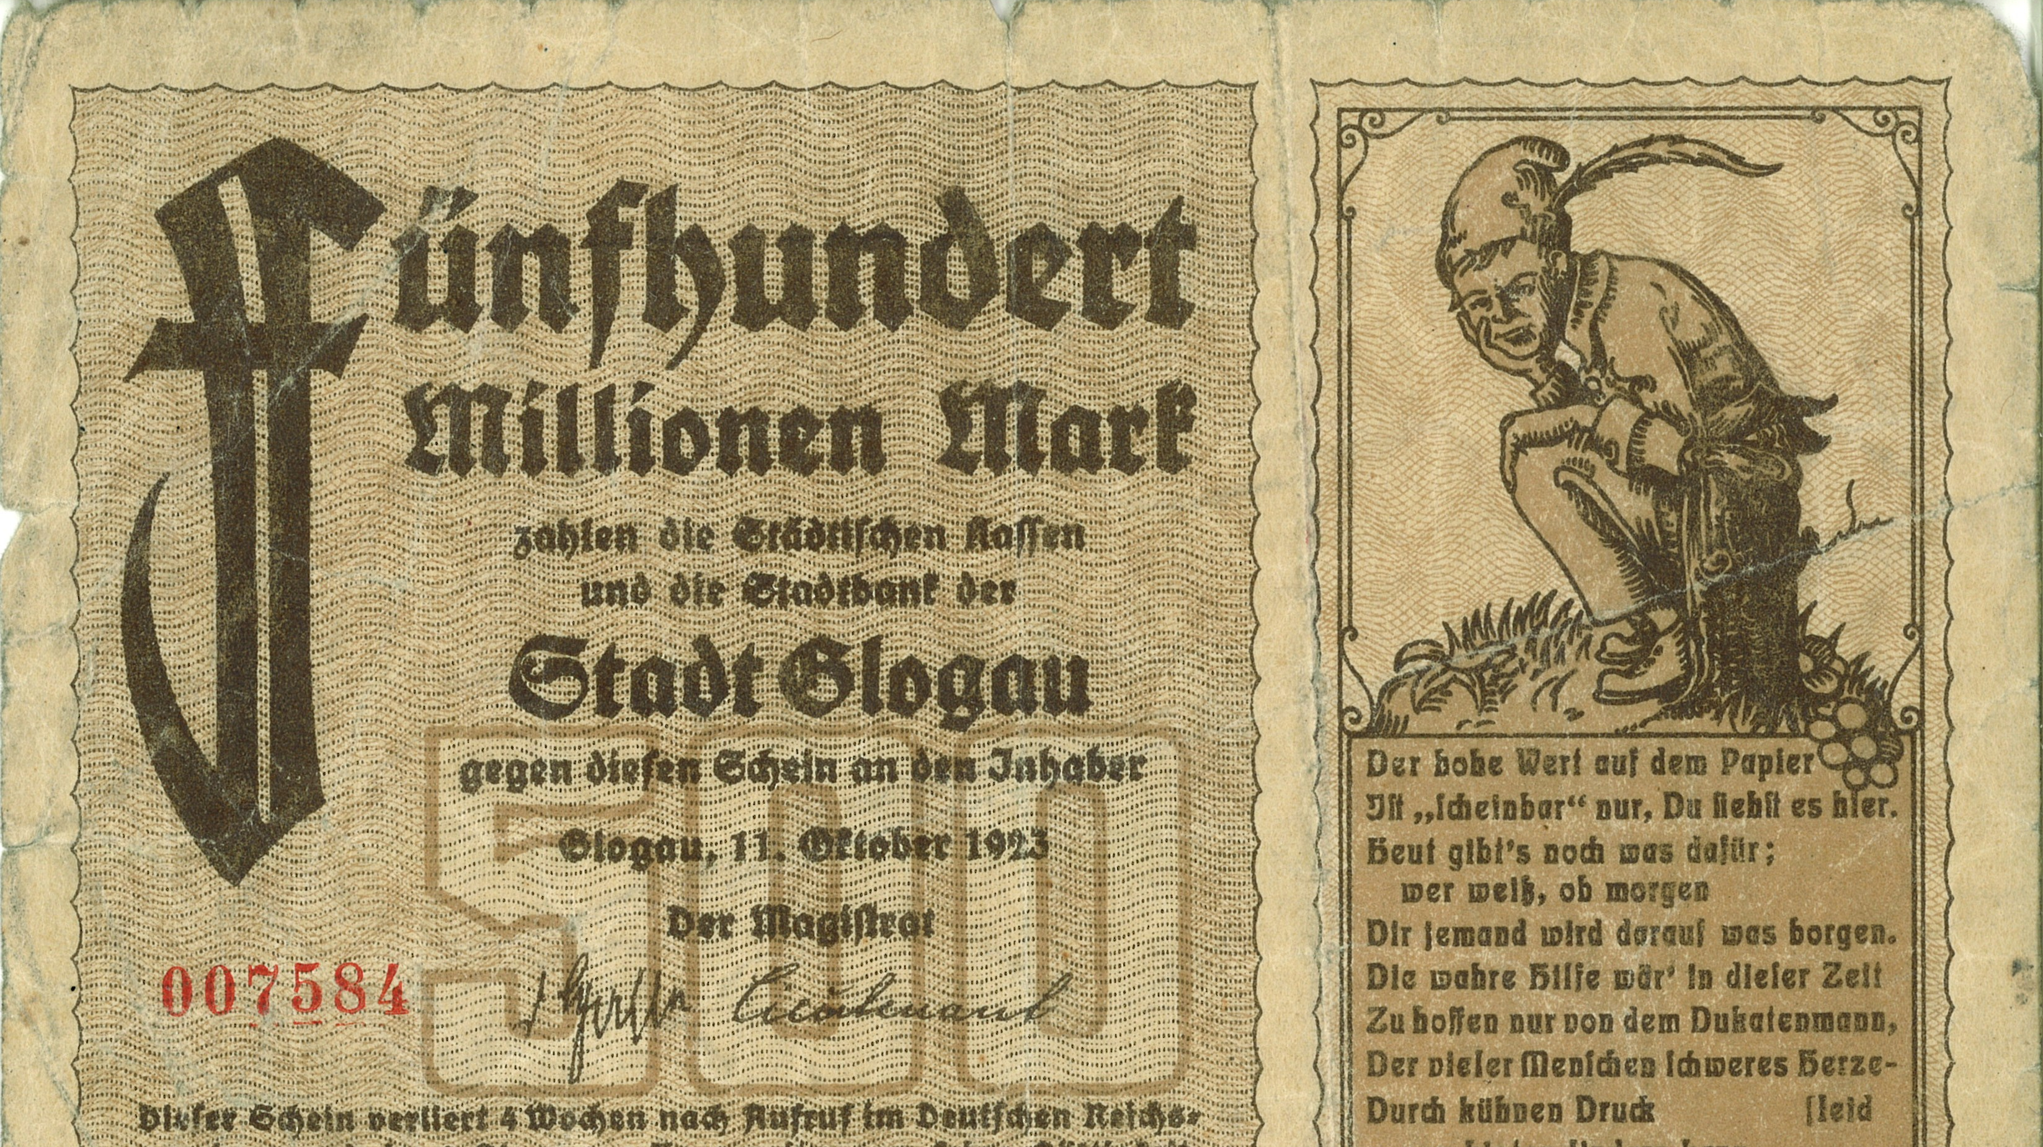
German inflation paper
500 million mark

Slide 9
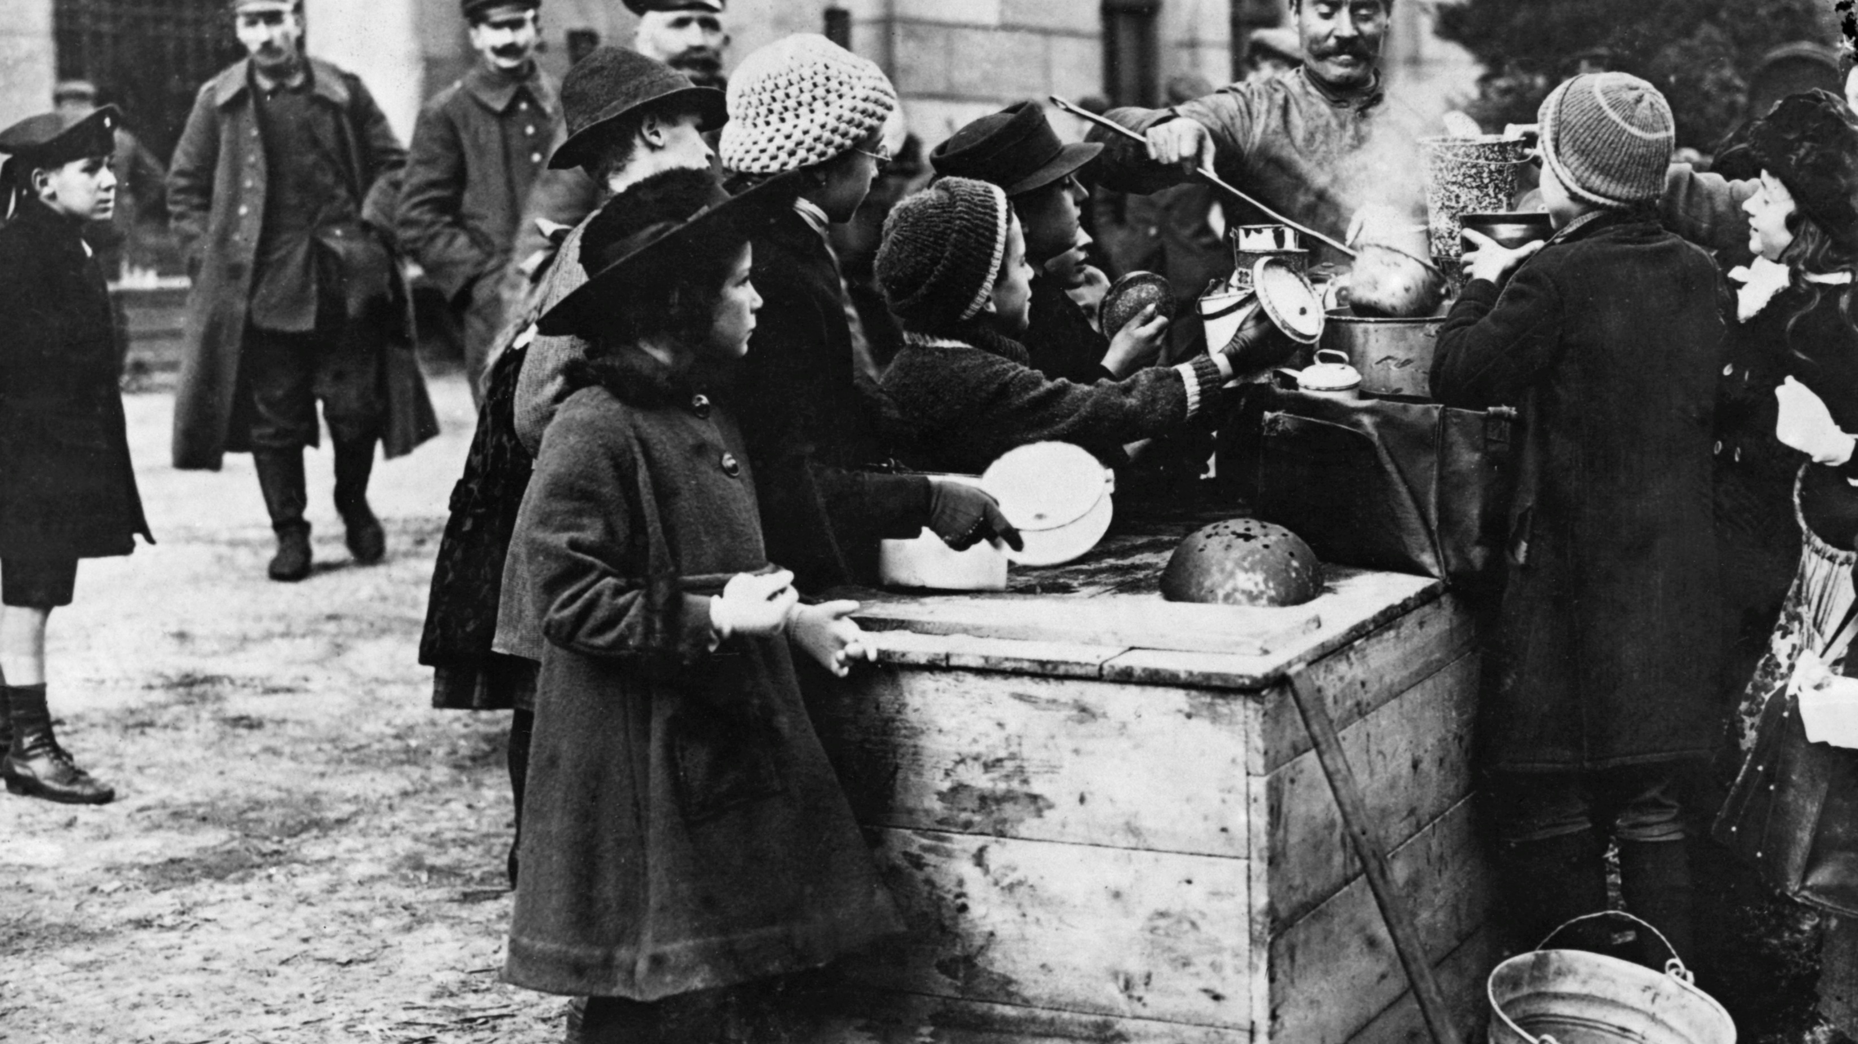

Slide 10
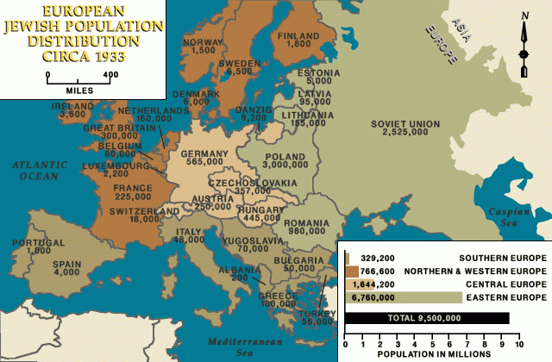

Slide 11
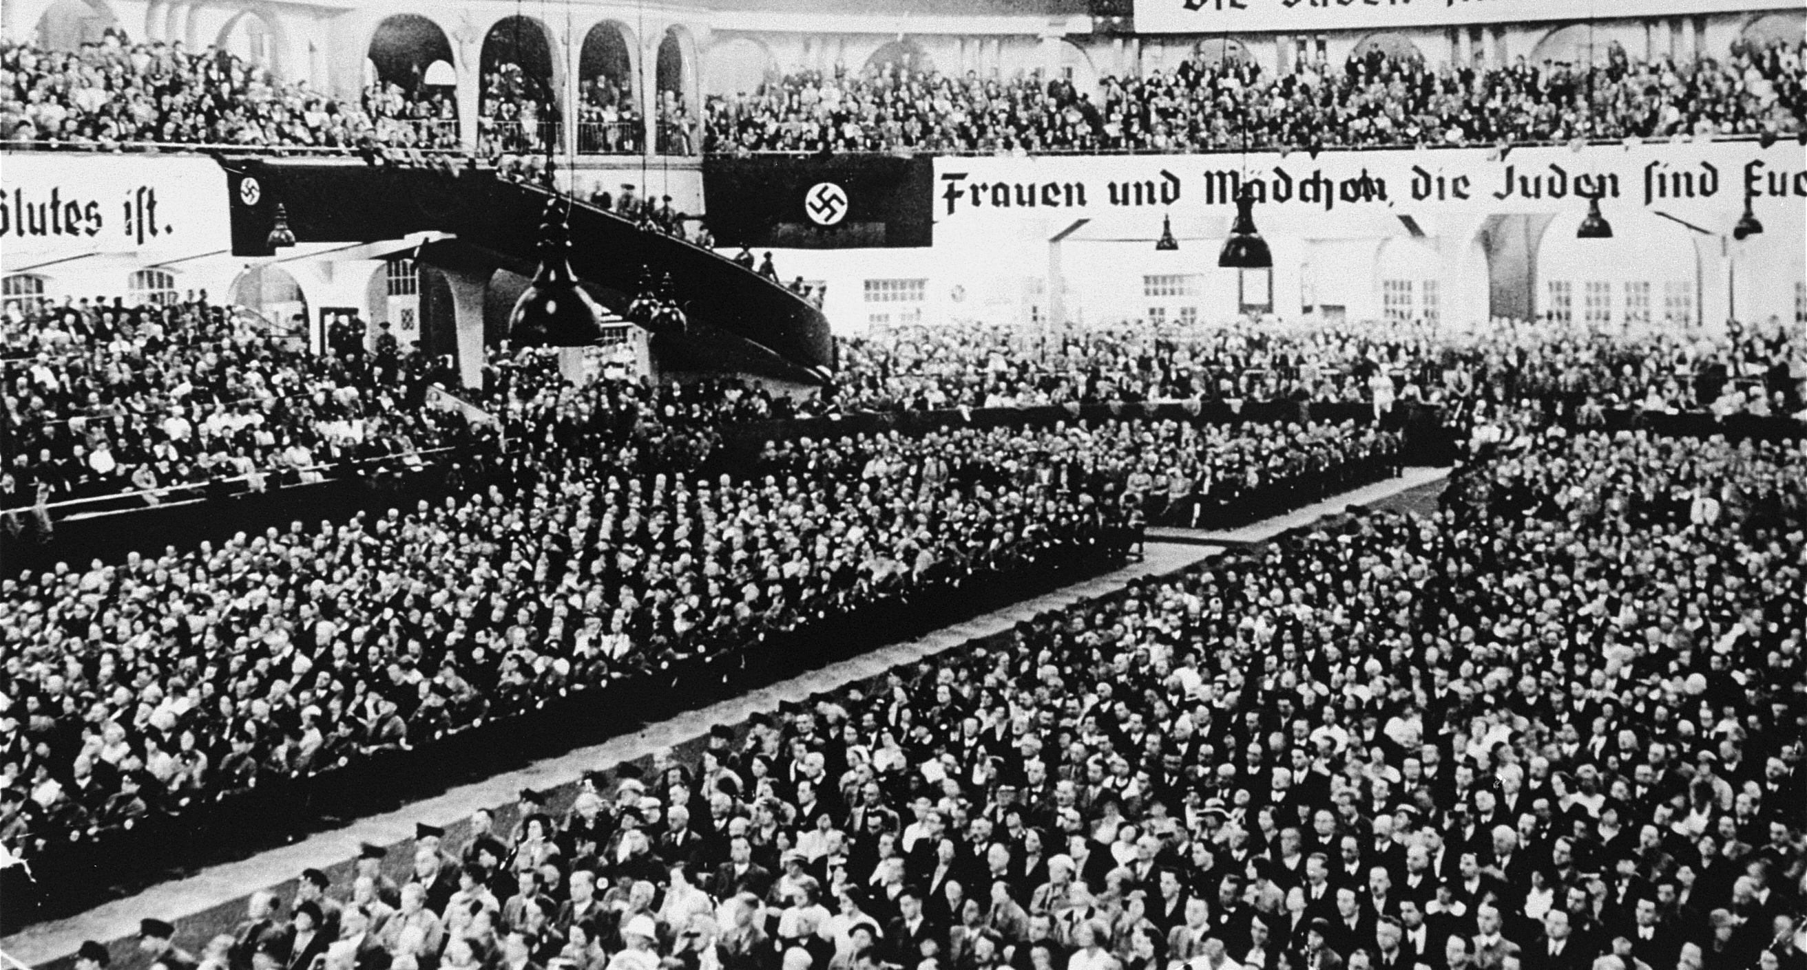

Slide 12
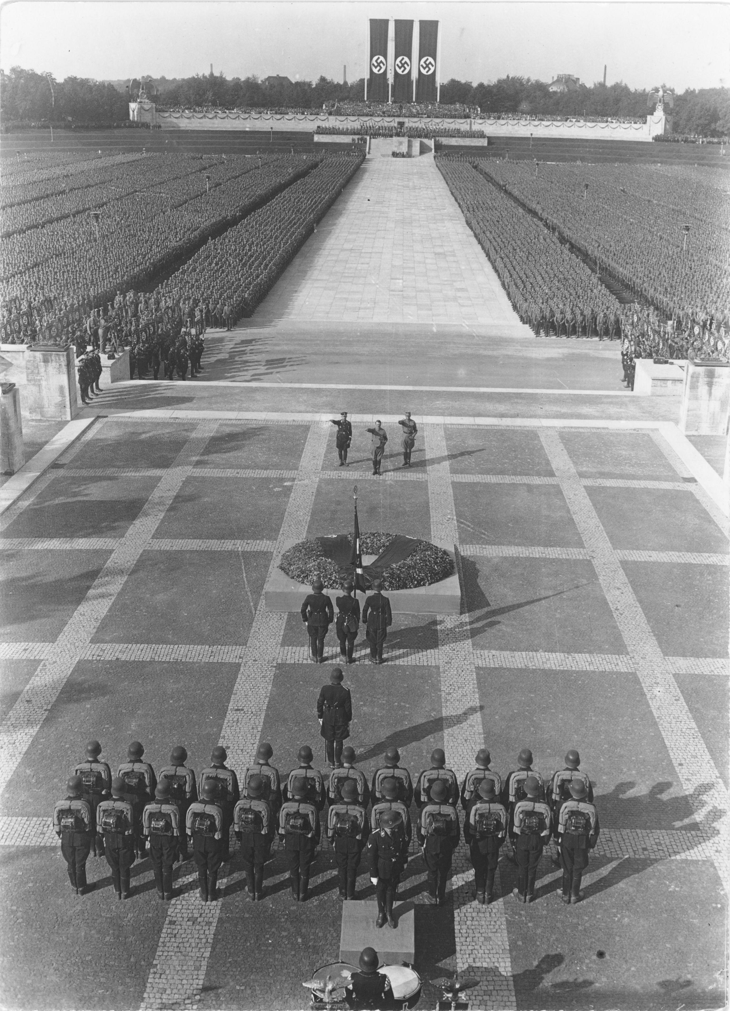

Slide 13
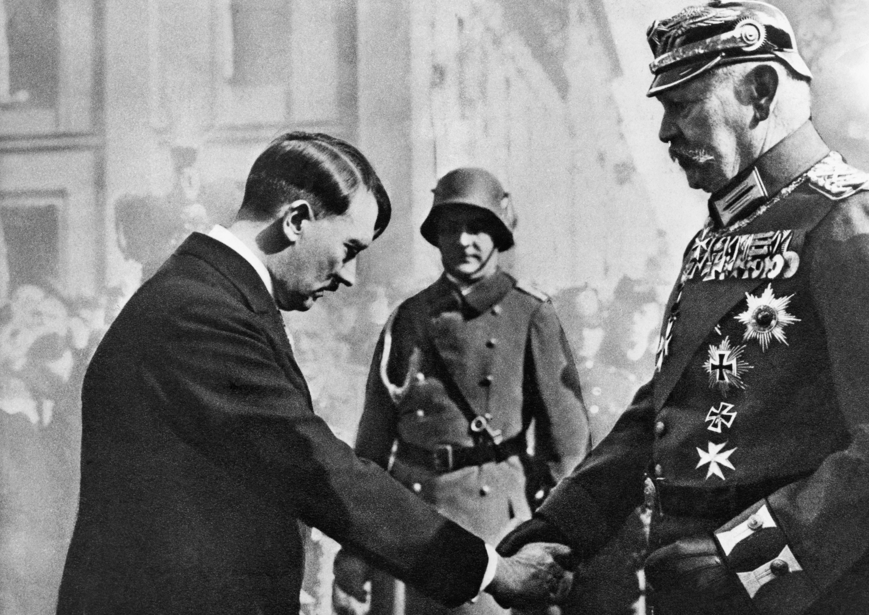

Slide 14
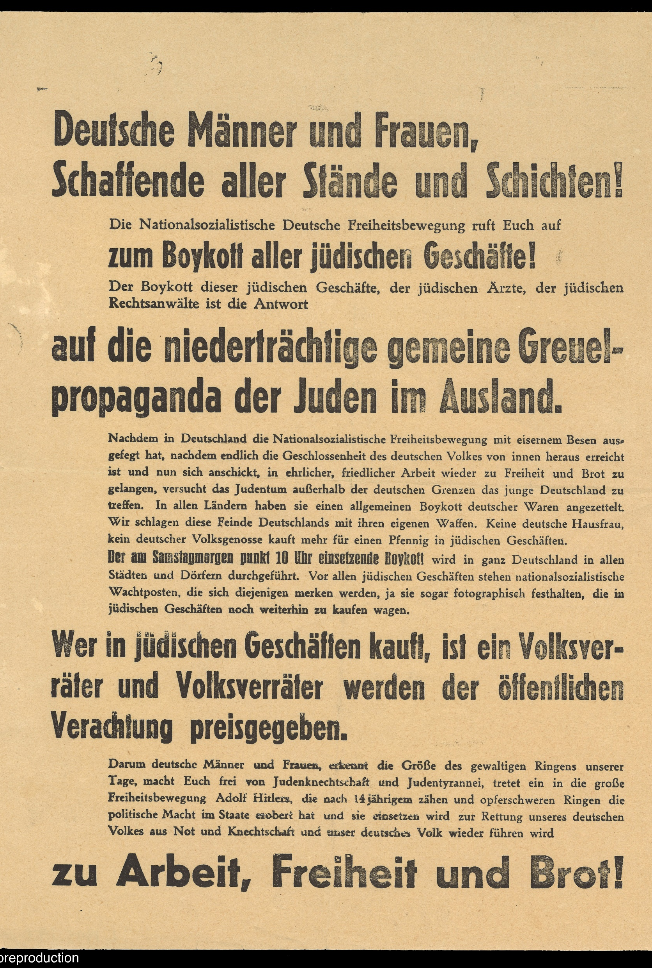
Poster printed in German announcing the German boycott of all Jewish stores

Slide 15
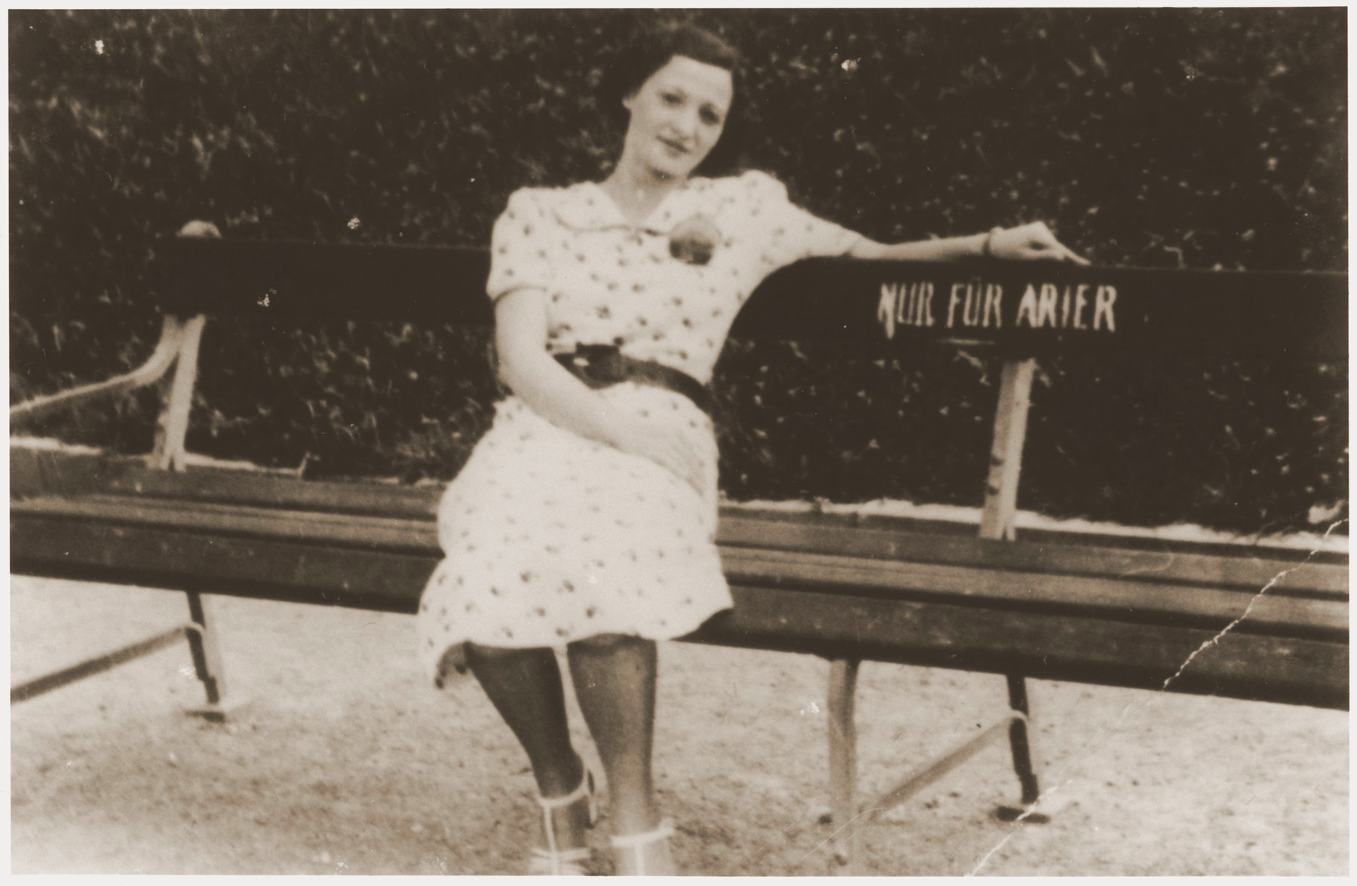
Park bench with a sign that says (translated)
"Only for Aryans."

Slide 16
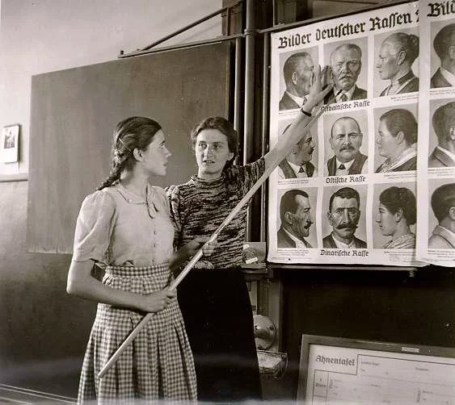
German student learning the differences between German and Jewish features during a racial theory lesson.

Slide 17
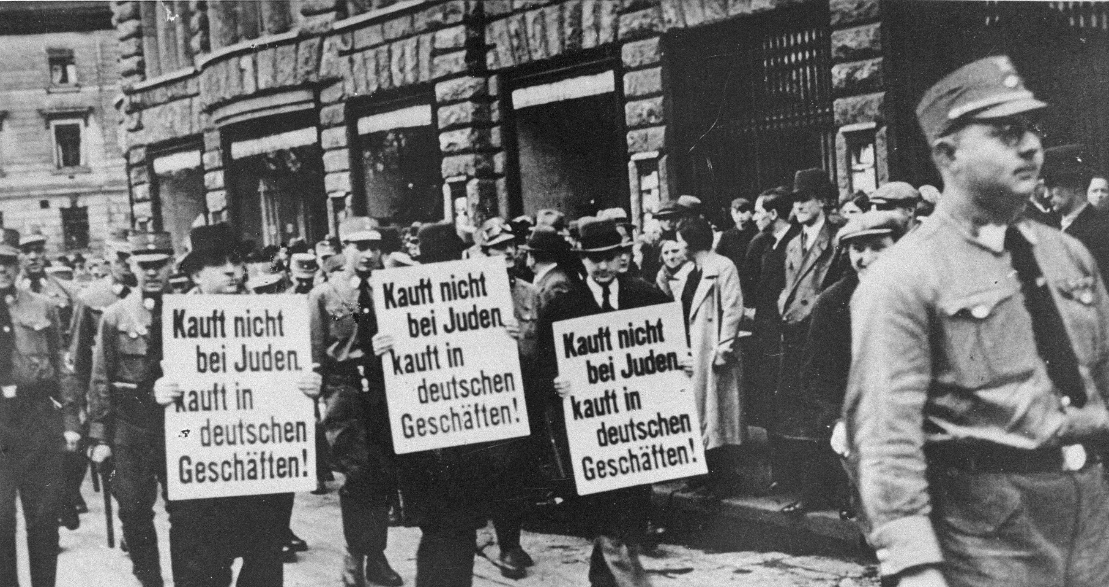
Sign translation: "Don't buy from Jews. Buy from German businesses.”

Slide 18
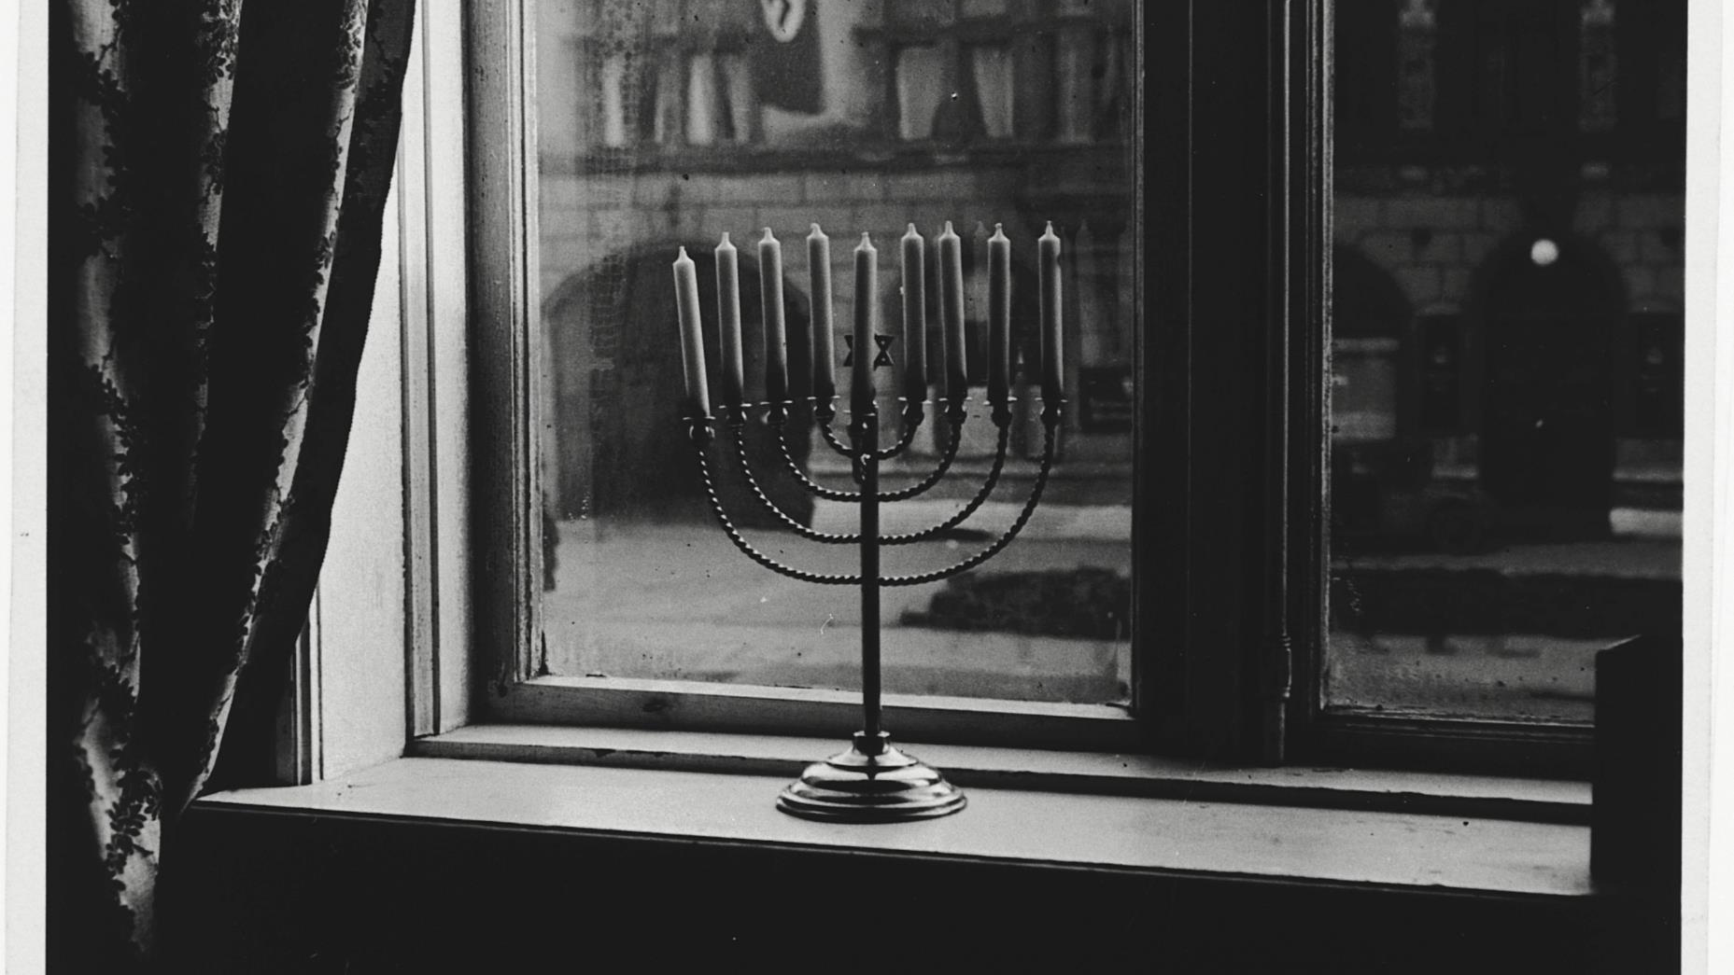

Slide 19
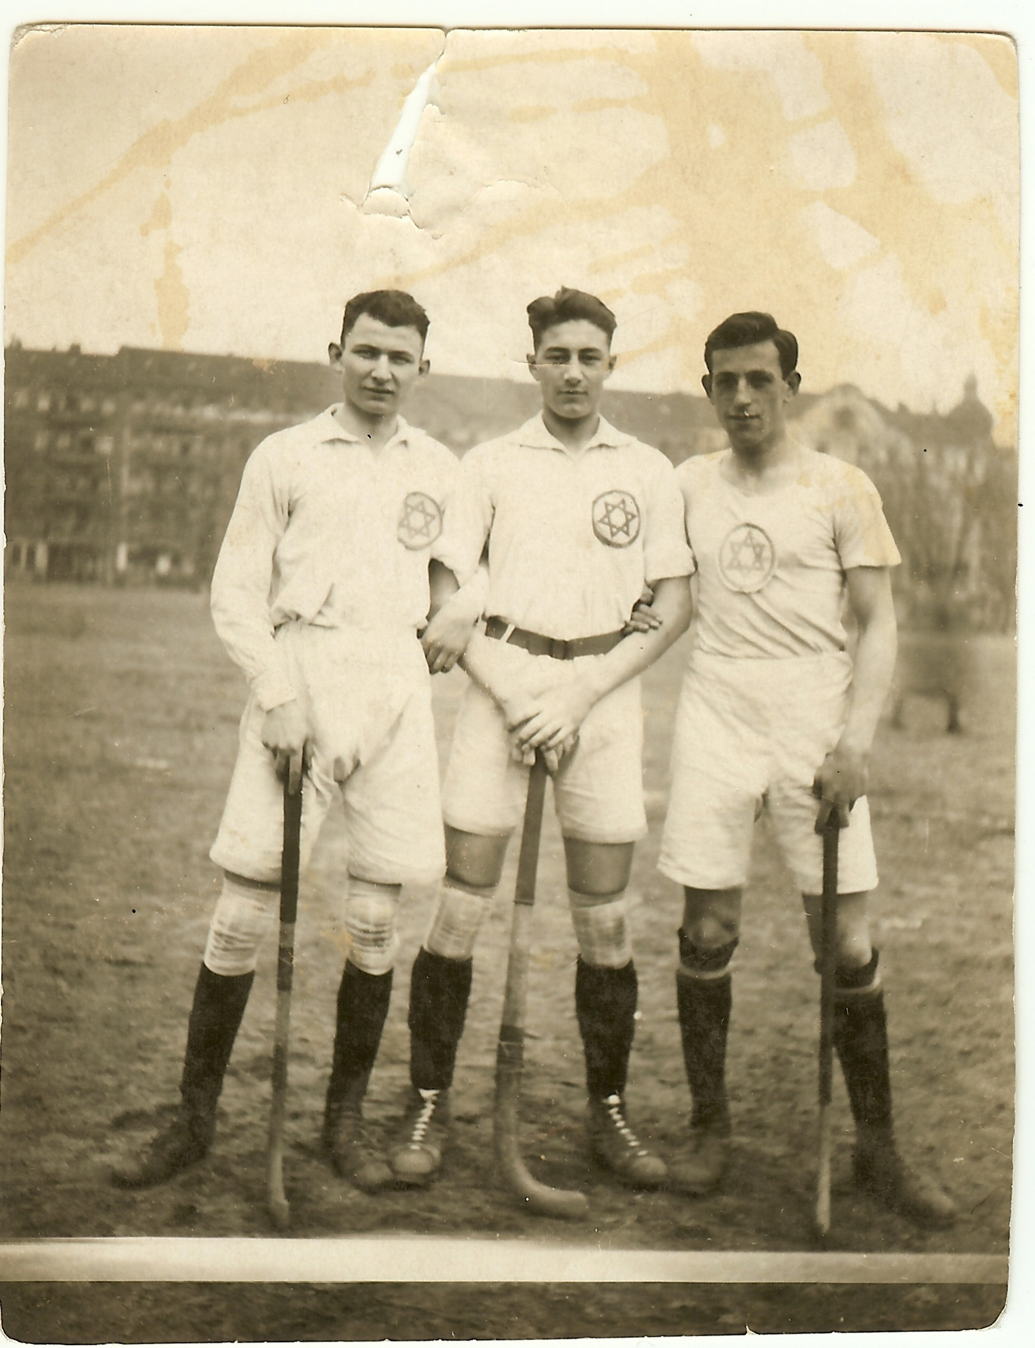

Slide 20
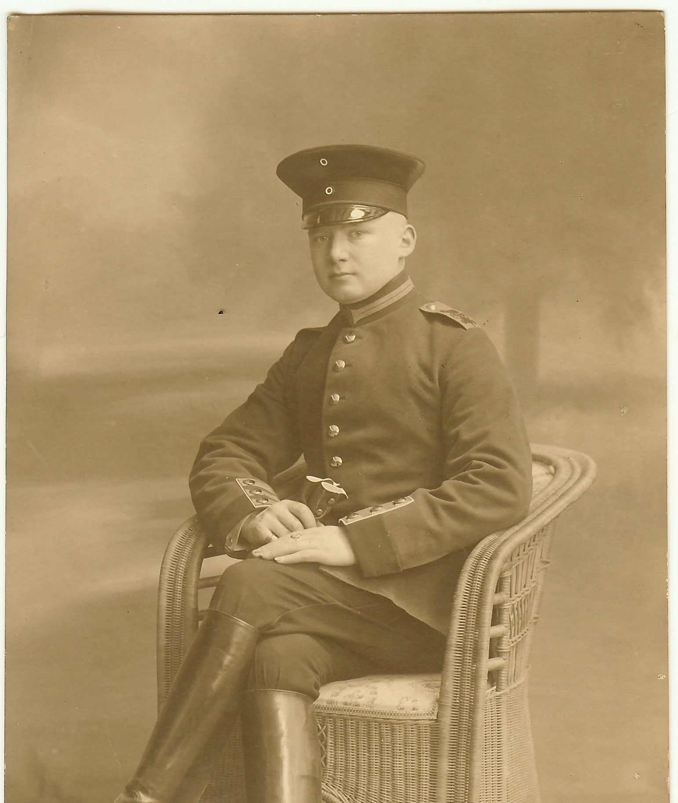
Walter Wollman

Slide 21
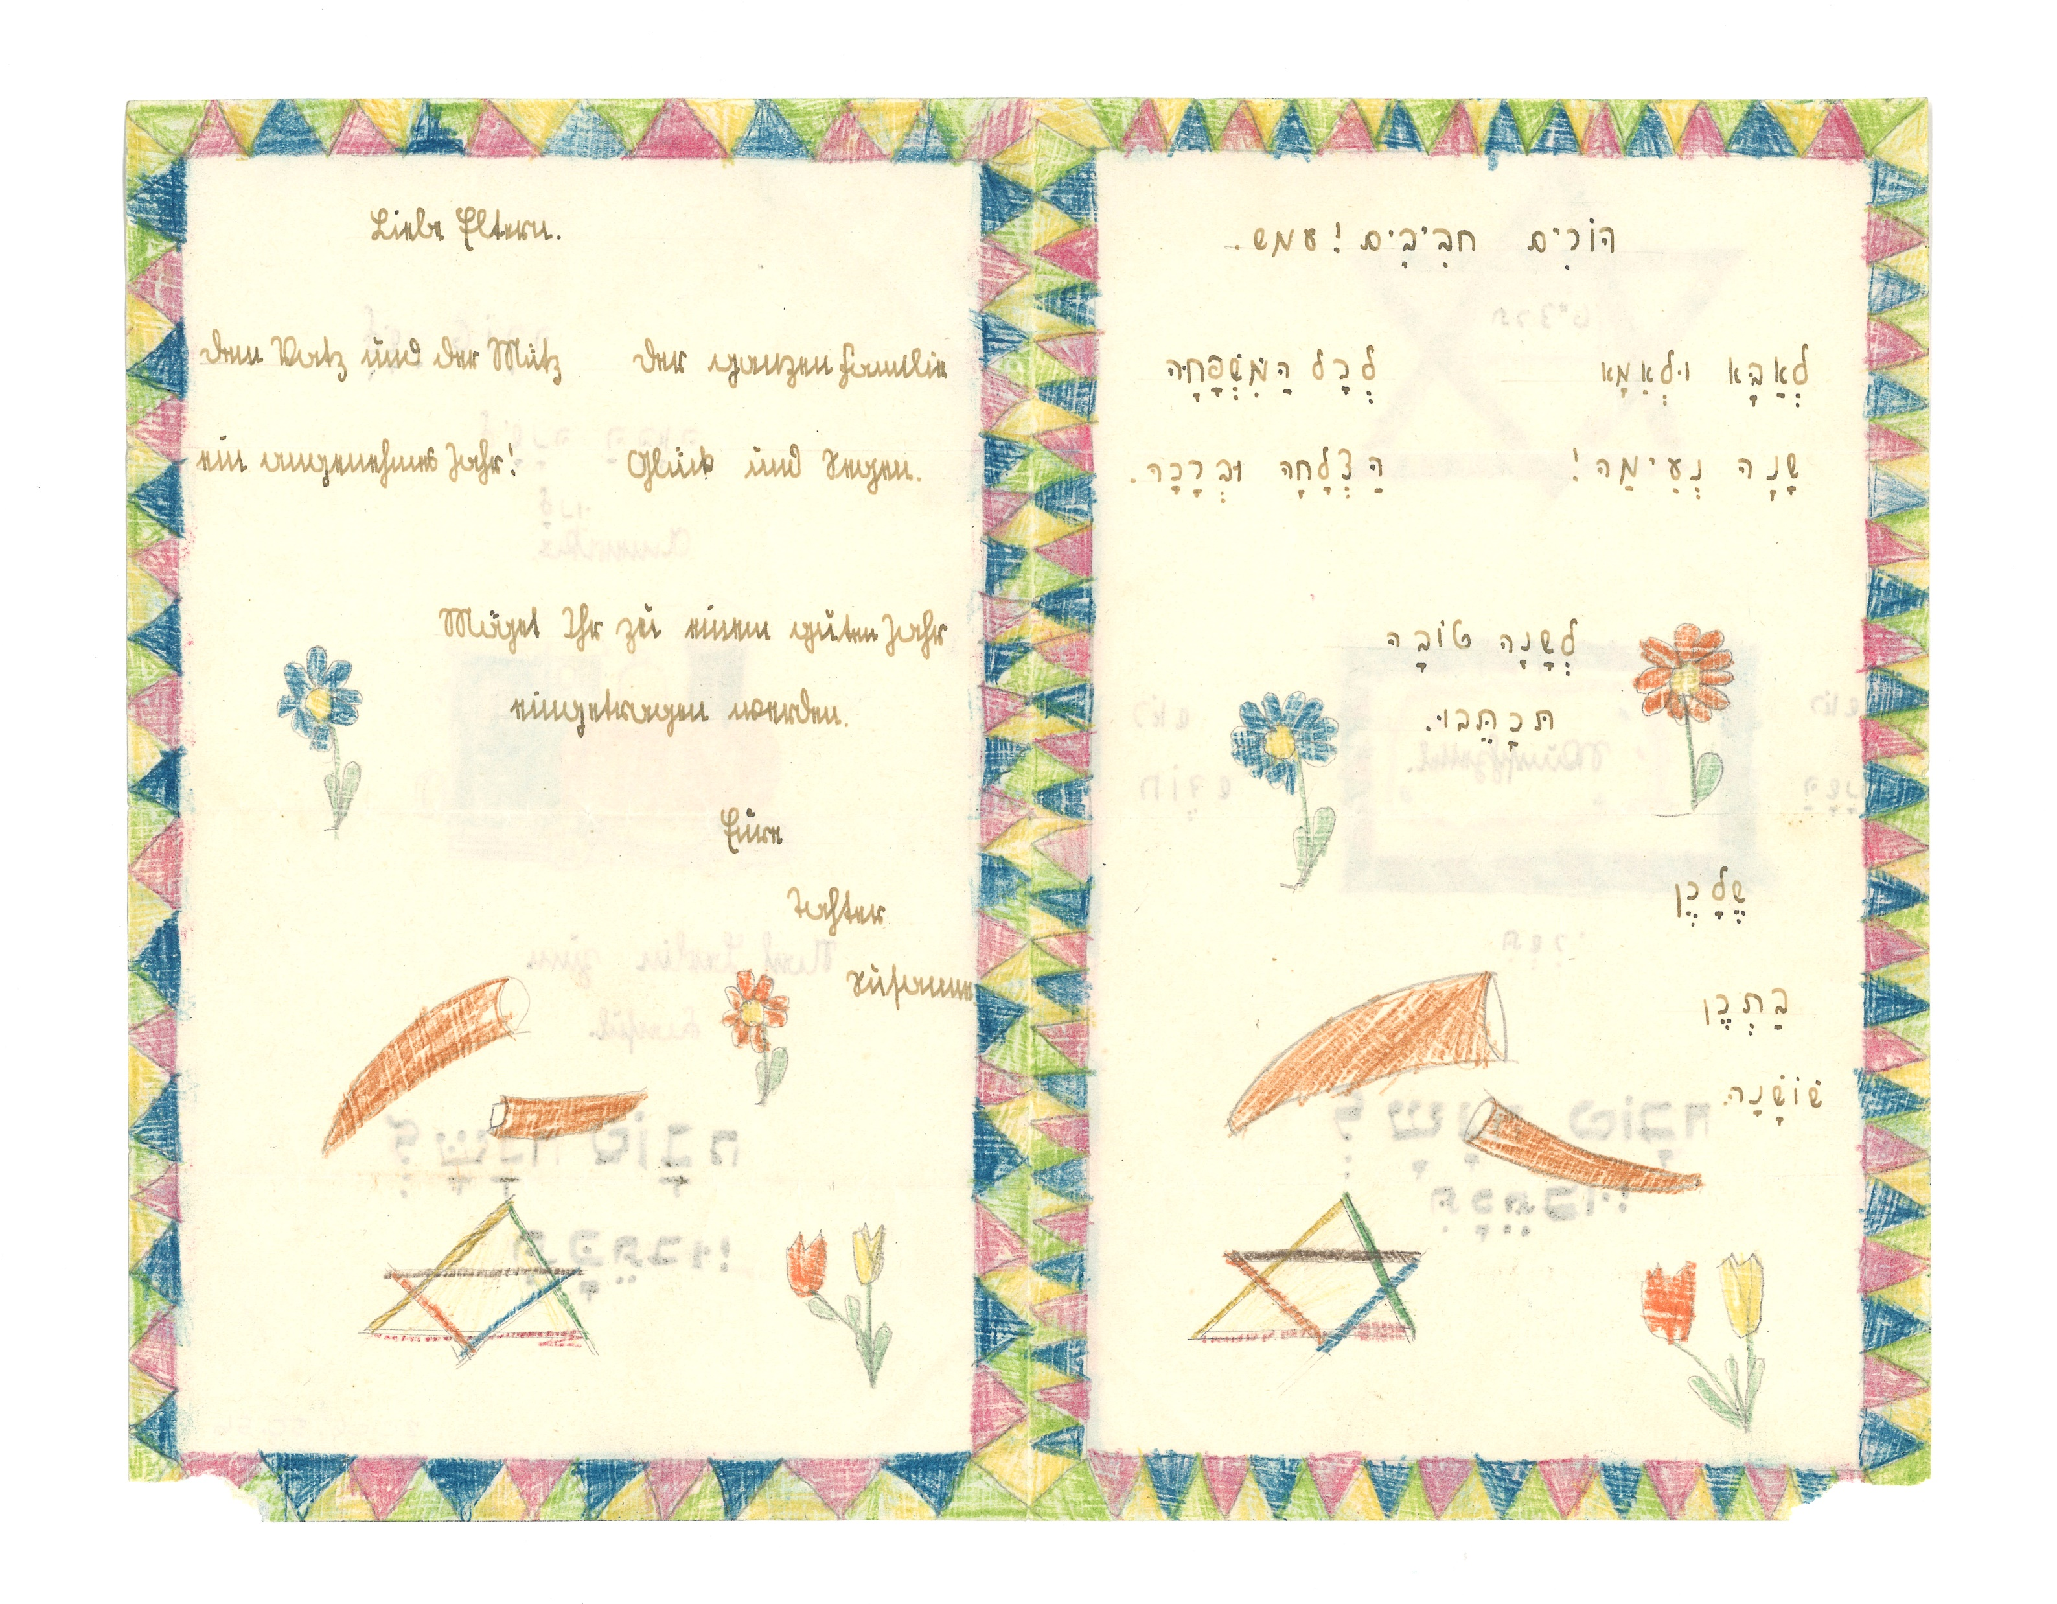
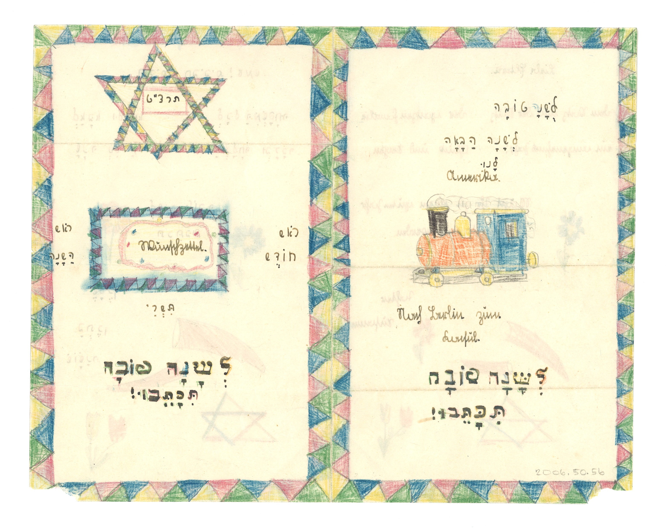

Slide 22
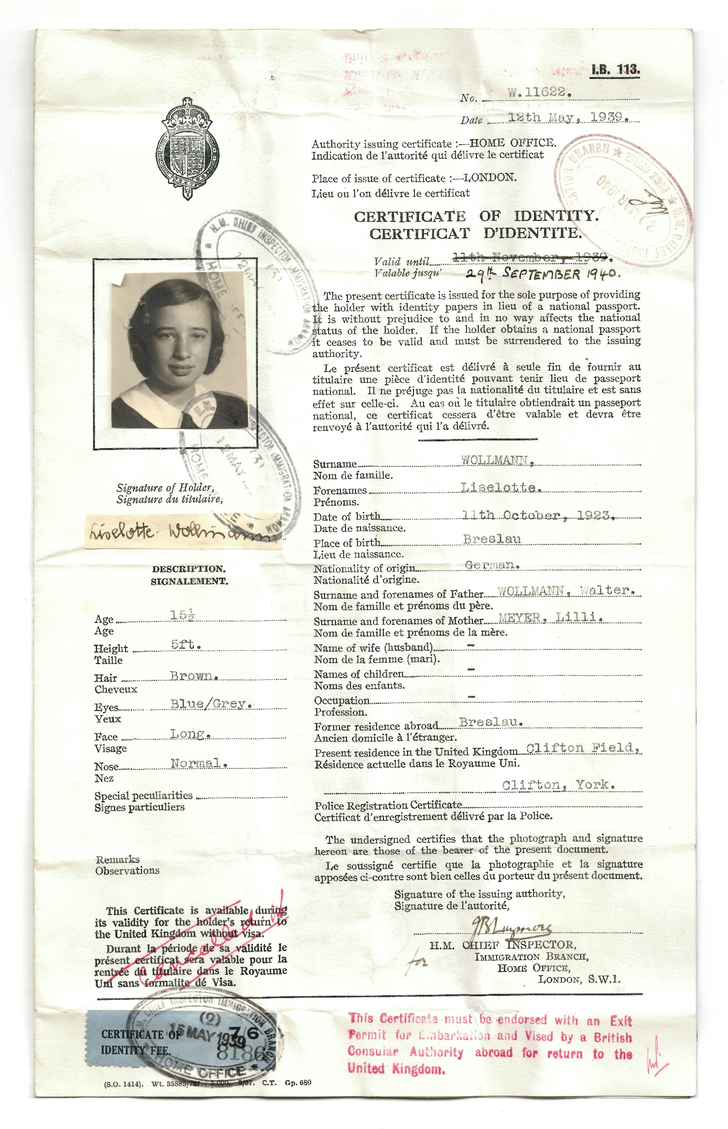

Slide 23
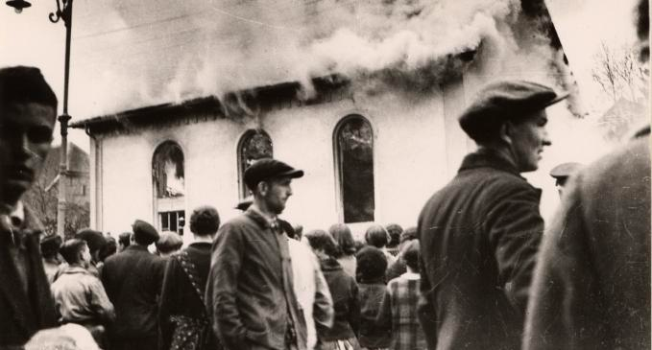

Slide 24
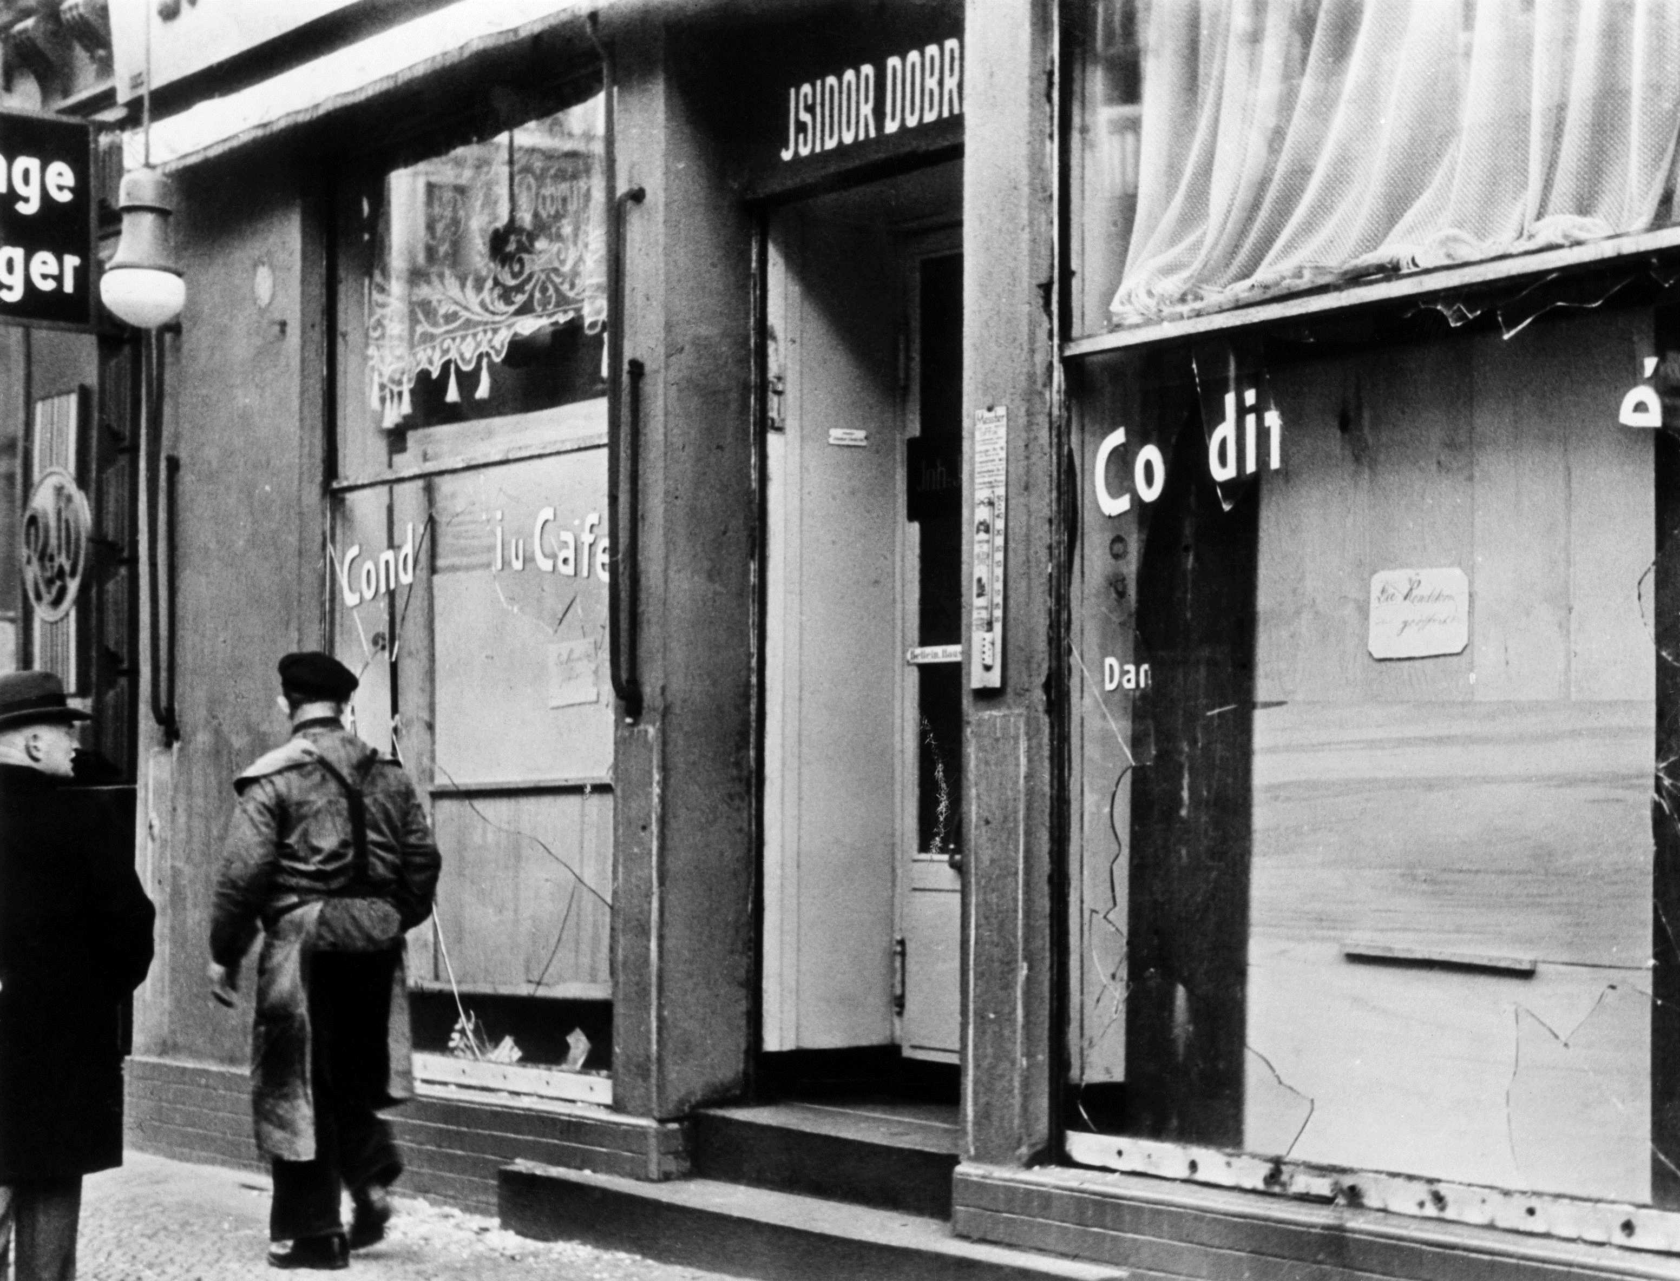

Slide 25
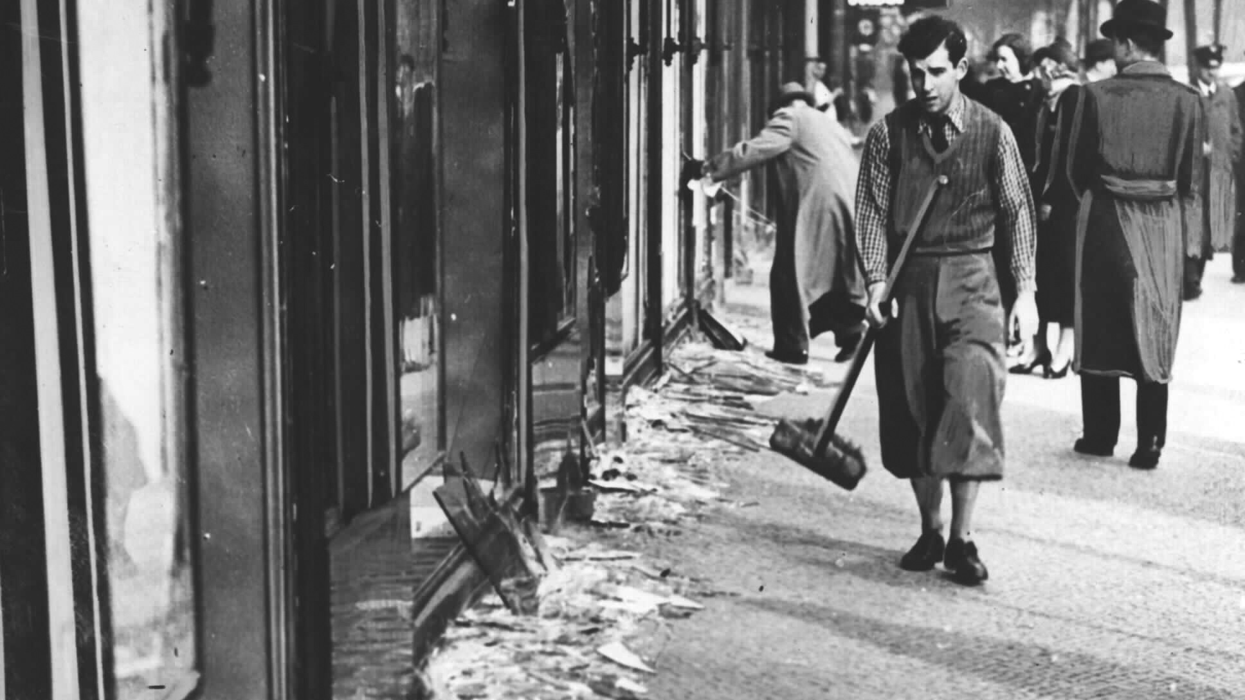

Slide 26
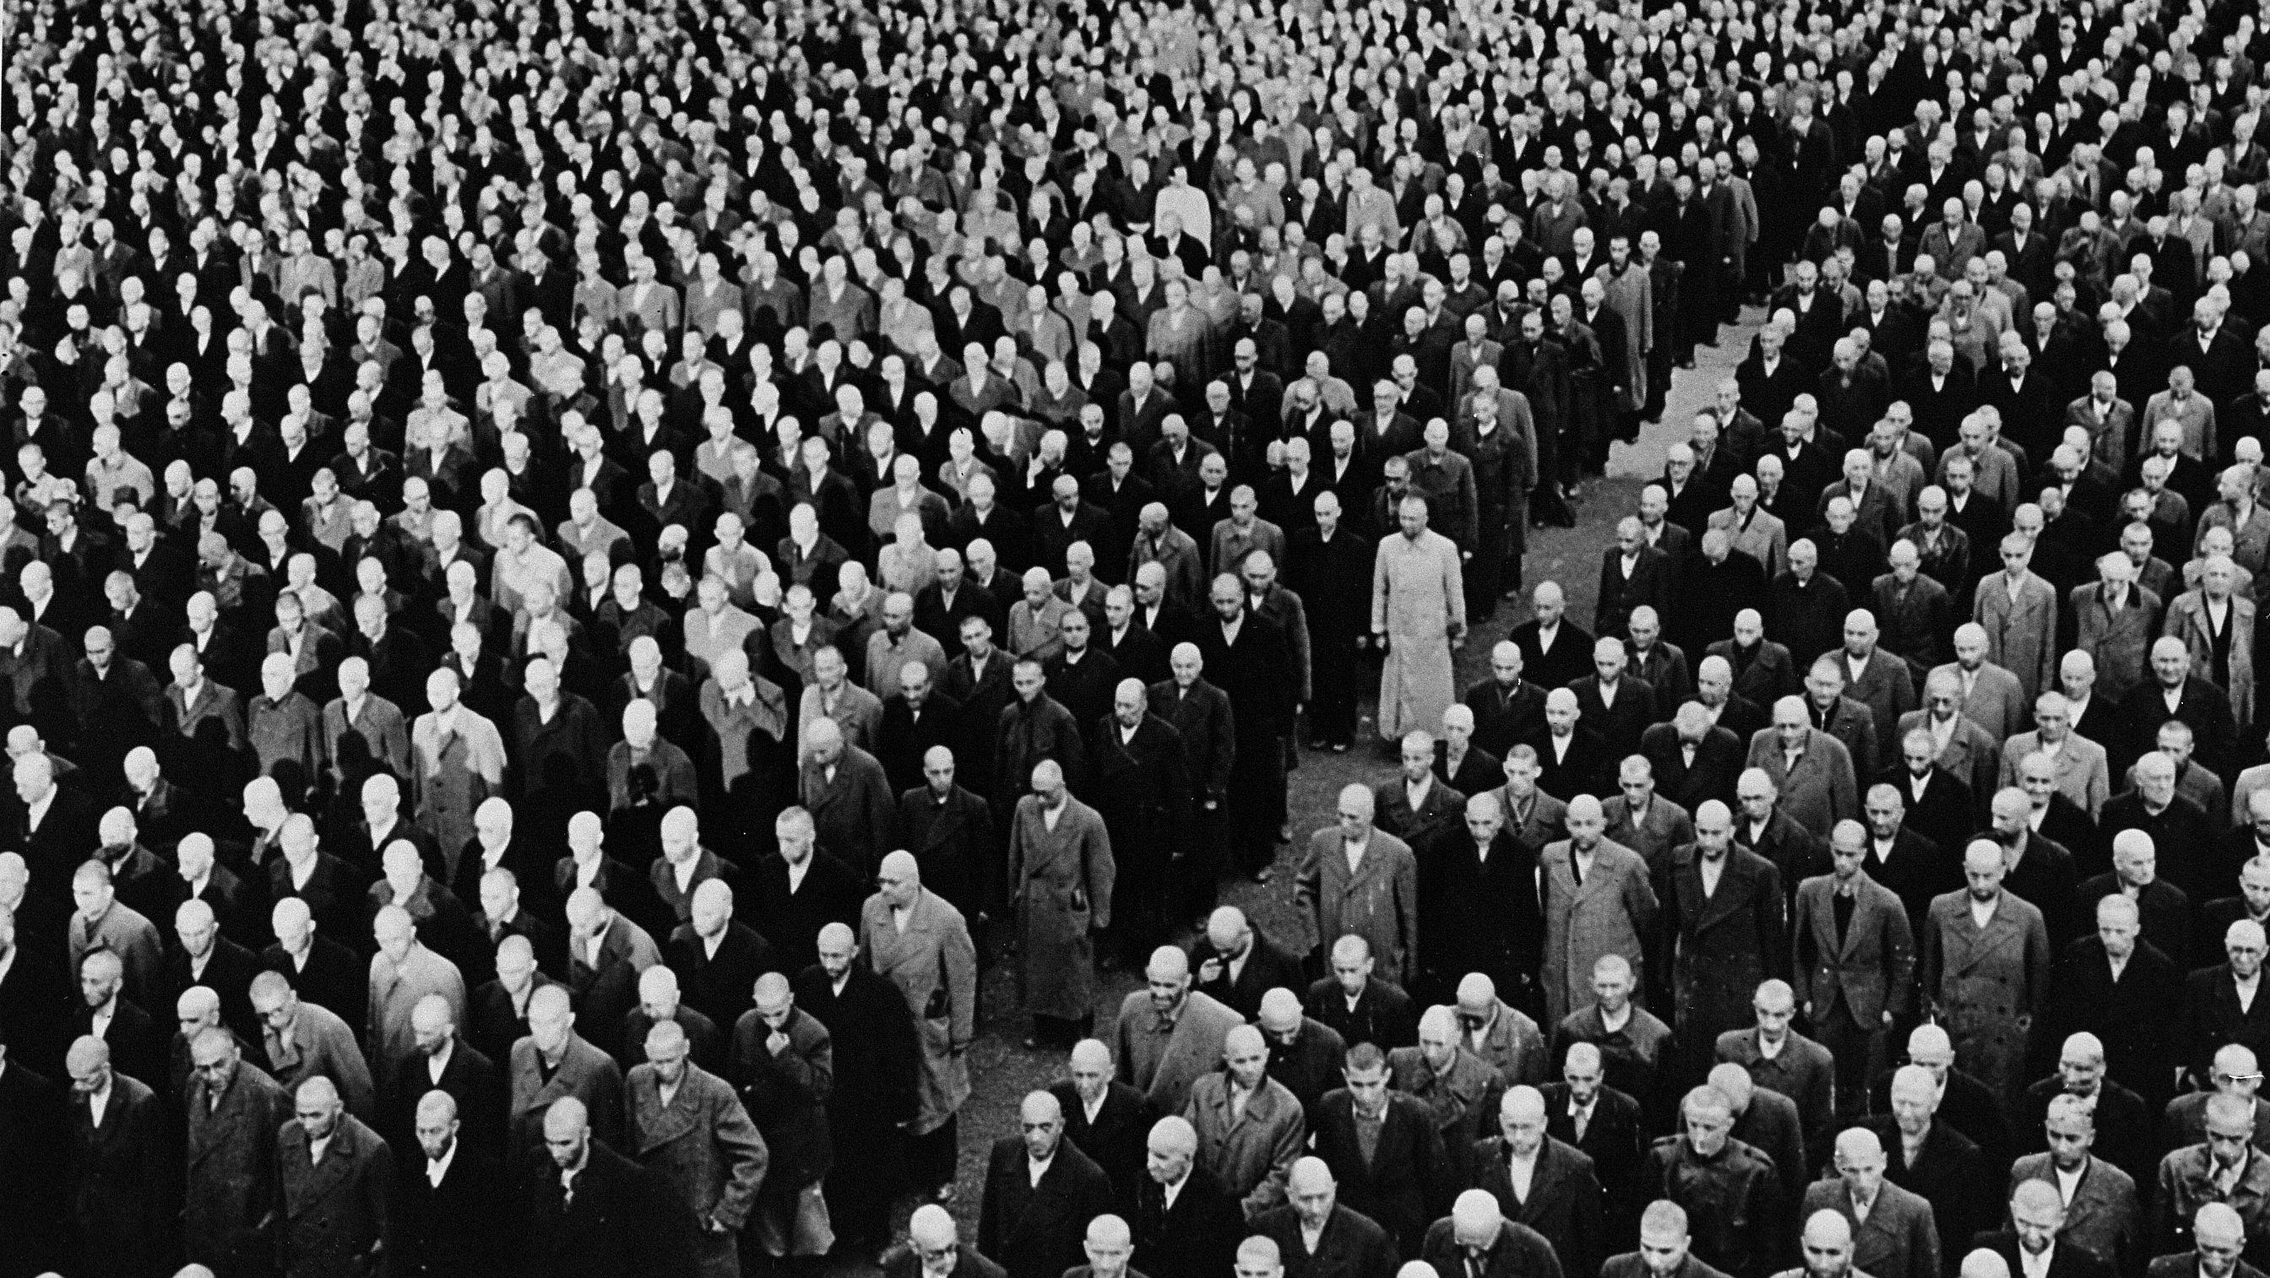
Jewish men and teenage boys arrested after Kristallnacht.

Slide 27
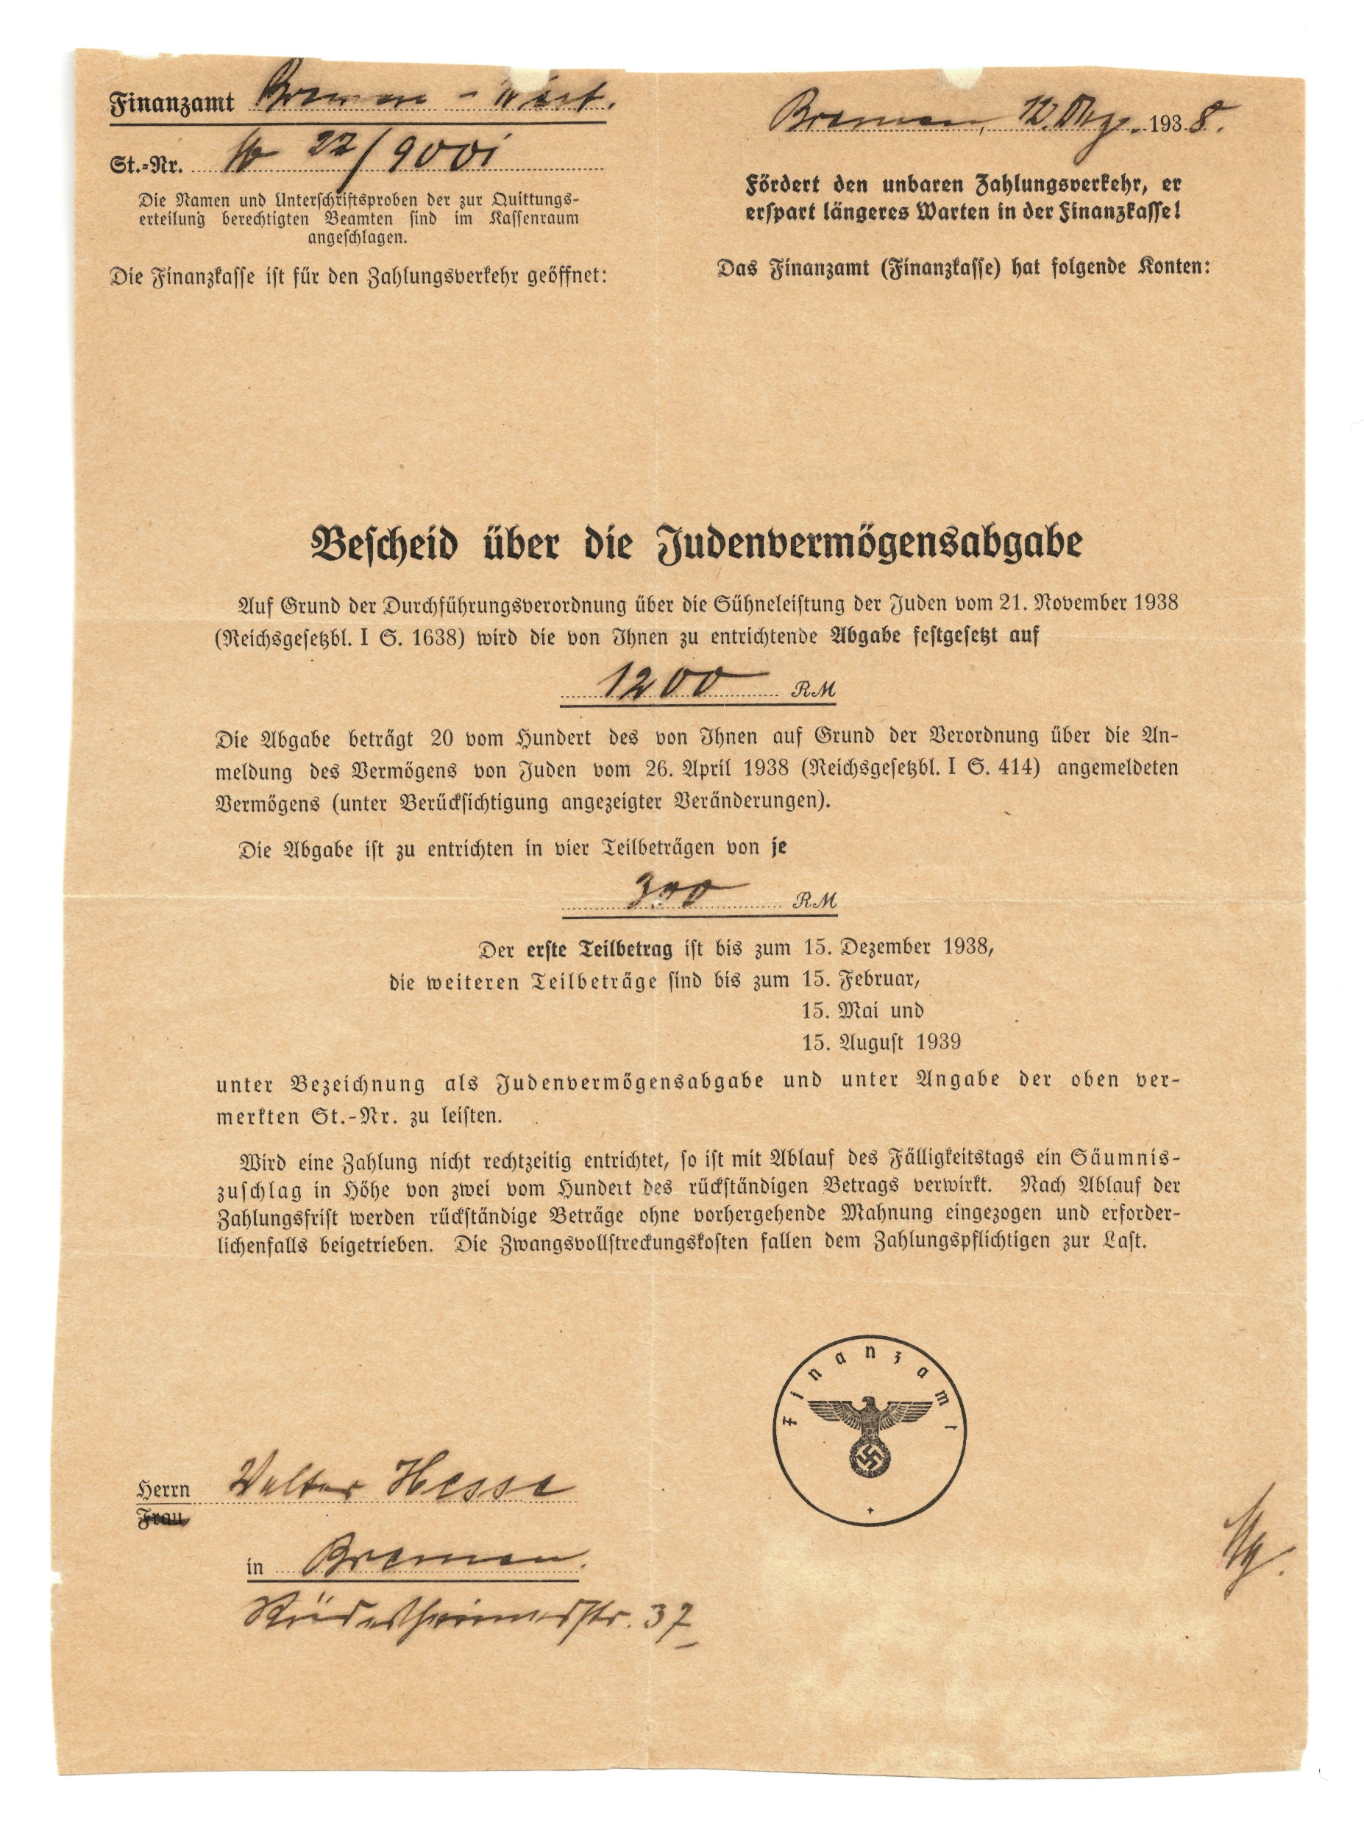
Tax assessment levied on Jews issued to Walter Hesse by the Nazi party after Kristallnacht to pay for damage done by the Nazis.

Slide 28
Questions for Discussion:

Slide 29
Photo Credits:

