Slide 1


Chim: From Destruction to Resurrection
September 22, 2022 – February 4, 2024

Slide 2
All handouts for today’s training are available at
www.ilholocaustmuseum.org/docent-information
Password: Docent96*03

Slide 3
Exhibit is broken into 4 parts
Spanish Civil War
We Went Back
UNESCO photos
  Post – War Euro Politics
Israel/Suez

Slide 4
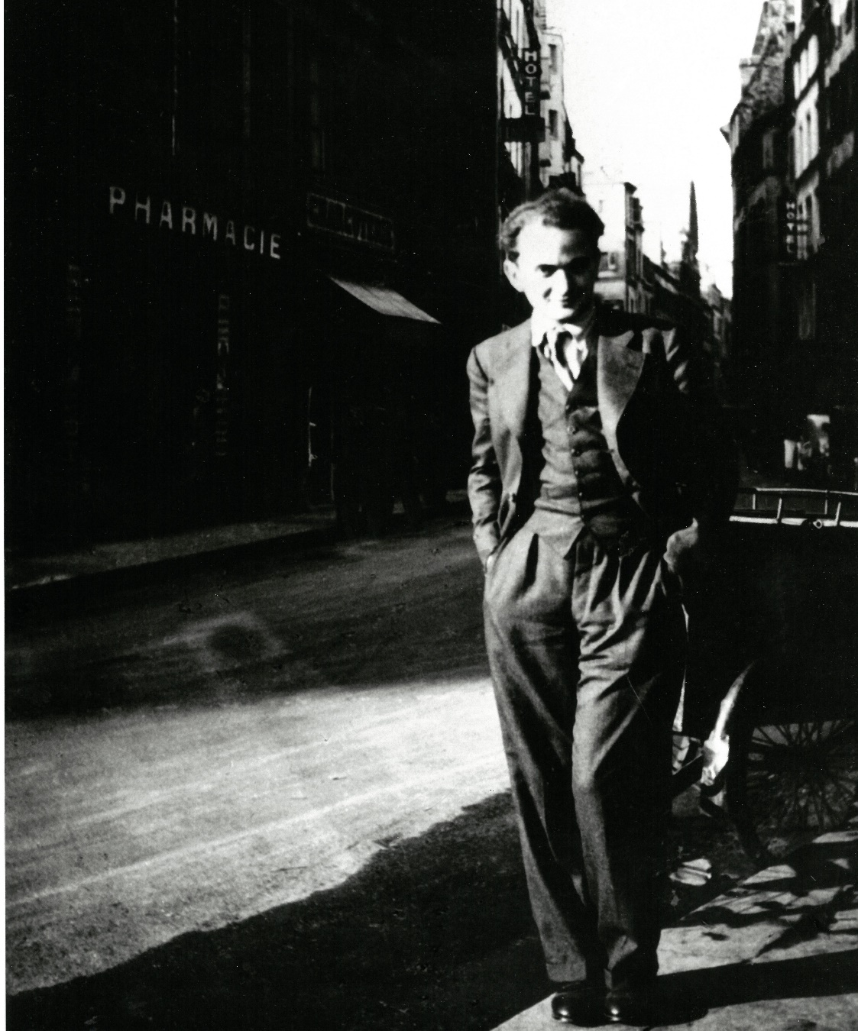
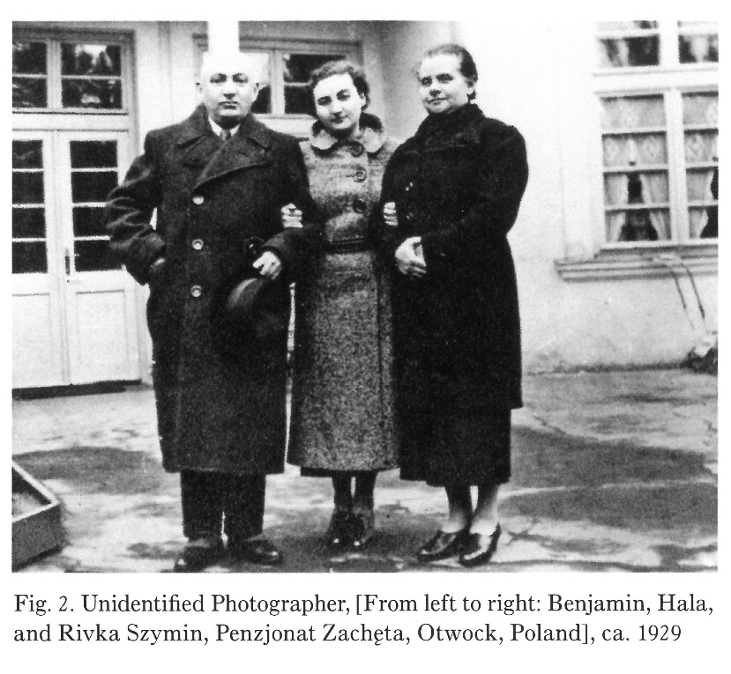
Dawid Szymin
Born in Warsaw Poland, November 20, 1911
Parents: Benjamin and Regina (Rivka)
Sister: Hala
Chim, 1934. Unidentified photographer

Slide 5
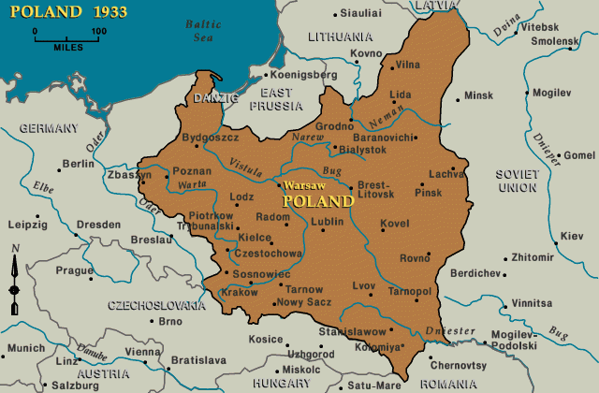
Around 1914, moved from Warsaw to Minsk because of German invasion of Poland. (WWI)

Slide 6
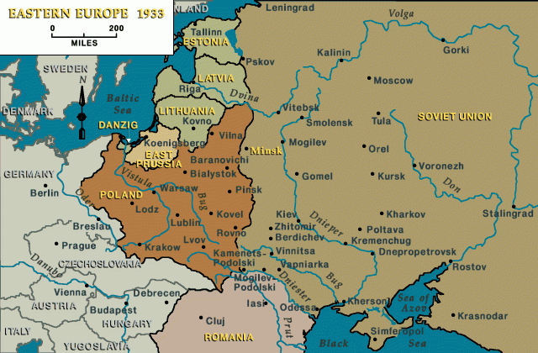
Political unrest: 1916, they moved from Minsk to Odessa.

Slide 7
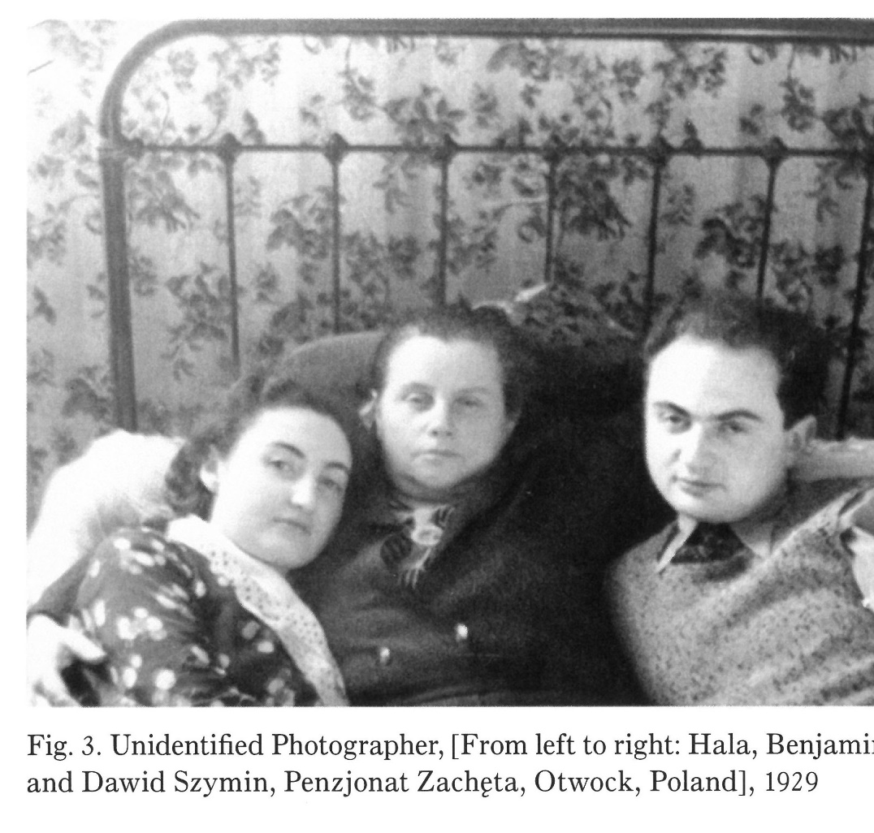
In October of 1929 to February 1931 – Dawid moved by himself to Leipzig Germany to attend the Akademie für Graphische Künst und Buchgewarbe (Academy for Graphic and Book Arts)
Here Dawid developed an interest in photography.
Portable cameras such as the Leica, and the rise of magazines like AIZ (Arbeither Illustrierte Zeitung) allowed photojournalists to construct stories with a new speed and immediacy.

Slide 8
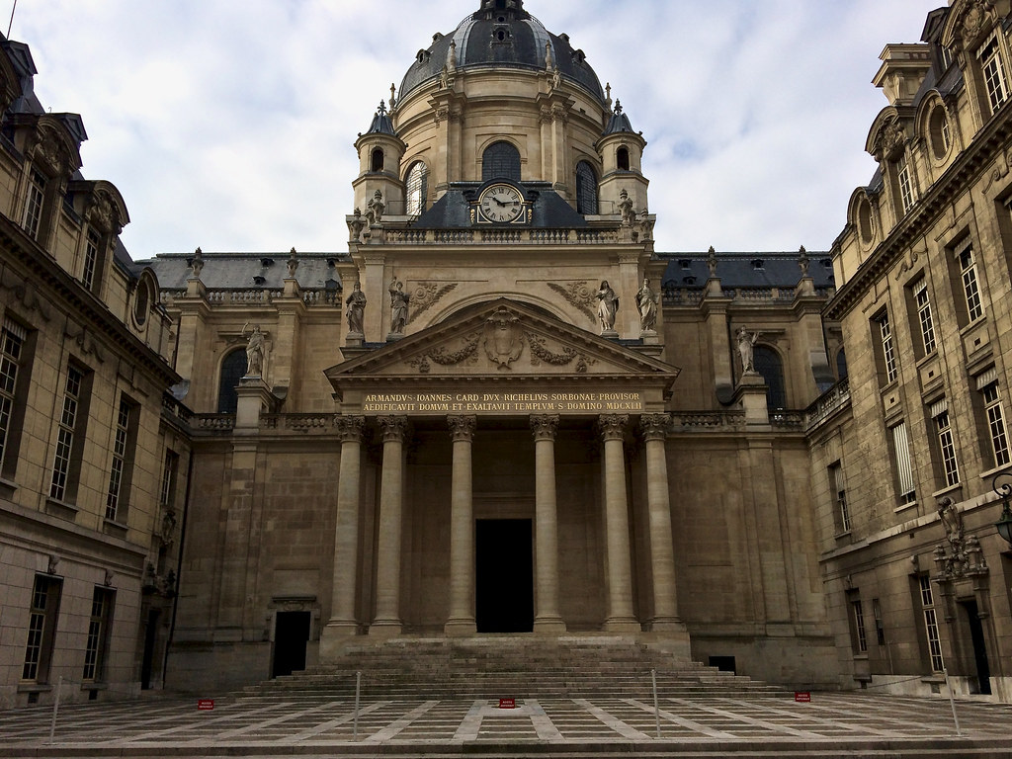
Spring of 1932: Enrolled at the Sorbonne in Paris, France.
Parents provided an allowance.
Registered to get a B.A. in Science, with a major in advanced chemistry and physics.

Slide 9
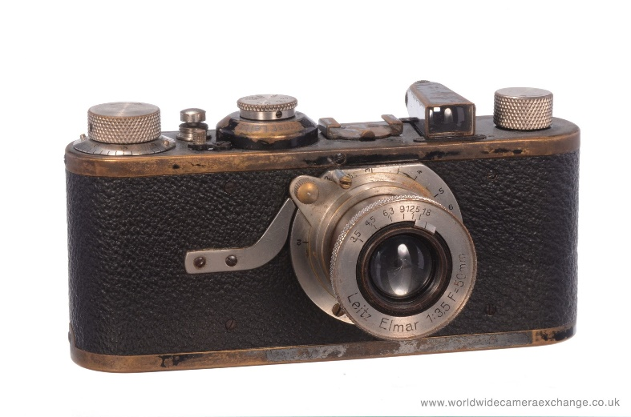
Soon after, his parents were no longer able to support him. He borrowed a 35 mm Vidom Camera, and begins to take photographs of every day life.
He sold his photographs to support himself.
New Life = New Name
Dawid Szymin becomes “Chim”
Used for his byline, shorter, easier to pronounce – evoked his former name –
But erased his Jewishness.
Chim becomes actively involved with AEAR (Association des Éricvains et Artistes Révolvutionaires). Career launch in 1934 with weekly magazine Regards

Slide 10
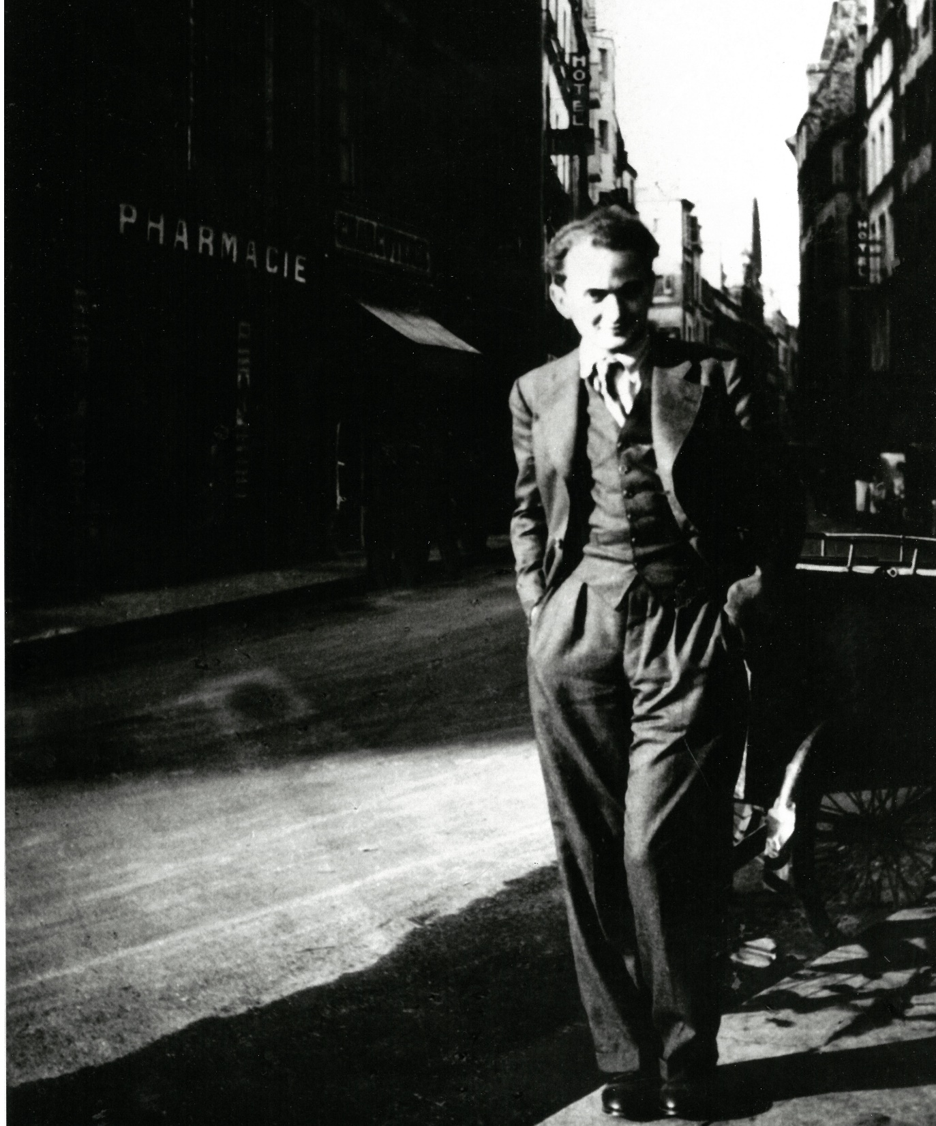
By 1934 was known as Chim, and living in Paris.

Slide 11
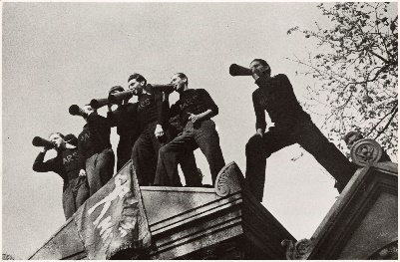

Slide 12
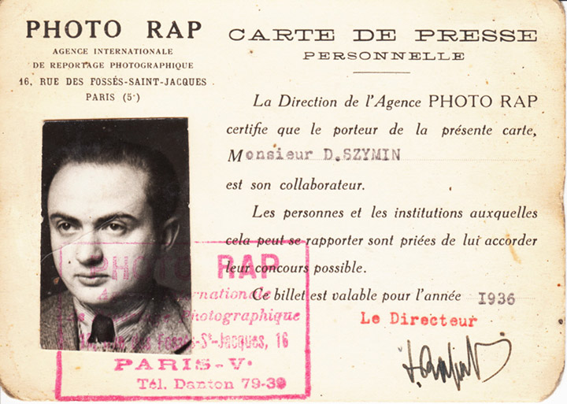
By 1936, Chim was working as a photojournalist – and covered the Spanish Civil War for Regards, Life, and Illustrated

Slide 13
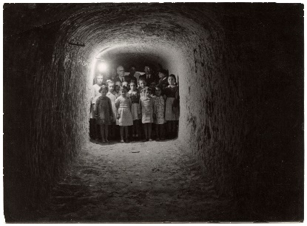

Slide 14
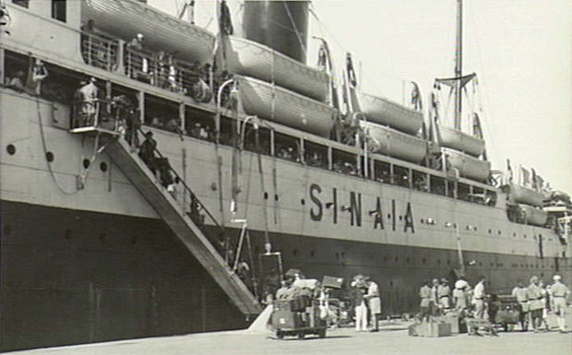
In 1939, he became one of the 1,600 Republican refugees on the S.S. Sinaia. Chim travelled to Laredo, TX and on to New York City.

Slide 15
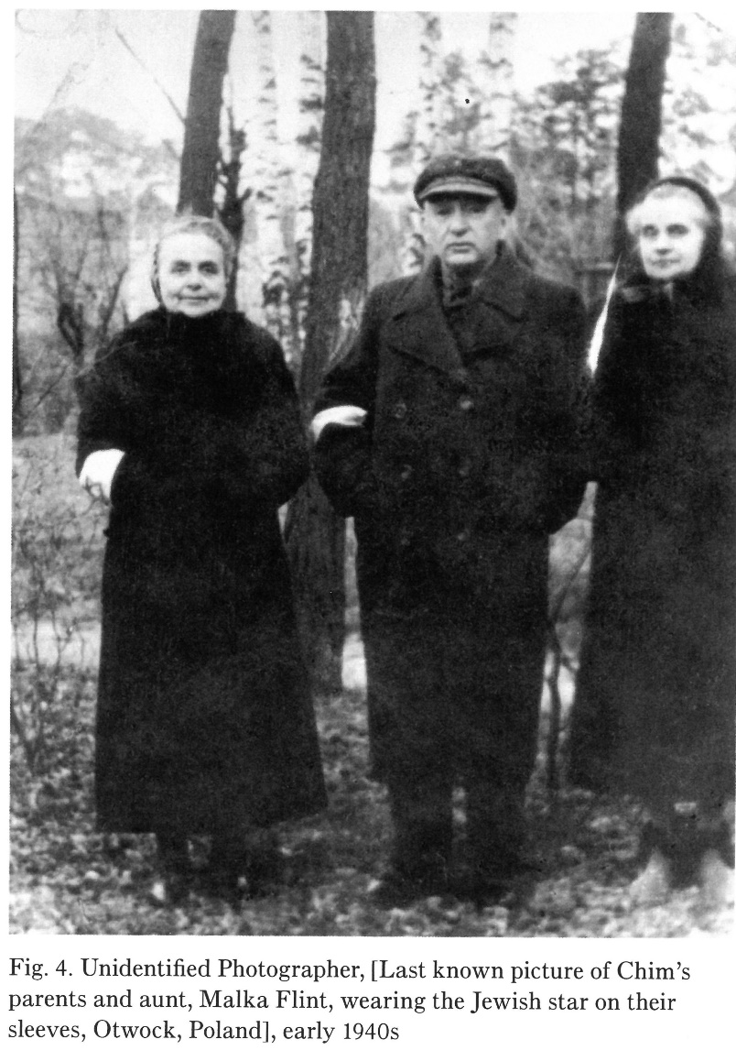
Tragedy strikes. By the early 1940’s, both of Chim’s parents are murdered in the Holocaust.
Around this time, he secures employment with Leo Cohn at Leco Service, a developing and photo retouching photo lab.

Slide 16
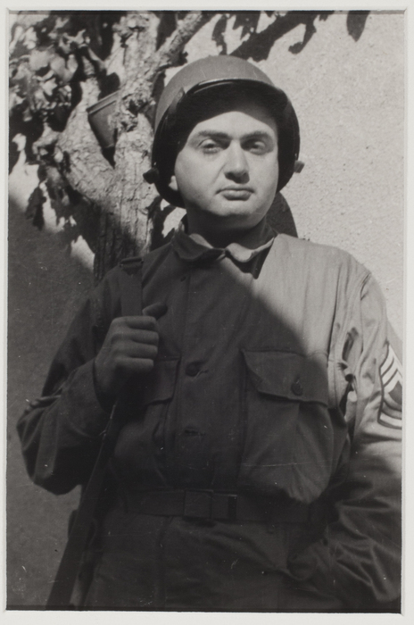
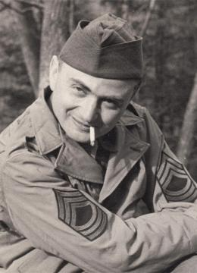
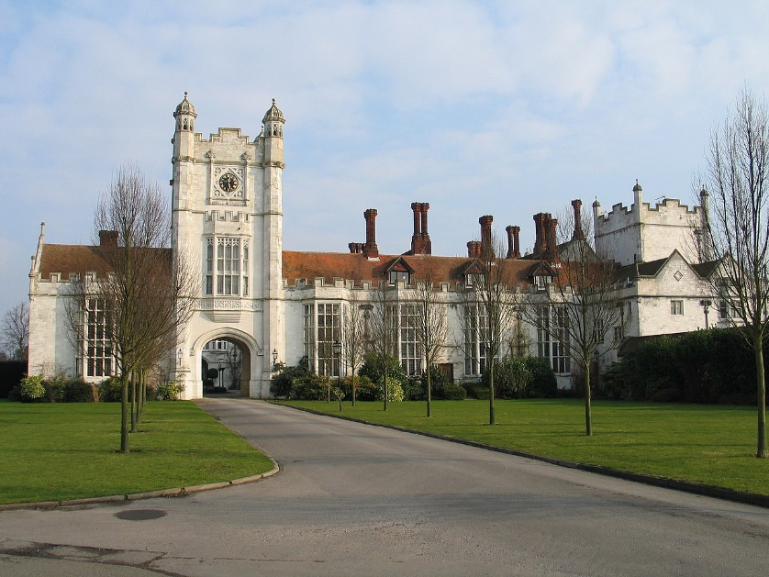
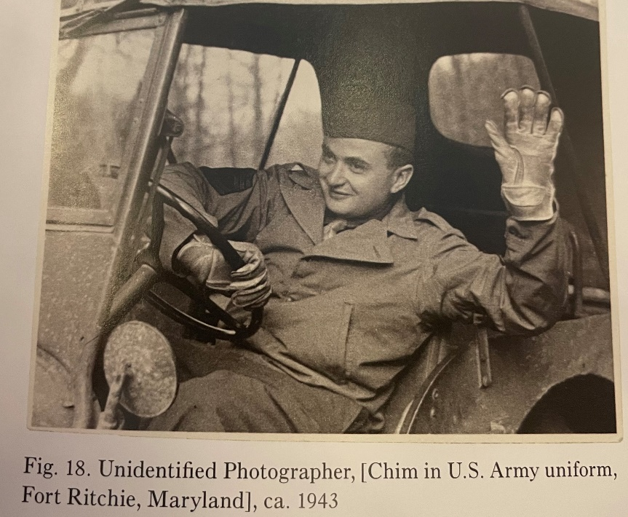
Chim, now settled in NY, joins the US Army in 1942. In May of 1943, he officially becomes “David Robert Seymour”, and is an American citizen. He is sent to Camp Ritchie in Maryland, and acts as a photography instructor.
In May of 1944, he receives his new appointment as photography interpreter at the Allied Central Interpretation Unit (ACIU) in Danesfield House, 35 miles from London.

Slide 17
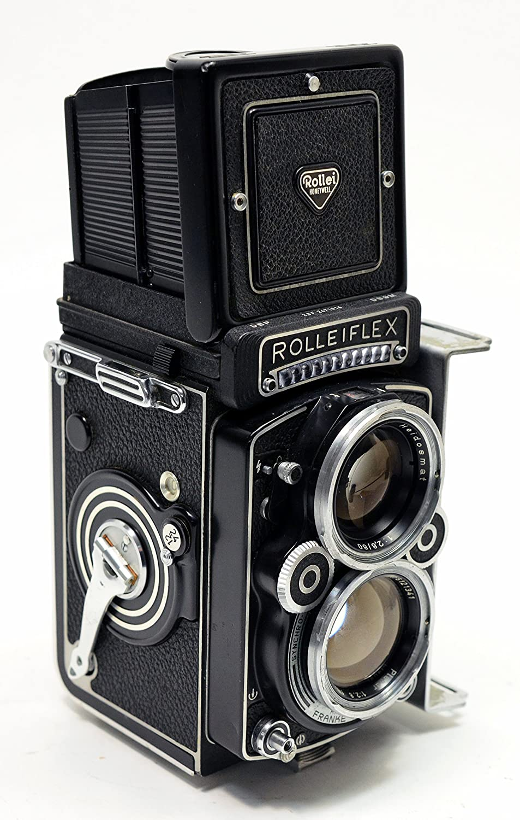
In 1947 he returns to NYC, but is again sent on assignment – back to Europe on April 25th. He is to photograph the places of the US Amy’s progress during the last months of the war.
With his borrowed Rolleiflex, he sets off to work.
In March of 1948 he embarked on a special assignment for UNESCO, documenting the conditions of children living in a post WW II Europe. He snapped 257 rolls of film.
1949 - 1955 Chim travelled extensively throughout Europe and Israel. In May of 1955 Chim finally settles down and signs a lease on a small apartment in Rome.

Slide 18
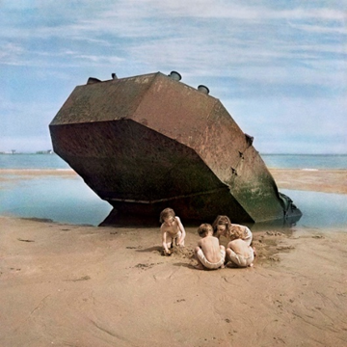

Slide 19
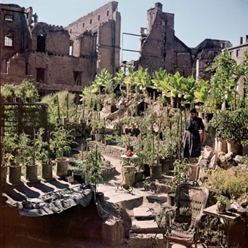

Slide 20
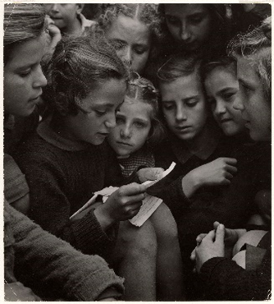

Slide 21
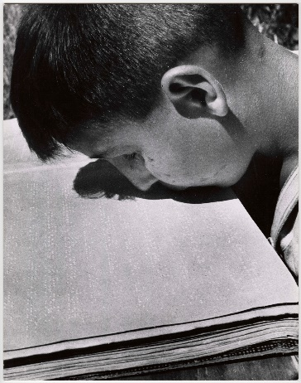

Slide 22
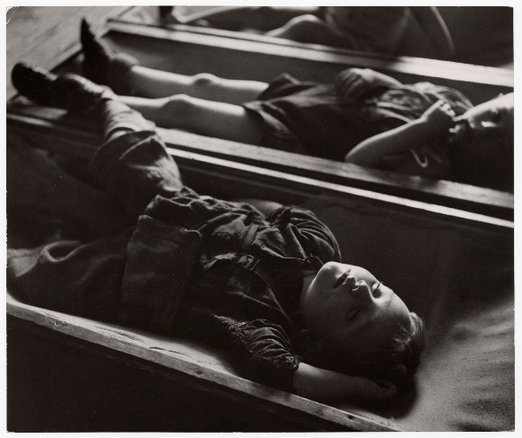

Slide 23
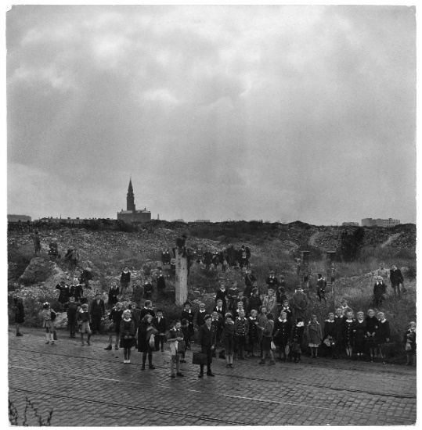

Slide 24
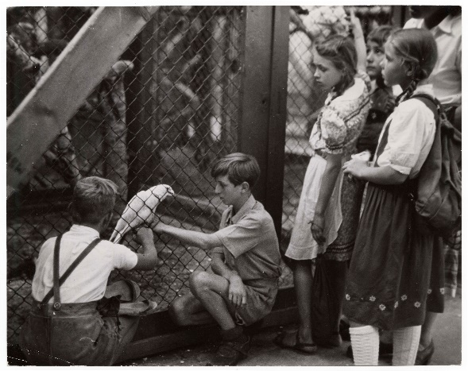
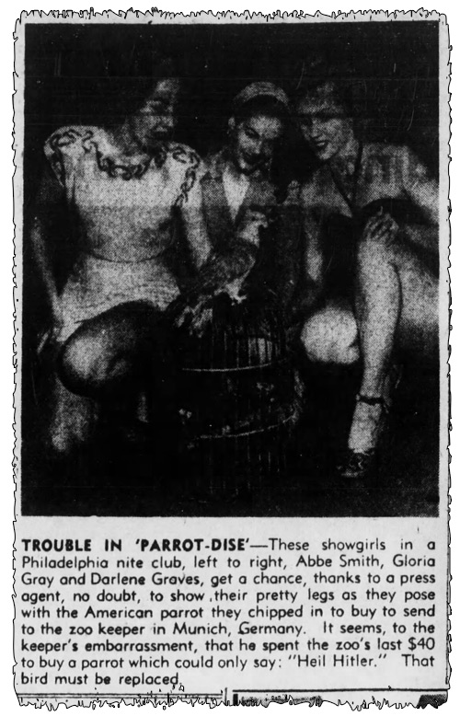
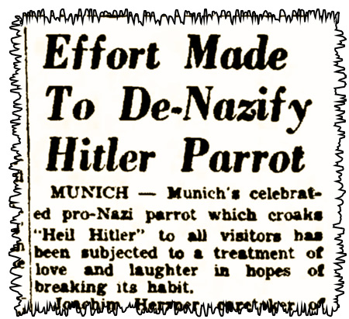
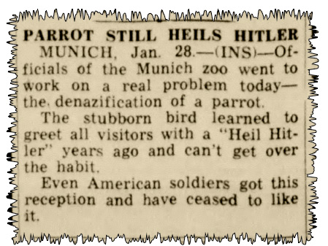
LAURA!
Brooklyn Daily Eagle - Feb 7, 1949
New Castle News - Jan 28, 1949
Brownsville Herald - Feb 20, 1949

Slide 25
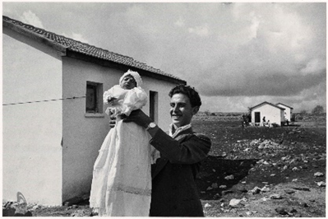

Slide 26
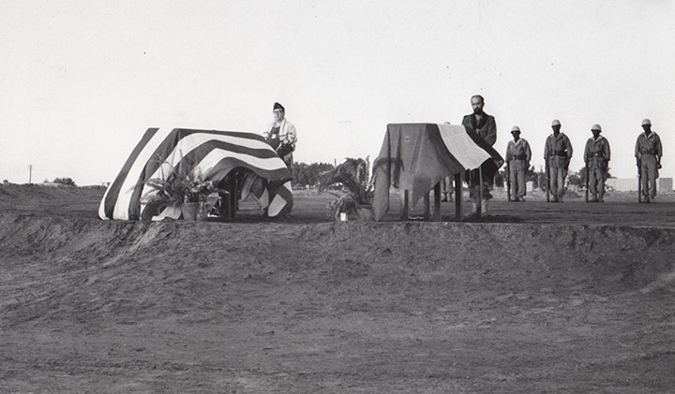
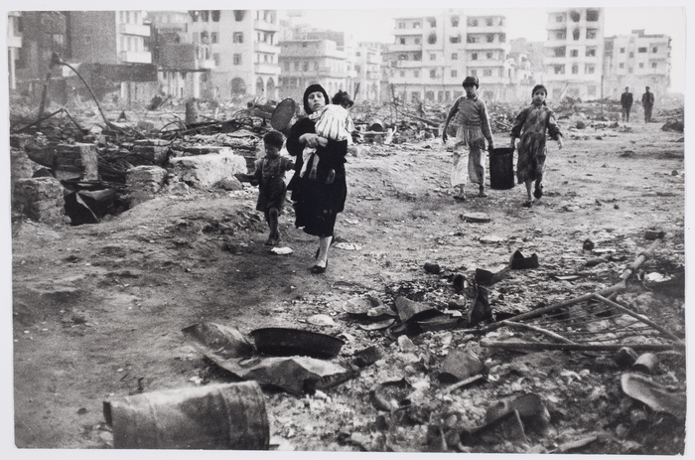
The Suez Crisis – 1956
While Chim had not been a war correspondent since 1939, he could not pass up the opportunity to cover the conflict.
On November 10, 1956, Chim was killed while driving to photograph an exchange of wounded soldiers at El Quantara (along with French photographer Jean Roy) by Egyptian machinegun fire four days after the armistice of the 1956 Suez Crisis, ten days before his 45th birthday.
Chims coffin, Port Fuad Egypt. November 14. 1956, Hanson Baldwin for the NY Times.
Port Said, Chim, 1956

Slide 27
DEMONSTRATION IN MEMORY OF THOSE KILLED DURING THE PARIS COMMUNE, PÈRE LACHAISE CEMETERY, PARIS, FRANCE], MAY 1934
International Center of Photography

Slide 28
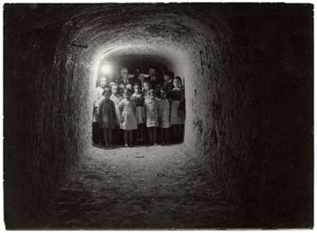
[CHILDREN TAKE REFUGE IN AN UNDERGROUND AIR RAID SHELTER, MINORCA, SPAIN], DECEMBER 1938
International Center of Photography, gift of Eileen and Ben Shneiderman, 1982

Slide 29
[CHILDREN PLAYING AMONG THE WRECKAGE OF D-DAY INVASION, OMAHA BEACH, NORMANDY, FRANCE], 1947
International Center of Photography

Slide 30
[FRAU WANDERER IN HER TOMATO GARDEN AMID RUINS, FRANKFURT, GERMANY], 1947
International Center of Photography

Slide 31
[REFUGEES FROM THE CIVIL WAR READING A LETTER, GREECE], 1948
Collection Ben Shneiderman, courtesy Howard Greenberg Gallery

Slide 32
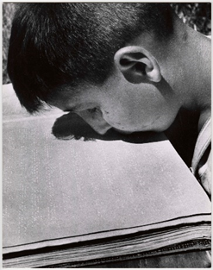
[BOY READING A BRAILLE BOOK WITH HIS LIPS, VILLA SAVOIA, ROME, ITALY], 1948
International Center of Photography

Slide 33
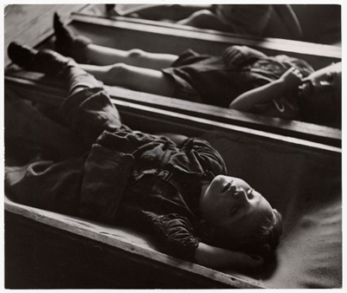
[BOYS TAKING A NAP IN A KINDERGARTEN AT A DP CAMP FOR SUDETENS, VIENNA, AUSTRIA], 1948
Collection Ben Shneiderman, courtesy Howard Greenberg Gallery

Slide 34
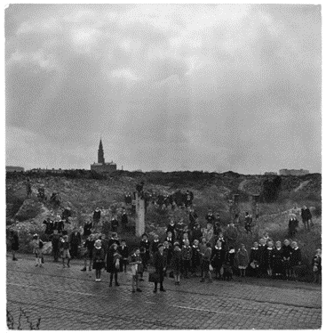
[SCHOOL CHILDREN WAITING FOR A BUS IN THE RUINS OF THE DESTROYED WARSAW GHETTO, POLAND], 1948
International Center of Photography, gift of Eileen and Ben Shneiderman, 1986

Slide 35
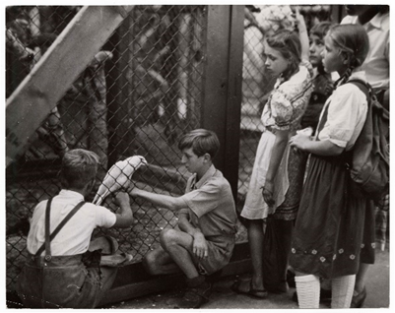
[CHILDREN AT THE MUNICH ZOO WITH ADOLF, THE PARROT THAT SAYS, “HEIL HITLER!”, GERMANY], 1949

Slide 36
[ELIEZER TRITO HOLDING HIS DAUGHTER, MIRIAM TRITO, THE FIRST BABY BORN IN THE SETTLEMENT OF ALMA, ISRAEL], 1951
International Center of Photography, gift of Ben Shneiderman, 1997

Slide 37
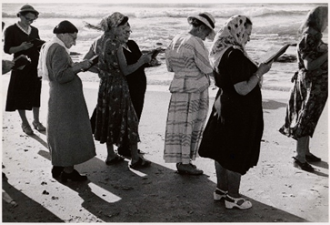
[WOMEN PERFORMING TASH’LICH, THE NEW YEAR RITUAL OF THROWING BREAD INTO WATER TO SYMBOLICALLY CAST OFF SINS, ON THE FIRST DAY OF ROSH HASHANAH, TEL AVIV, ISRAEL], SEPTEMBER 1954
Collection Ben Shneiderman, courtesy Howard Greenberg Gallery

Slide 38

Questions?
Amanda.Friedeman@ilhmec.org
Matthew.Sackel@ilhmec.org

